Slide 1
Simulation of silver evaporation for a Knudsen Effusion
experiment under zero gravity
25.09.2019 | D. Henriquesª, M. Schulz^{b}, H. Fritze^{b}, T. Markusª
COMSOL Conference, Cambridge
ªMannheim University of Applied Sciences / Germany
^{b}Clausthal University of Technology / Germany

Slide 2
Content
Introduction
Method Knudsen Effusion
Results: Simulation
Results: Simulation vs. Experiment
Summary and Outlook

Slide 3




Introduction: Project Partners
High Precision Determination of Thermodynamic Data by Knudsen Effusion at Zero Gravity
- preliminary studies for experiments at the International Space Station (ISS) -
  TU Clausthal – Energieforschungszentrum Niedersachsen
  Hochschule Mannheim – Institut für Angewandte Thermo- und Fluiddynamik
  DLR– Institut für Materialphysik im Weltraum
  Airbus Defence & Space
Determination of Gibbs-Energies (∆G) at Zero Gravity
  Relevant for new metals and alloys for new technologies
  Thermodynamic data
  Evaporation rate
  Electromagnetic Levitator Melting Furnace (EML) / Tempus System
http://www.dlr-innospace.de/startseite/gefoerderte-projekte/knudsen-eml/

Slide 4
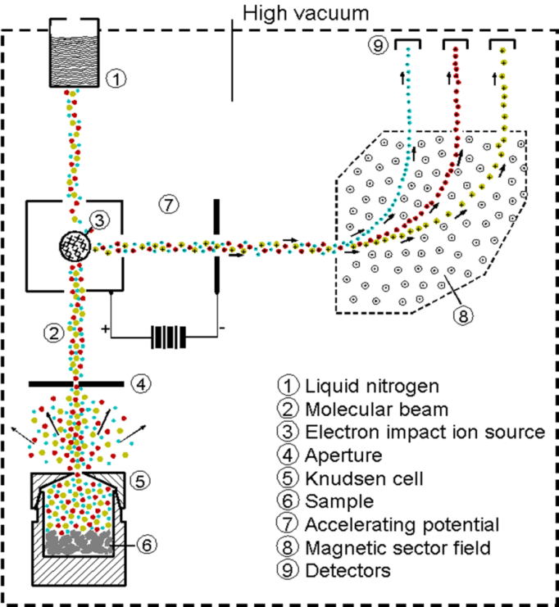
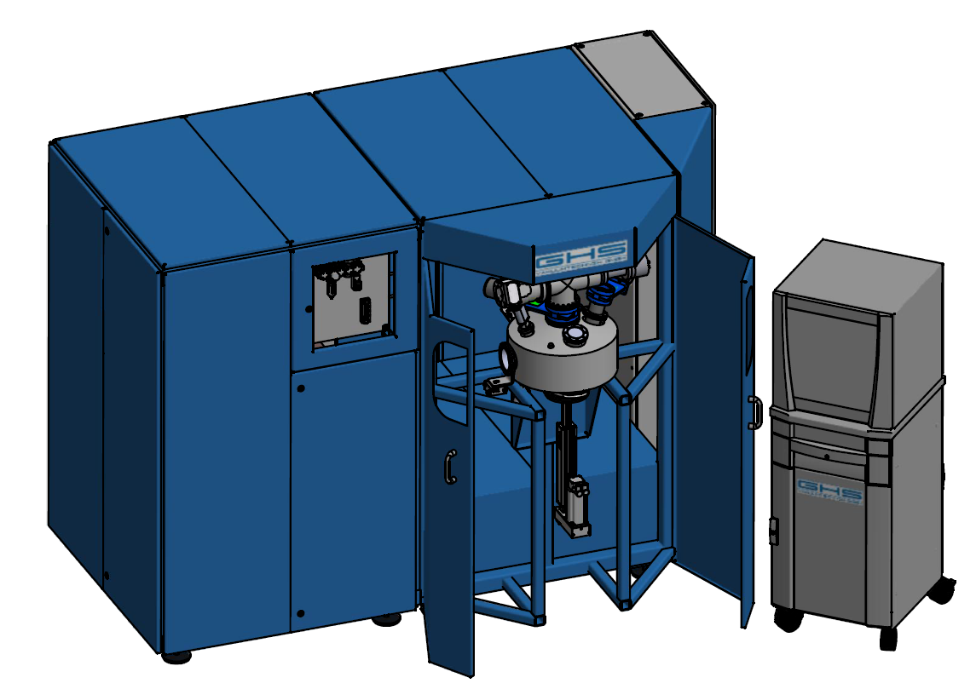
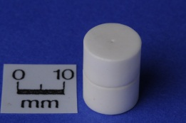


Introduction: Knudsen Effusion Method
Partial pressure:
$$p_{i}=k\frac{1}{σ_{i}}I_{i^{+}}T$$
i gas species
k pressure calibration constant
σ_{i} ionization cross section of species i
I_{i}⁺ ion intensity of the ion i+ originating from neutral species i
T temperature
Thermodynamic activity:
$$a_{i}=\frac{p_{i}}{{p°}_{i}}=\frac{I_{i_{}^{+}}}{{I°}_{i^{+}}}$$
P_{i} partial pressure of species I over the mixture (i=Li,Sn)
p°_{i} partial pressure of pure species I (I=Li,Sn) over the pure components
→ Thermodynamic Data:
Thermodynamic activity
Chemical potential
∆_{mix}H, ∆_{mix}G, ∆ _{mix}S

Slide 5
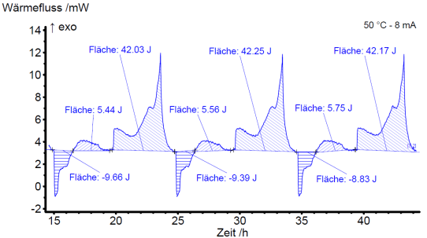
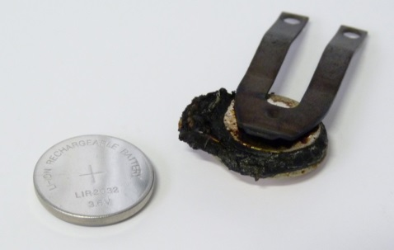
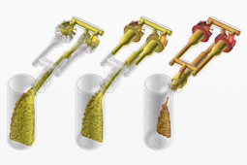
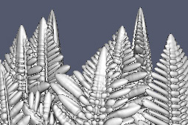
Use Cases
  Lithium-Ion Batteries
  Cell capacity, cell voltage
  Thermal & chemical stability
  Thermal behavior during cycling
  Metallurgy
  Vapor pressures
  Thermodynamic activities
  Enthalpies and entropies of formation
  Chemical Industry
  Determination of chemical reactions and processes
  Identification of gaseous species and their vapor pressures
  REACH: 10⁻⁸ Pa – 100 Pa
http://www.access.rwth-aachen.de/node/801
→ For Computer Simulations Materials Properties of High Quality are needed

Slide 6
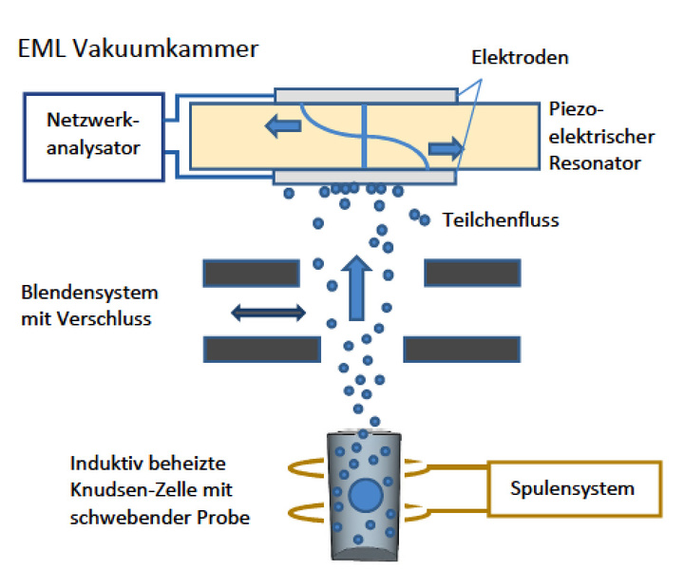
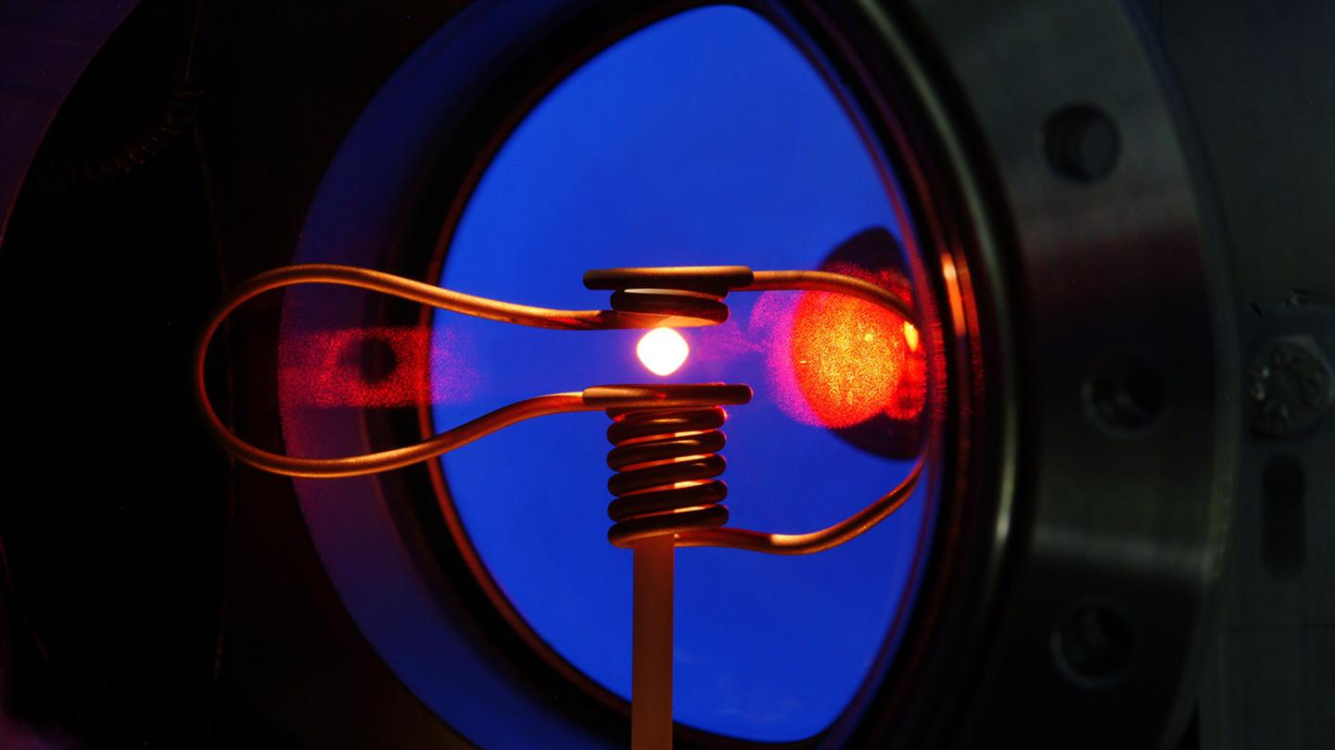
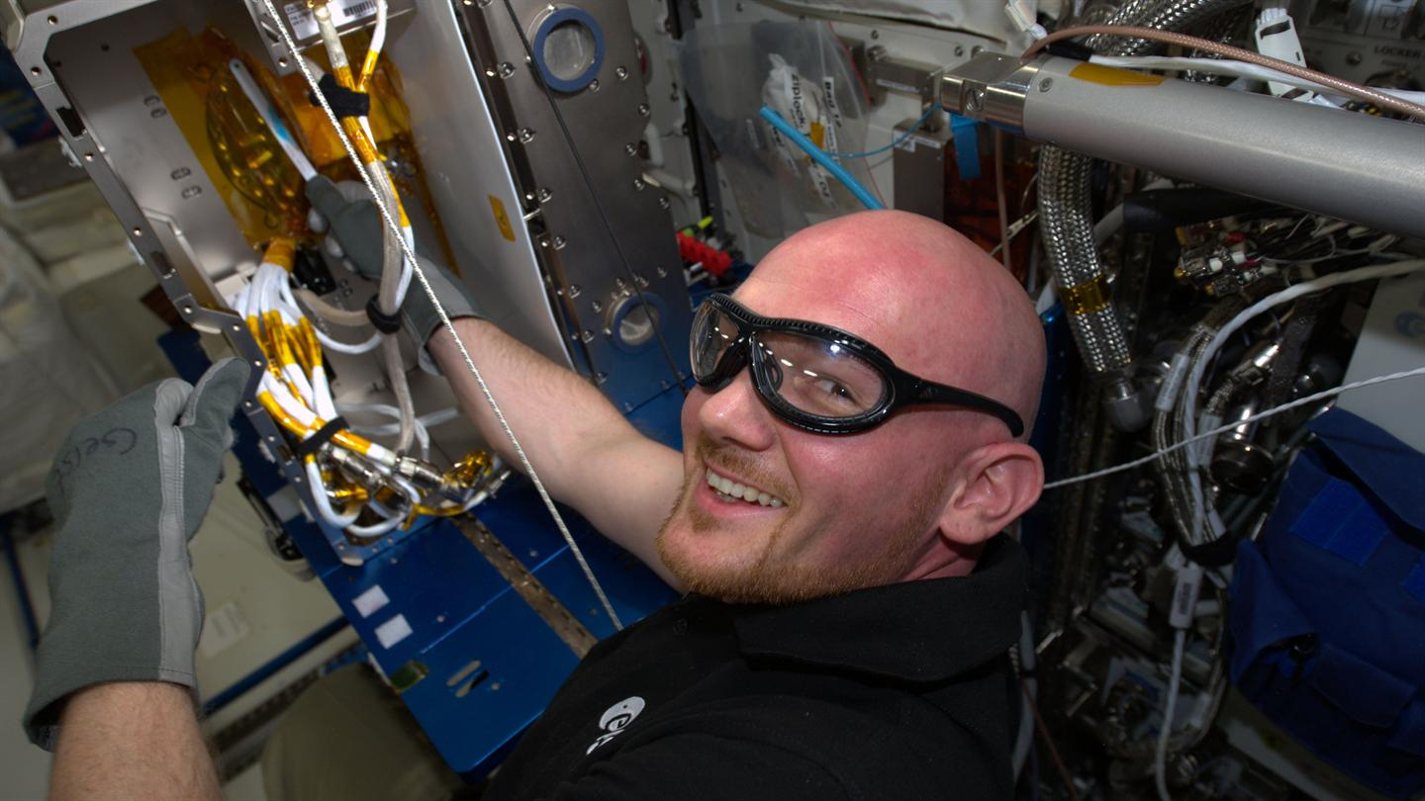
Introduction: Project Idea
Thermodynamic data:
without influence of gravity driven effects such as convection, sedimentation and natural draft
Free vaporization
No reaction with crucibles
Alexander Gerst (2014)
(German Astronaut at the ISS, Mission Blue Dot)
http://www.dlr-innospace.de/startseite/gefoerderte-projekte/knudsen-eml/

Slide 7
Introduction
Integration of the Nano-Balance in the Tempus Facility (Earth and Parabolic flights)
Tempus System is similar to the EML System at the ISS
Developing new Knudsen Cell
  Project Aim:
  Showing feasibility to perform Knudsen experiments at the International Space Station (ISS)
  Modelling the evaporation out of a Knudsen Cell (HS Mannheim)

Slide 8

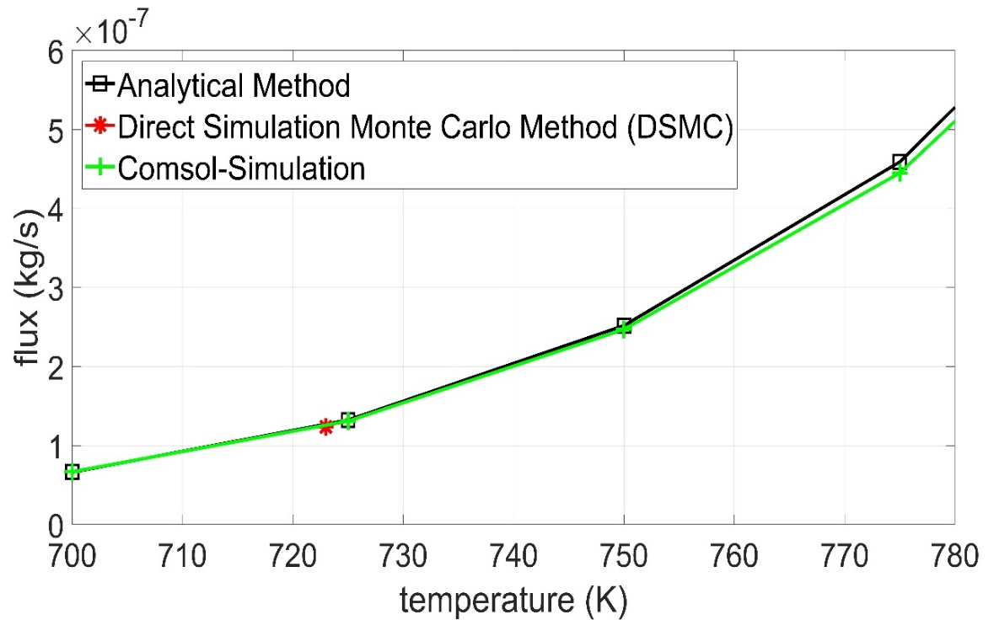
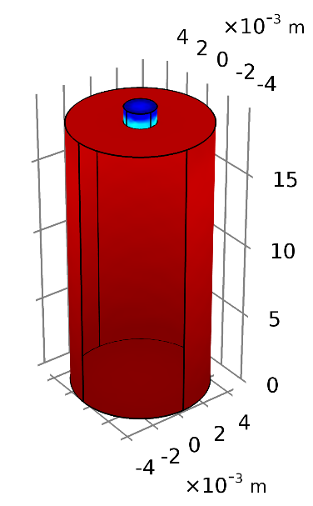
Simulation of a “normal Knudsen Cell” (Zinc)
Modelling Strategy
3 different Methods were applied to simulate Knudsen Effusion (sample: Zinc)
  Analytical Method: based on Hertz-Knudsen-Langmuir equation
  Direct Simulation Monte Carlo Method: Hard Coded in MATLAB
  COMSOL Multiphysics (Version 5.3a)
Knudsen Cell orifice:
Radius = 1mm
Length = 1mm
Geometry Knudsen Cell:
Height = 18.5 mm
Radius = 4.5 mm
Results:
All results in very good agreement → Deviation smaller than 2% (723K: 45 Pa)
723 K : 1.247x10⁻⁷ kg/s (COMSOL) → further Modelling with COMSOL

Slide 9
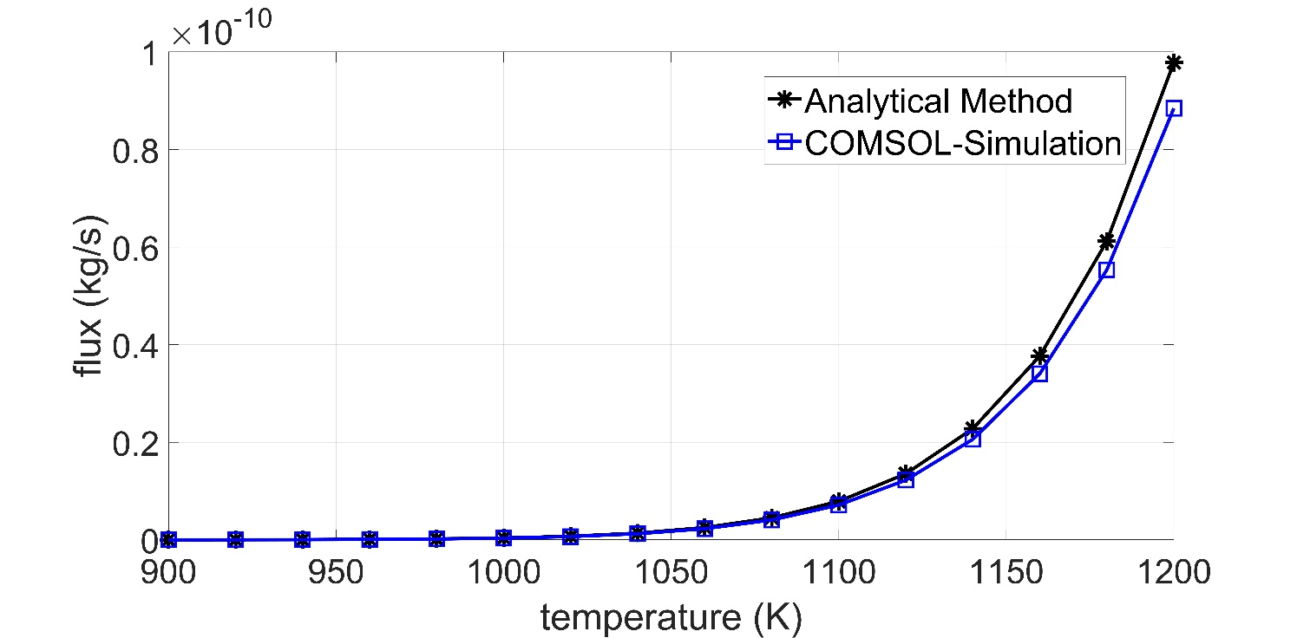
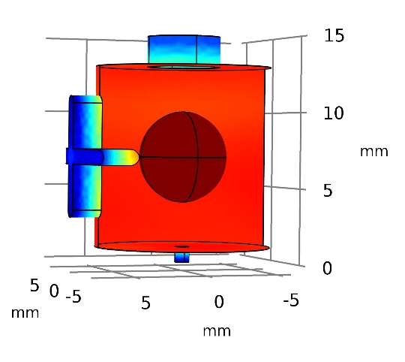
Simulation of a “new designed Knudsen Cell” (Silver)
Simulation of a “new designed Knudsen Cell”
3 different aperture:
  #1 aperture for temperature measurement
  #2 aperture for sample positioning (silver sample: radius=3 mm)
  #3 Knudsen Cell Orifice: (Molecular Beam to the Nano-balance)
#1
#2
#3 Knudsen Cell orifice:
Radius = 0.5 mm
Length = 1mm
Comparison between simulated flux with COMSOL out of the Knudsen cell orifice and calculated analytical values of a „normal Knudsen Cell“ with the same geometrical orifice → Deviation smaller than 10%

Slide 10
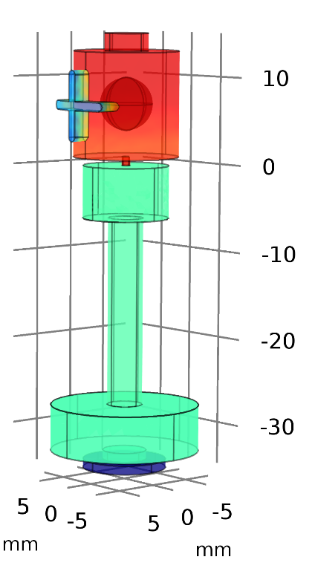
Flux Simulation “Knudsen Cell to the Nanobalance”
Simulation of the flux from the Knudsen Cell to the Nanobalance
  #1 Silver Sample: 920, 924 and 975 °C (radius=3mm)
  #2 Knudsen-Cell: 800, 800 and 850 °C (inner surface temperature)
  #3 : 20 °C (inner surface temperature)
  #4 Simulated Flux on the Nanobalance
#1
#2
#3
#4

Slide 11
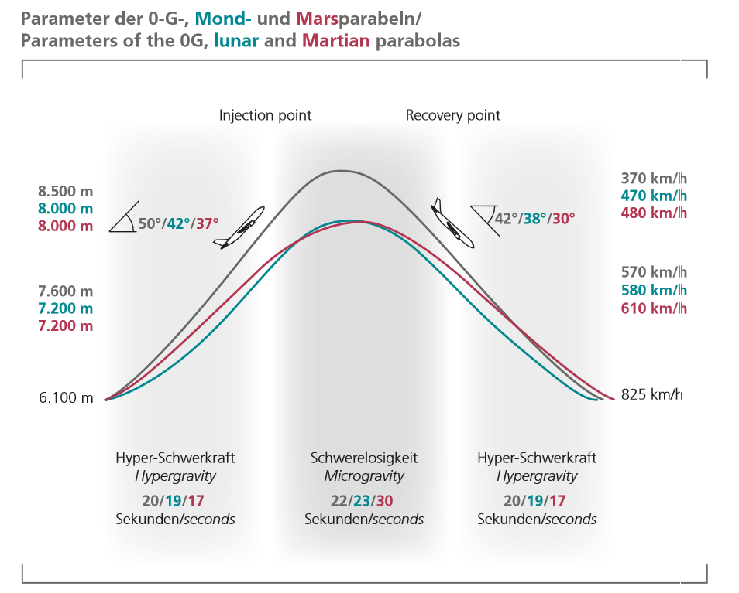
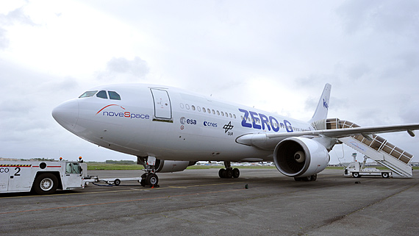
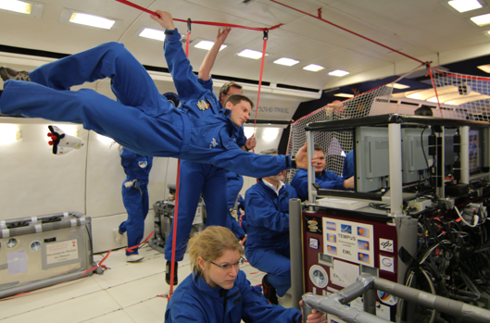
Parabolic Flights
http://www.dlr.de/rd/Portaldata/28/Resources/dokumente/publikationen/Broschuere_Parabelflug_hires.pdf

Slide 12
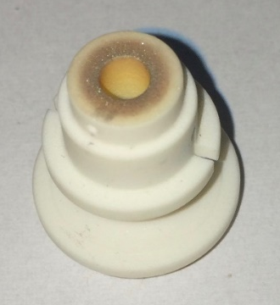
Flux Simulation “Knudsen Cell to the Nanobalance”
Temperature | Simulation Flux (“Knudsen Cell to the Nanobalance”) | Measured Flux in ng/s (“Measured Flux on the Parabolic Flight”) | n-fold of Parabolic Flight Flux
920 °C (1193 K) | 11.56 | 1.51 | 7.65 | solid
924 °C (1197 K) | 12.68 | 1.57 | 8.08 | solid
975 °C (1248 K) | 34.91 | 6.46 | 5.40 | liquid
Simulated Flux: 5 – 8 n-fold of Parabolic Flight
But:
No Consideration of Vacuum Pressure of the sample chamber
Temperature Gradients unknown (time dependent)
No Consideration of Wall-Condensations-Effects of Gas species
Condensation of Silver on the sample holder after Parabolic Flights
(Dr. Michal Schulz, TU Clausthal)

Slide 13
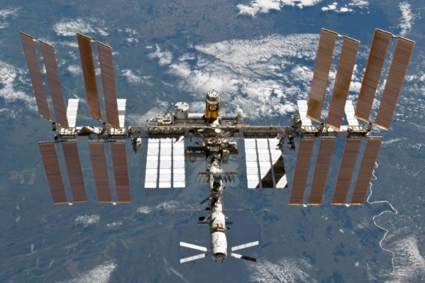
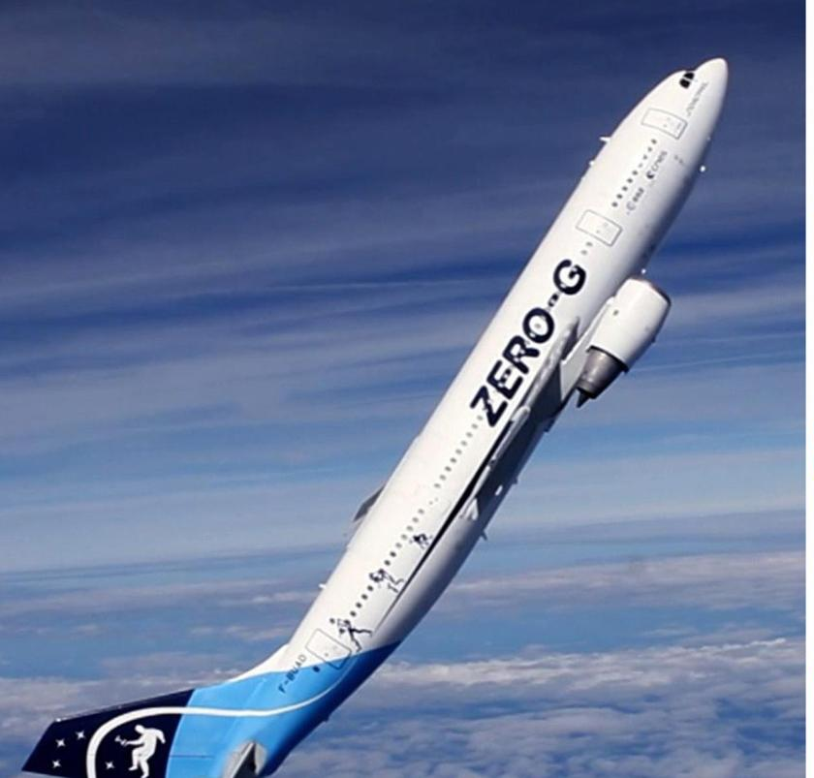
Conclusion & Outlook
Method of Knudsen Effusion
Results:
Simulation of a “Normal Knudsen Cell” with the Analytical Approach, DSMC and COMSOL Multiphysics are in very good agreement (<2%)
Simulation of the “Nano-Balance System” 5-8 n fold of the Experiment Parabolic flight
Further Work:
More information about conditions at the Experiment are needed (Temperature Gradient, Condensation effects)
Based on this information more Simulation can be performed to generate Knowledge about
free vaporization and the gravity-effect to the
evaporation process

Slide 14

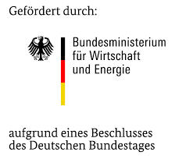

Acknowledgement
    Jens Peter
    Matthäus Wittek
    Gert Thiel
    Maximilian Länge
    Uzair Tahir
    Christoph Huber
    Prof. Torsten Markus
Knudsen EML - Technology demonstrator for measuring
evaporation rates of metals and alloys
- High-precision determination of material constants under zero-g conditions -
- Preparatory work for measurements on the International Space Station (ISS) -

Slide 15
Thank you for your attention !!!

