Slide 1
The Idea 1
Displacement Node 1
2
3
4
5
m2
m1
K1
K2
let’s see how m1 and m2 move with the displacement excitation from node1

Slide 2
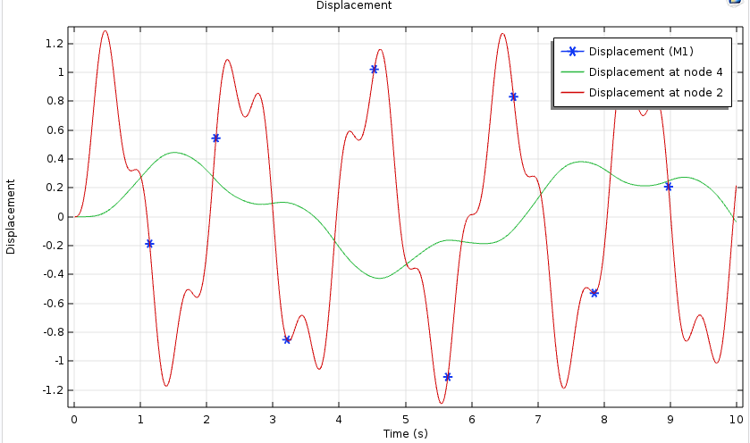
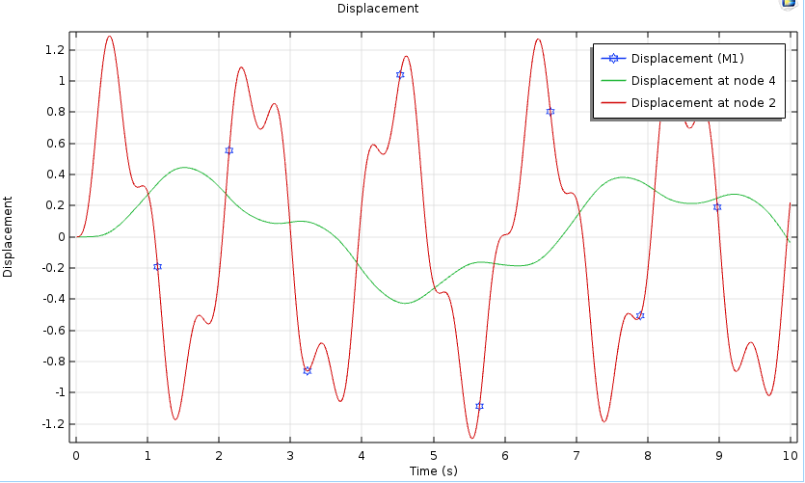
Perfectly Match!
The result from the pure “Lumped Mechanical System”
The result from the “Lumped Mechanical System” and “Multibody Dynamics”

Slide 3
The Idea 2
Displacement Node 1
2
3
4
5
m2
m1
K2
K1
C2
let’s see how m1 and m2 move with the displacement excitation from node1

Slide 4
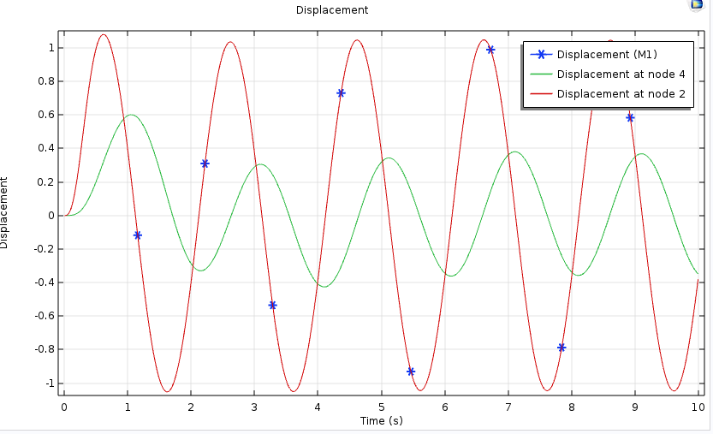
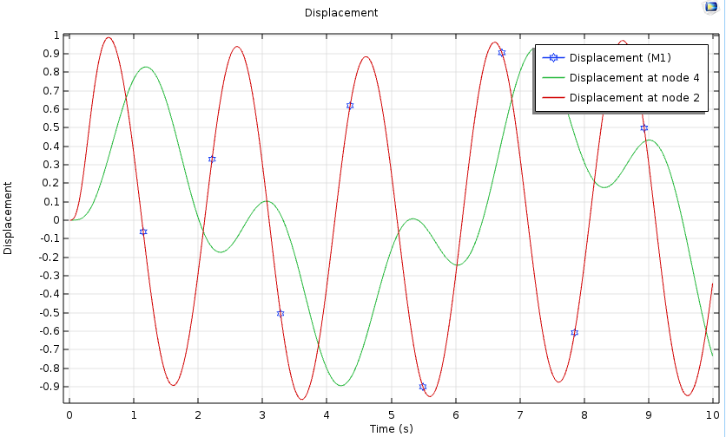
Big deviation for the movement of m2
The result from the pure “Lumped Mechanical System”, which is correct in theory.
The result from the “Lumped Mechanical System” and “Multibody Dynamics”, which is not correct in theory.

Slide 5

Why it doesn’t work with the LMS and MBD method at the model?

