Slide 1
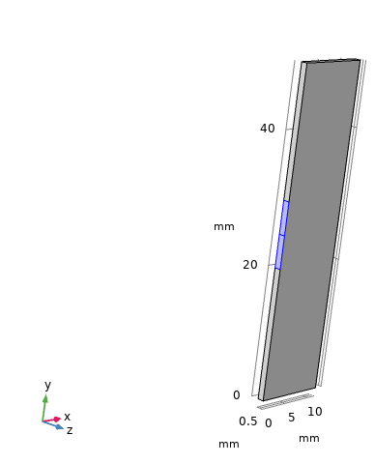
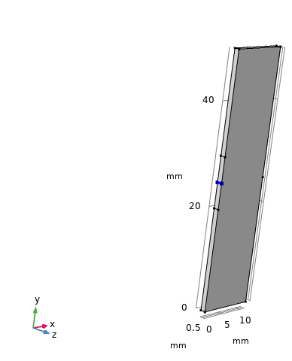
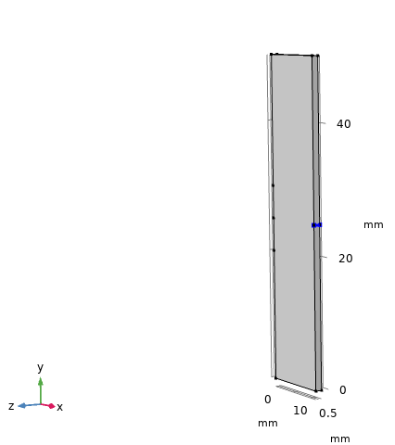
Measured x-displacement with time on these edges which lie on opposite boundaries
Excitation boundary
Prescribed velocity is given in x-direction
Edge probe 1
Edge probe 2

Slide 2
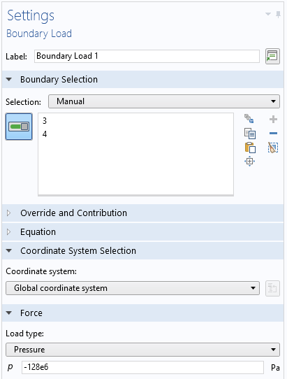
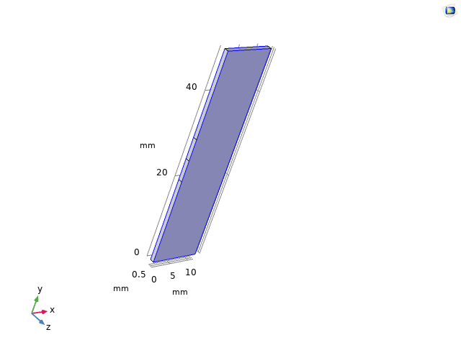
Tensile stress is applied on z-axis opposite faces

Slide 3
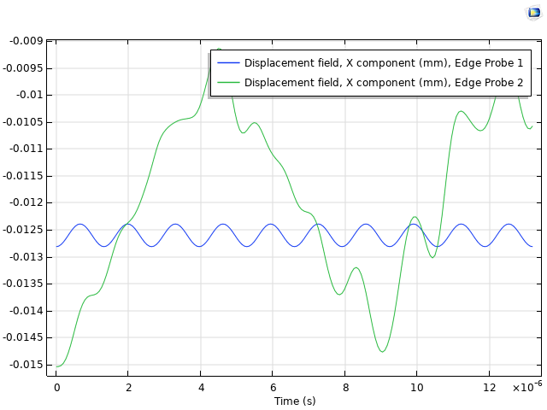
It looks that 128MPa is taken as an initial value and stress move towards zero means I stretch plate then release
So, at receiving edge I can’t measure displacement correctly. I want constant 128MPa stress throughout my time dependent analysis
It can be seen displacement is not only changing with prescribed velocity but prestress is also changing with time
In next slide, it is shown in animation that how prescribed velocity and stress are both changing with time

Slide 4
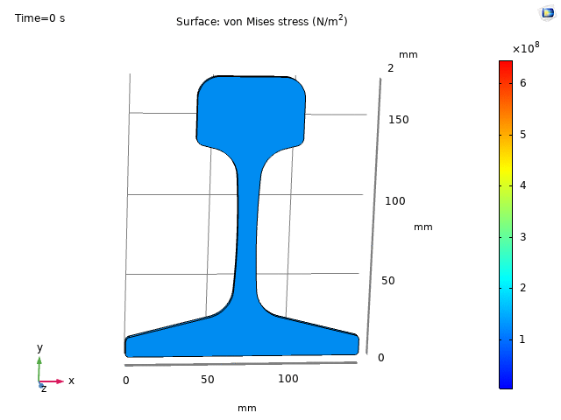
Here is prescribed velocity signal and rest of thing is caused by prestress

