Slide 1
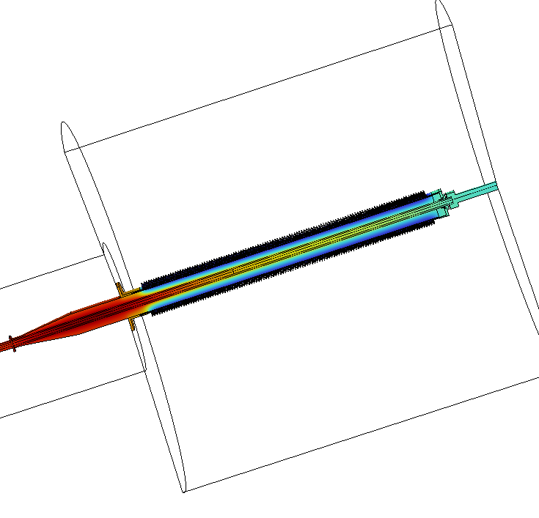
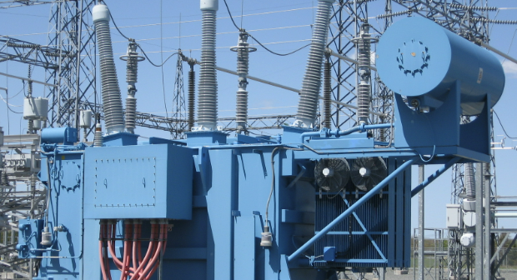

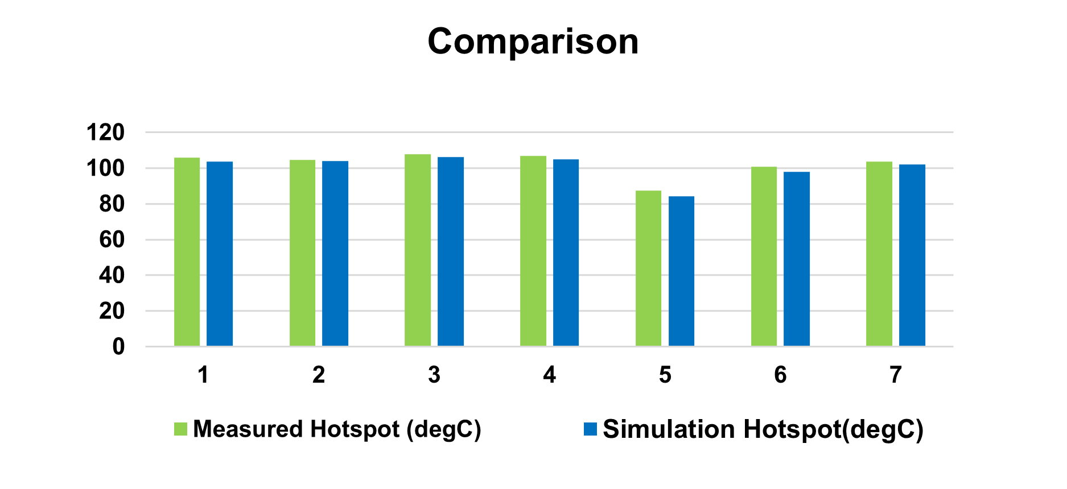

Thermal Simulation Using COMSOL Application Builder for Oil-Air Transformer Bushings
This application was developed for loss estimation and temperature prediction during design stage of condenser bushings. The application also incorporates comparison with type test results performed on existing designs.
Somil Joshi
Technology Center (Product development Engineer), Hitachi Energy India Limited, Vadodara, Gujarat
Introduction & Goals
Transformer bushings are power system equipment installed on transformers tank to connect overhead conductor & transformer leads. These Bushings at high voltages carry large currents leading to higher temperature & catastrophic failures. Whereas excess insulation further reduces Inservice life. Hence during design, it becomes important to thermally comply with governing standards (Ref. 1) & ensure reliable operation.
The purpose of this work was to develop user friendly thermal simulation application which reduces efforts during preprocessing, give accurate losses & temperature prediction for newly designed condenser core transformer bushings. The key users from product development, design & tender can use this application to predict temperature, compare existing designs & generate reports swiftly.
Methodology
A generic & parametric 2D axis symmetry sketch of bushing with all components was created in COMSOL geometry builder. Each bushing components were given required material properties. The current carrying central conductor were given temperature dependent heat losses. Heat loss calculation includes skin depth were ever applicable as per conductor configuration.
All boundary conditions, with required ambient temperature were given to the bushing components. The heat transfer in solids & laminar flow module were used to simulate thermal phenomena.
FIGURE 1. Transformer bushings installed on transformer tank connecting over head conductor with transformer leads.
Results
The measured hotspot temperature and simulation results have close correlation for different current ratings and bushing dimension. About 95 % accuracy in estimation of hotspot temperature was achieved over 30 different thermally tested designs.
Due to higher oil temperature (80-90 °C) and heat losses generated by current carrying central conductor, hotspots at lower middle region of bushings were seen in simulation. Due to low ambient temperature (< 30 °C) in air region a reduction in temperature is observed while moving towards top axially. The process time of thermal simulation was significantly reduced from days to hours.
FIGURE 2. Hotspot comparisons of measured and simulation results for seven designs. Bushings with different voltage, current ratings and physical dimensions showed variation in hotspot temperature.
1. "Insulated Bushings for alternating voltages above 1000 V", IEC 60137-2017.

