Slide 1
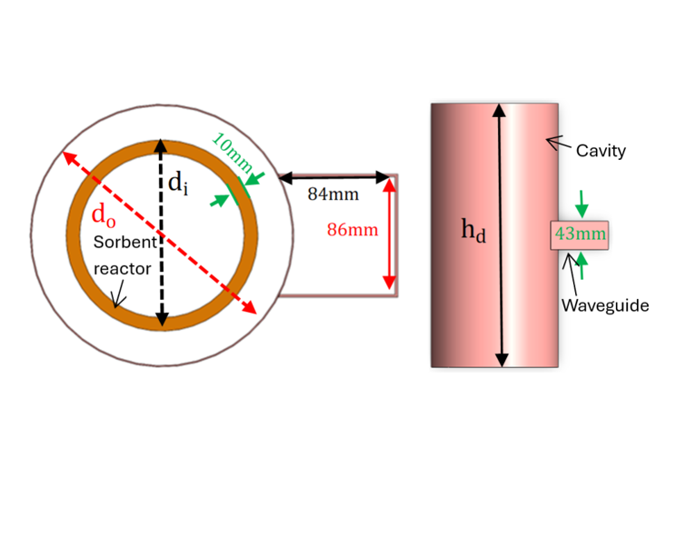
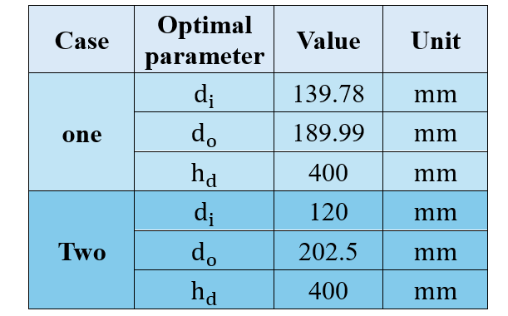
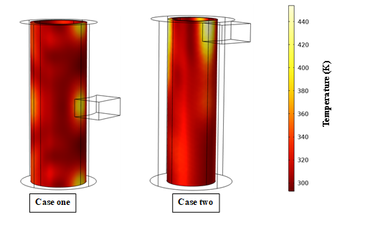


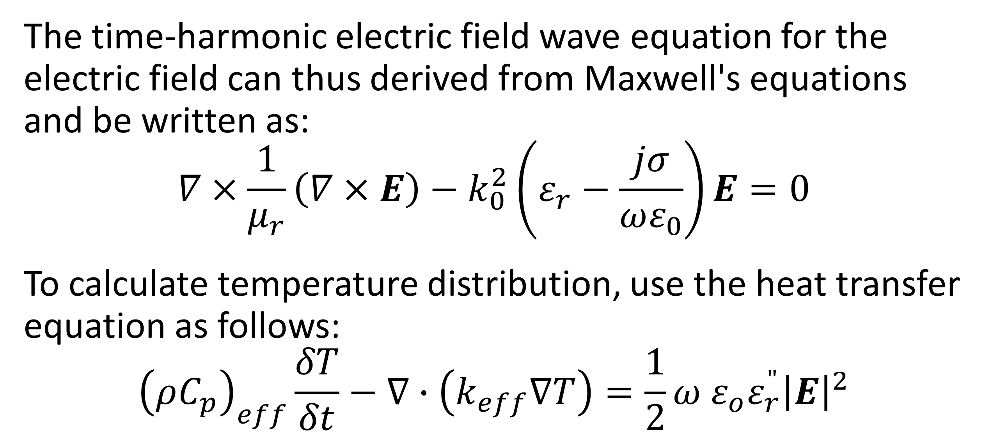
Optimization of the cylindrical $CO_{2}$desorption reactor
A simulation study was constructed using the COMSOL Multiphysics program to investigate, simulate, improve the heating process and optimize microwave cavity.
Hassan Ali Alkhalifah1, Arvind Narayanaswamy1, Alissa Park2
1. Mechanical Engineering Department, Columbia University, New York City, NY, USA.
2. Samueli School of Engineering, UCLA, Los Angeles, CA, USA.
Abstract
Microwave heating offers a promising approach for efficient desorption in carbon capture.
The COMSOL Multiphysics simulation study described here optimized microwave cavity design, revealing that optimal dimensions can absorb over 98% of input power.
Positioning the waveguide at the cavity's middle height proved most effective, not only absorbing 1.6% more power but, possibly more importantly, providing uniform heating distribution. This configuration is ideal for fluidized bed reactors, potentially enhancing energy efficiency in carbon capture processes.
Methodology
The time-harmonic electric field wave equation for the electric field can thus derived from Maxwell's equations and be written as:
$$∇×\frac{1}{μ_{r}}\left(∇×E\right)−k_{0}^{2}\left(ε_{r}−\frac{jσ}{ωε_{0}}\right)E=0$$
To calculate temperature distribution, use the heat transfer equation as follows:
$${\left(ρC_{p}\right)}_{eff}\frac{δT}{δt}−∇∙\left(k_{eff}∇T\right)=\frac{1}{2}ω ε_{o}ε_{r}^{"}{\left|E\right|}^{2}$$
The optimal dimensions for case one and case two.
Results
Key findings include:
- Optimal cavity dimensions can result in over 98% absorption of microwave power input, significantly enhancing system efficiency.
- Waveguide positioning at the middle height of the cavity proved superior, absorbing 1.6% more power than the top-end position and providing more uniform electrical and temperature distribution.
- The middle waveguide position is particularly suitable for fluidized bed reactors, where sorbent material moves along the reactor's length.
The temperature field [K] and temperature distributions within the sorbent for A) case one and B) case two.
[1] C. e. a. Ellison, "Comparison of microwave and conventional heating for CO2 desorption from zeolite 13X," International Journal of Greenhouse Gas Control, 107(103311), 2021., vol. 107, 2021.
[2] e. a. Yamid Gomez-Rueda, "Rapid temperature swing adsorption using microwave regeneration for carbon capture," Chemical Engineering Journal, vol. 446, 2022.
[3] e. a. Tar Hwan Lim, "Microwave-based CO2 desorption for enhanced direct air capture: experimental validation and techno-economic perspectives," Environmental Research Letters, vol. 19, 2024.

