Slide 1
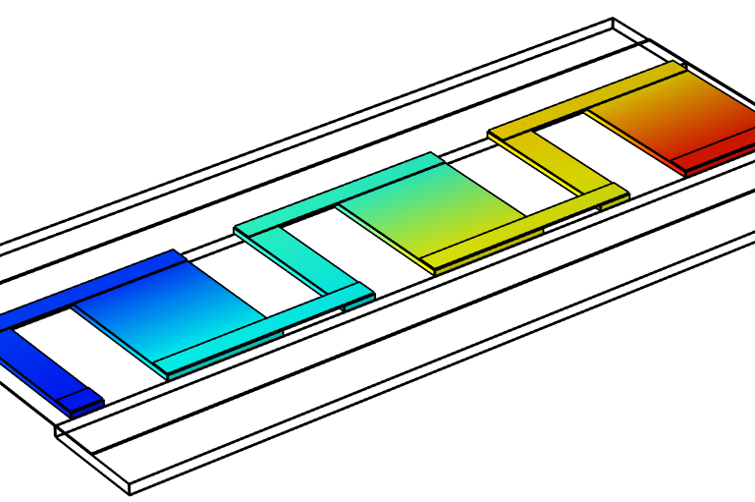
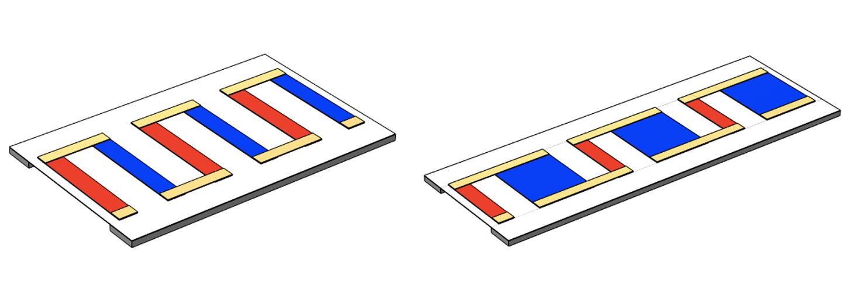
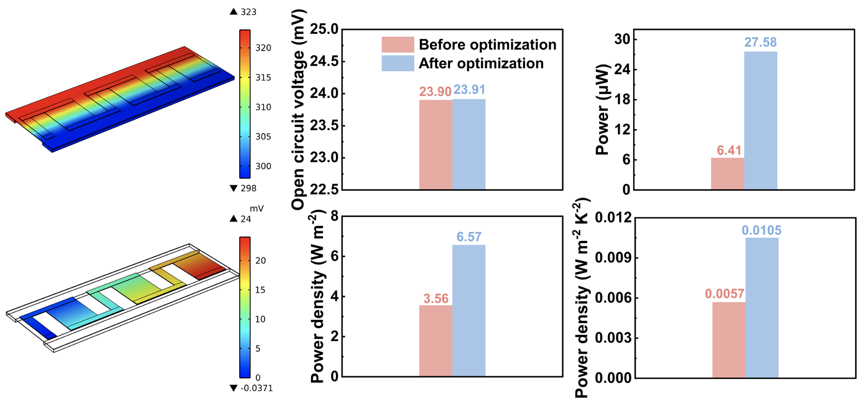

Geometric optimization of thermoelectric sensor
Optimize the thermoelectric sensor's output performance by refining the design rules and geometric structure of the thermoelectric film.
Kai-Yu Yang ¹, Kai Guo² 1. School of Materials Science and Engineering, Guilin University of Electronic Technology, Guilin 541004, China. 2. School of Physics and Materials Science, Guangzhou University, Guangzhou 510006, China.
Abstract
Thermoelectric sensors, which are capable to convert temperature gradients into electrical signals, hold promise for use in wearable body-temperature monitors and self-powered electronic devices. However, traditional flexible thermoelectric devices constructed with organic materials have been hampered by their low energy conversion efficiency, largely stemming from the lack of ideal materials and optimized device geometry.
In this study, we utilize state-of-the-art Ag₂S-based inorganic materials to fine-tune the geometric parameters of full-inorganic flexible thermoelectric devices and delve into the potential application of this technology in the realm of respiratory monitoring, underscoring its significance and promising prospects.
Methodology
The model consists of three pairs of n-p thermoelectric films. Each pair of copper electrodes is connected to adjacent thermoelectric films in series. The aluminum plates provide the same temperature gradient for each thermoelectric film, enabling electrical series and thermal parallel connections.
The influence of the geometric parameters of the film—length, width, and thickness—on device performance is interdependent. When these parameters are optimized simultaneously, the result often exhibits a synergistic effect. Therefore, only one geometric parameter is adjusted at a time, while other parameters and conditions remain unchanged, allowing for clearer, more accurate, and simpler analysis of their impact.
FIGURE 1. Left: Model of thermoelectric sensor. Right: The model after full-size optimization.
Results
The results are shown in Figure 2. The left figure shows the temperature and potential distribution of the full-size optimized sensor at a current of 0mA, corresponding to its working condition in the case of open circuit. The right figure shows that the performance of the sensor is indeed influenced by the geometric dimensions of the thermoelectric film. Under the same temperature difference, the optimized power density is significantly increased by 84.55 %.
FIGURE 2. Left: Temperature and potential distribution of the sensor. Right: Performance comparison of the sensor before and after full-size optimization.
1. Zhou, Q et al. High-performance flexible thermoelectric generators with tunable in-plane and out-of-plane architectures. Nano Energy 2023, 118. 2. Zhang, C et al. MXene-based wearable thermoelectric respiration sensor. Nano Energy 2023, 118. 3. Zhang, F et al. Flexible and self-powered temperature-pressure dual-parameter sensors using microstructure-frame-supported organic thermoelectric materials. Nature Communications 2015, 6.

