Slide 1
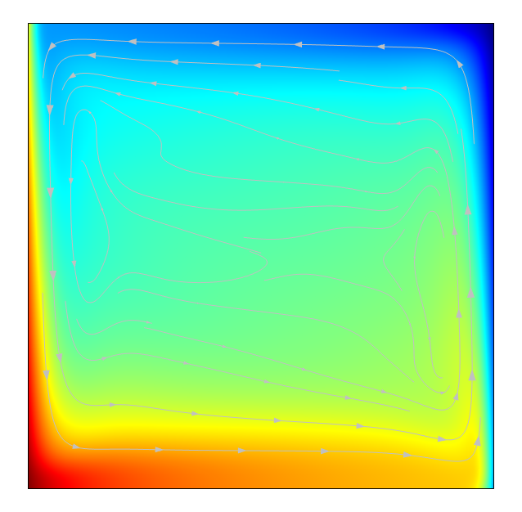
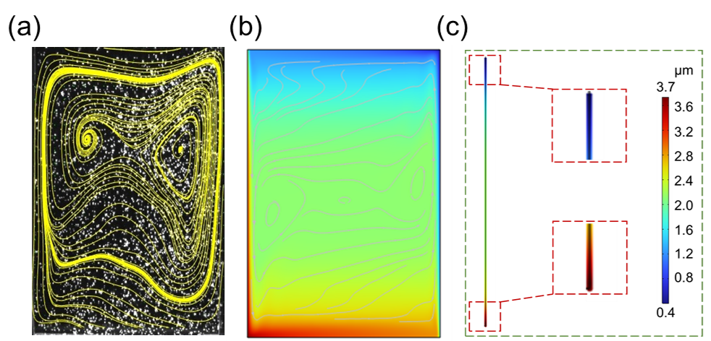
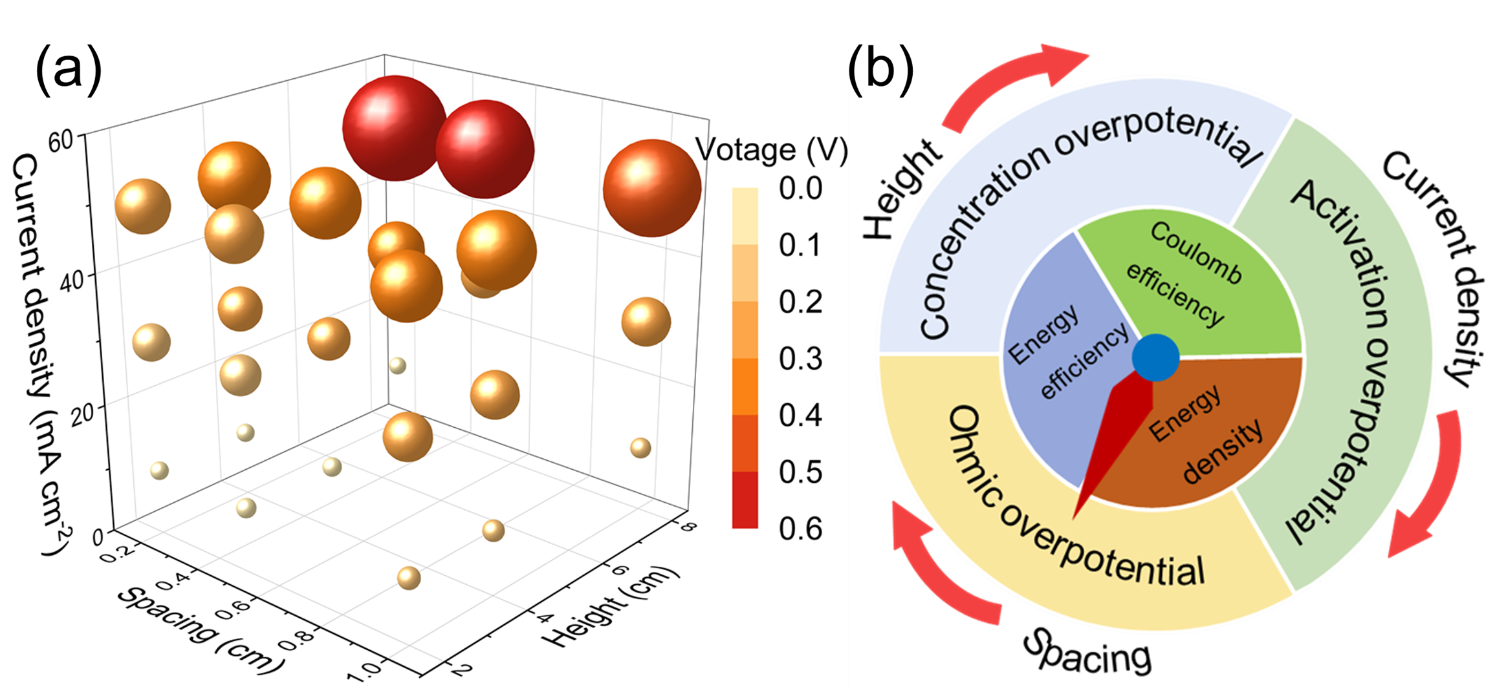
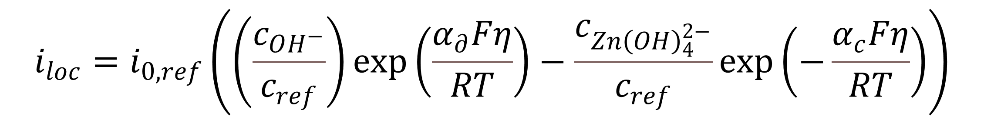
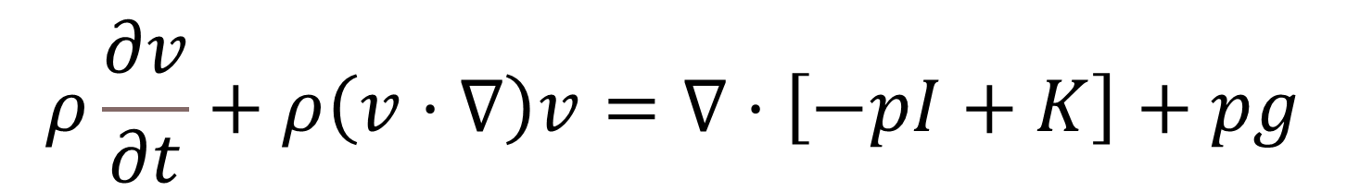
Convective Mass Transfer in Aqueous Zinc-Based Batteries
The mass transfer effect caused by natural convection in aqueous zinc-based battery is revealed and the design of battery is guided.
Jianwen Yu¹ , Peng Tan^{1,2}
Department of Thermal Science and Energy Engineering, University of Science and Technology of China (USTC), Hefei, China
State Key Laboratory of Fire Science, University of Science and Technology of China (USTC), Hefei, China
Abstract
By simulating the operation of zinc symmetrical batteries under the influence of a gravitational field, it has been pointed out that the non-uniform deposition phenomenon in aqueous zinc-based batteries is caused by uneven ion concentration distribution between the upper and lower parts of the battery due to natural convection. Additionally, natural convection is considered as a mode of mass transfer in aqueous zinc-based batteries, revealing that the electrochemical performance of the battery under natural convection aligns more closely with actual conditions. On the other hand, since natural convection leads to uneven concentration distribution while enhancing mass transfer effects, simulations have been conducted to assess the impact of various conditions on natural convection, leading to proposed optimization design strategies for battery structures. (Ref. 1)
Methodology
In the model, the mass transfer process can be described by the Nernst-Planck equation:
The electrochemical process can be described by the Butler-Volmer equation:
Fluid flow is described through the Navier-Stokes and continuity equations:
$${\vec{N}}_{i}=−z_{i}u_{i}c_{i}F∇φ_{l}−D_{i}∇c_{i}+\vec{v}c_{i}$$
$$i_{loc}=i_{0,ref}\left(\left(\frac{c_{OH^{−}}}{c_{ref}}\right)exp\left(\frac{α_{∂}Fη}{RT}\right)−\frac{c_{Zn{\left(OH\right)}_{4}^{2−}}}{c_{ref}}exp\left(−\frac{α_{c}Fη}{RT}\right)\right)$$
FIGURE 1. Natural convection in zinc-based batteries.(a) Particle tracing experiment. (b) Concentration field simulation. (c) Deposition thickness simulation.
$$ρ\frac{∂v}{∂t}+ρ\left(v⋅∇\right)v=∇⋅\left[−pΙ+Κ\right]+pg$$
Results
The simulation results indicate that near the electrode surface, convective flux can account for about 10% of mass transfer, while in the bulk solution, convective flux can reach hundreds of times the diffusion flux. Additionally, different factors have varying effects on voltage; an increase in current density and battery height leads to higher voltage, while the impact of battery spacing is not linear. At high currents and heights, increasing spacing can actually be beneficial when considering natural convection. Furthermore, these three factors affect voltage to different extents, necessitating a comprehensive consideration during battery size design. (Ref. 2)
FIGURE 2. Effects of three parameters on battery voltage.(a) Synergistic effect of current density, height, and spacing. (b) Factors to consider in battery design.
REFERENCES
[1] J. Yu, W. Yu, Z. Zhang, P. Tan, Reunderstanding the uneven deposition in aqueous zinc-based batteries, Chemical Engineering Journal 481 (2024) 148556.
[2] J. Yu, Z. Zhao, Z. Zhang, K. Sun, P. Tan, Revealing the intricacies of natural convection: A key factor in aqueous zinc battery design, Energy Storage Mater 73 (2024) 103823.

