Slide 1
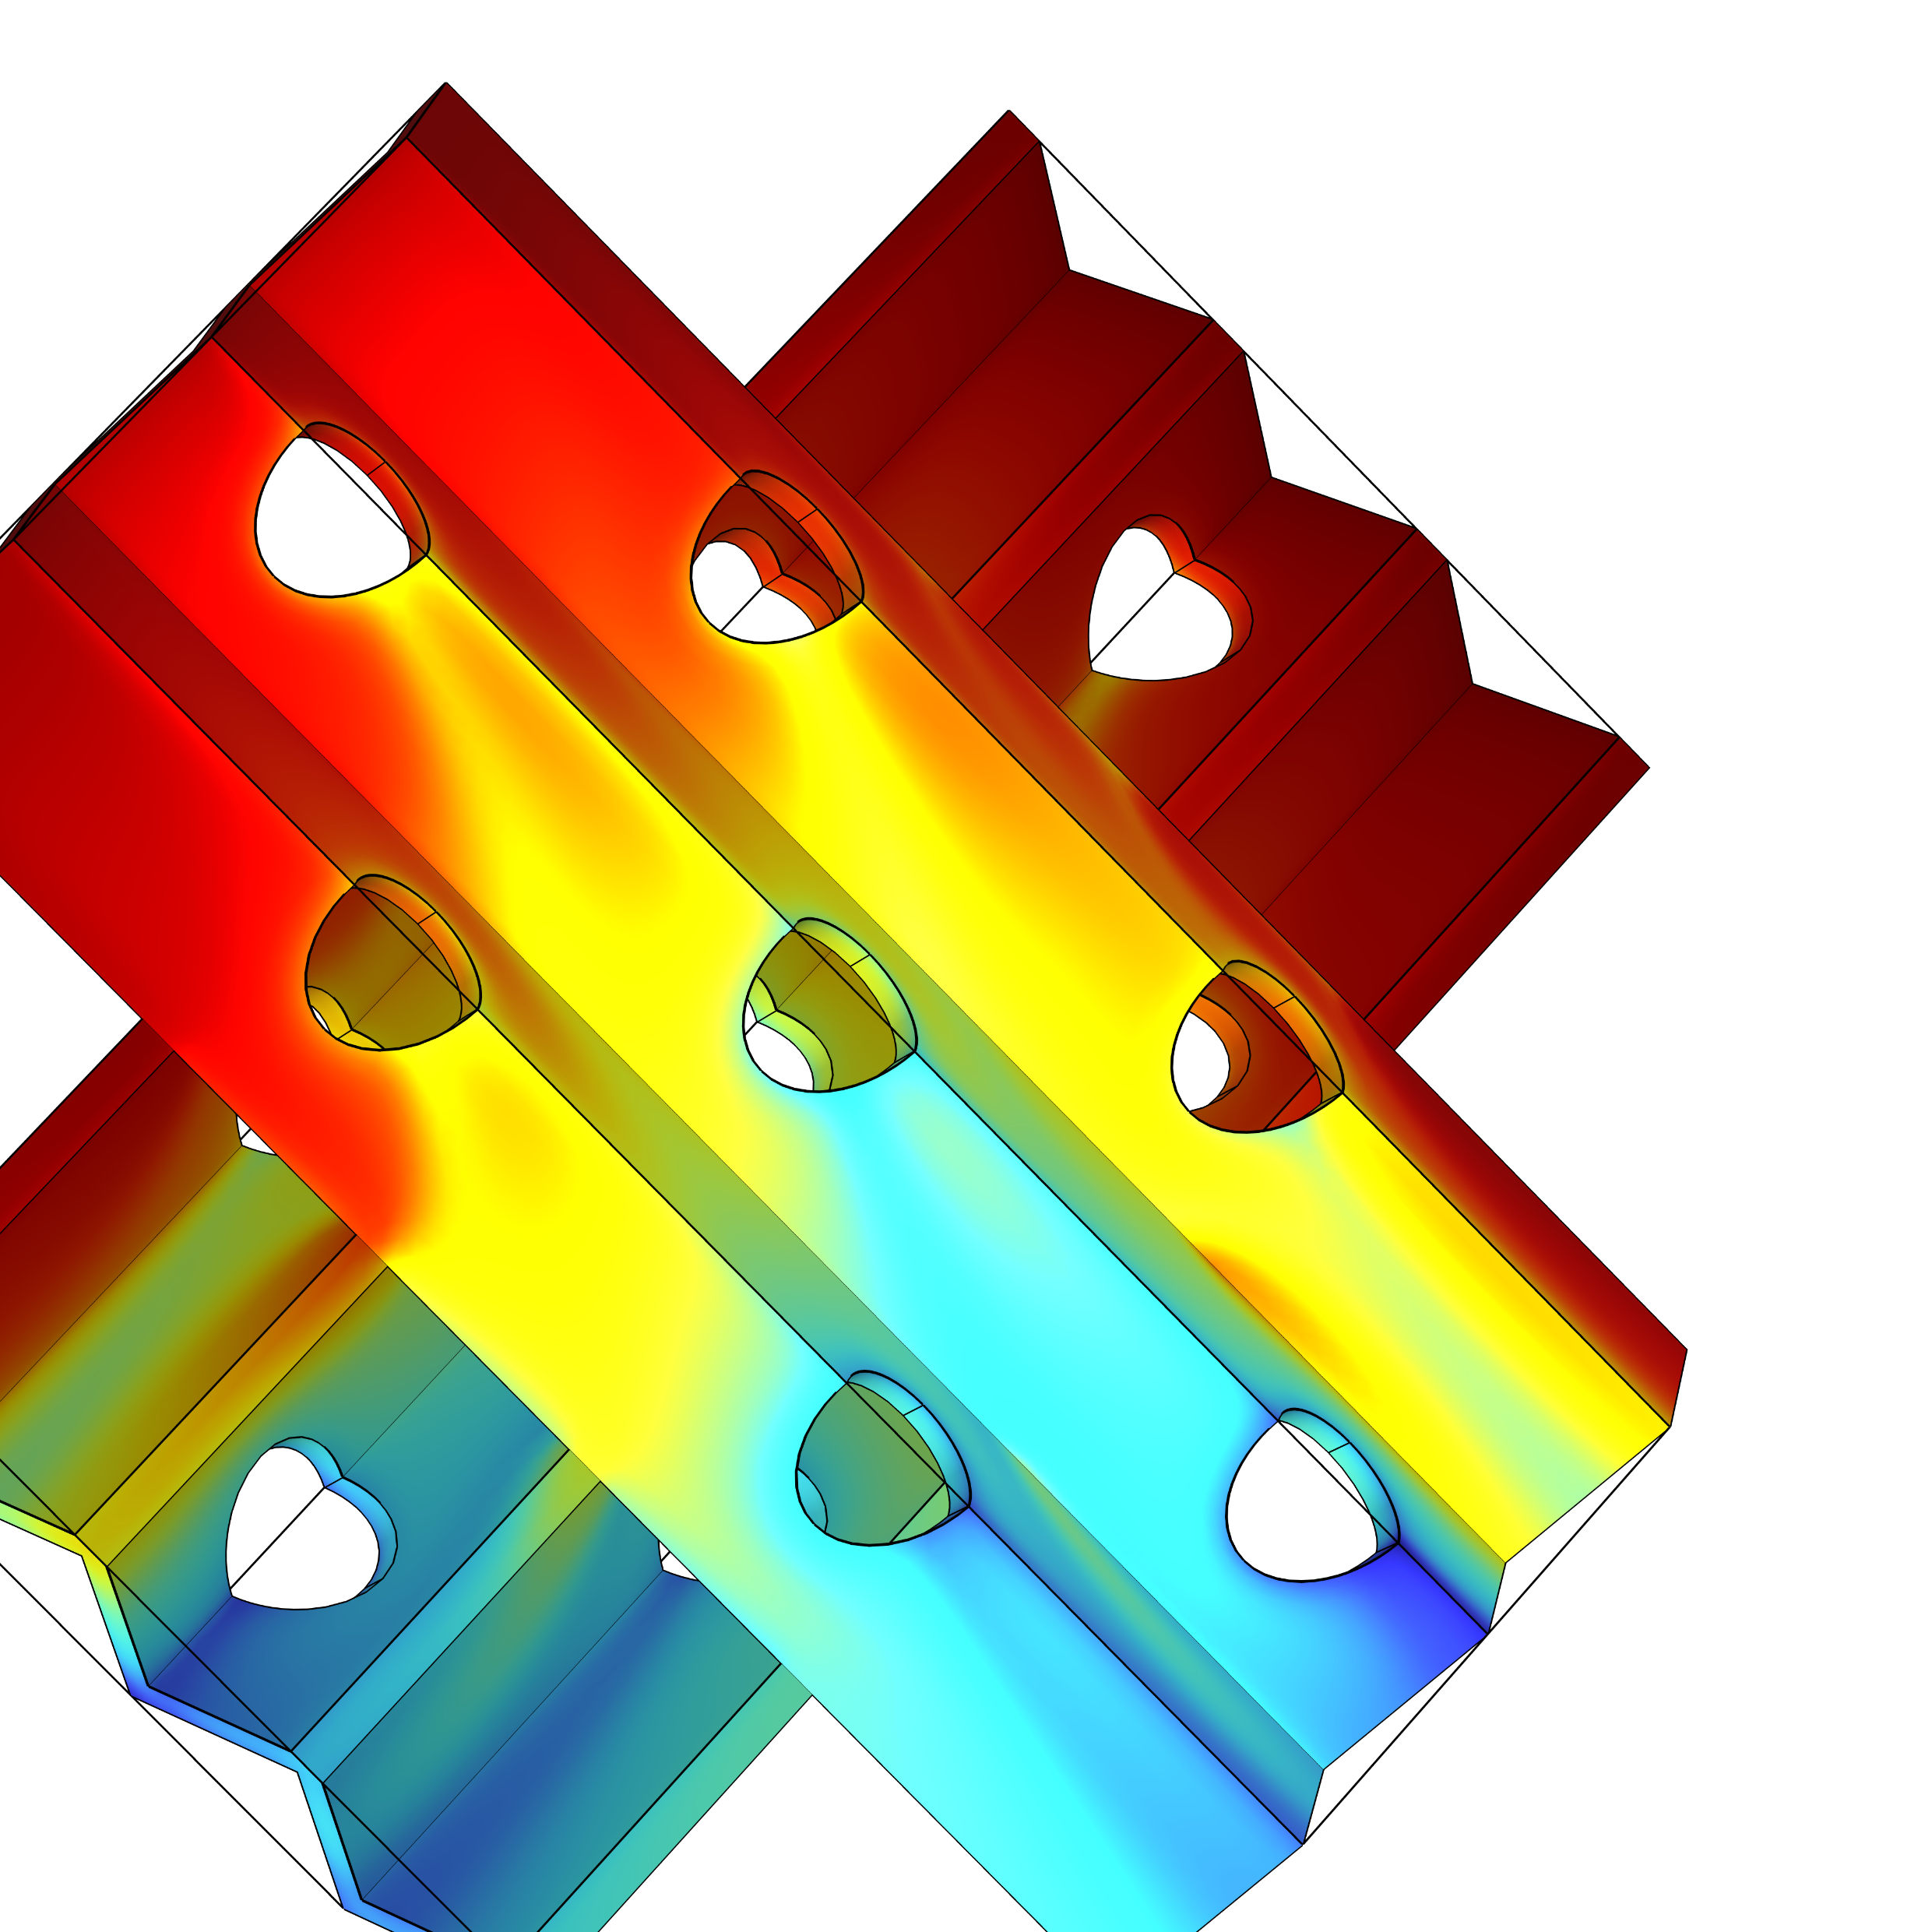
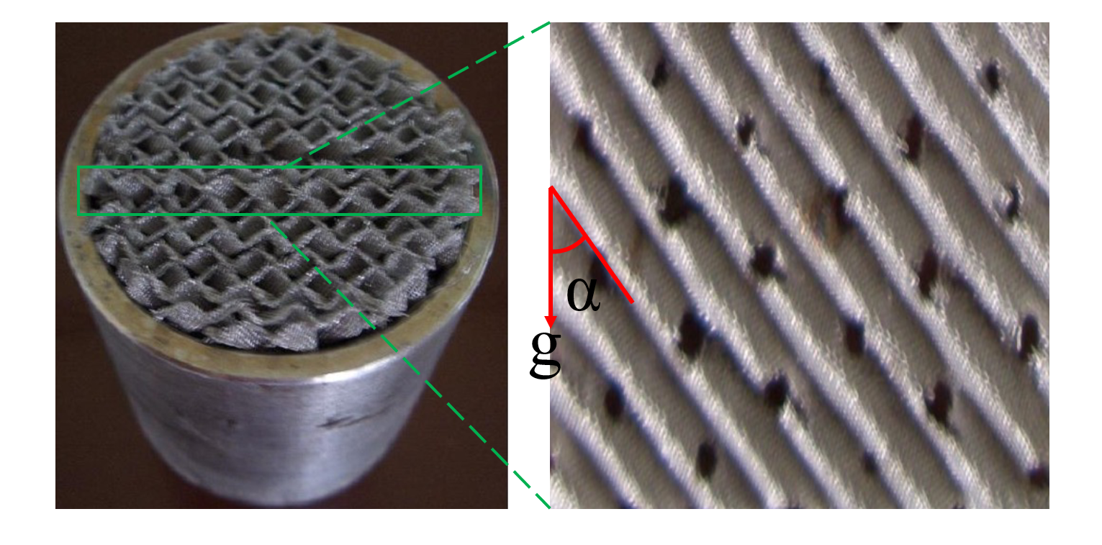
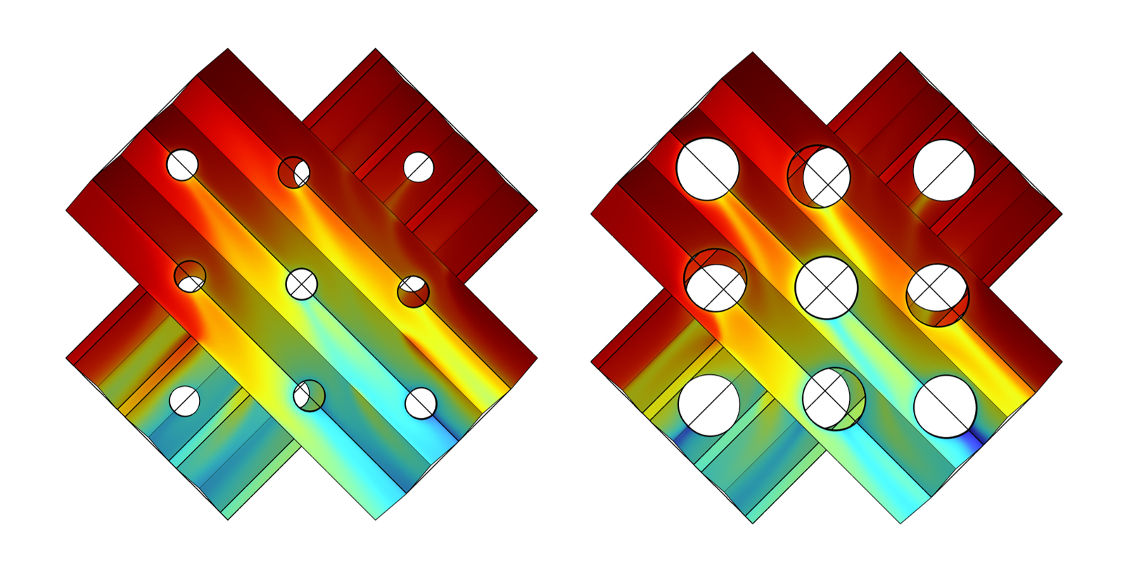


Simulation of Multiphysics in Structured Packings PACK-13C
Simulation and optimization of the heat and mass transfer at structured packings based on the experiment of ultra‐high purity xenon‐krypton cryogenic distillation.
Congcong Lu¹, Zhou Wang^{1,2}, Yonglin Ju¹
Institute of Refrigeration and Cryogenic, Shanghai Jiao Tong University, Shanghai China
Tsung‐Dao Lee Institute, Shanghai Jiao Tong University, Shanghai, China
Abstract
Based on the experimental data derived from the independently developed ultra‐high purity krypton‐xenon separation cryogenic distillation system^{1,2}, a new REU model of the stainless steel structured packing fabricated by suppressing double layer silk screen into the corrugated shape is developed using COMSOL Multiphysics® software, focusing on the analysis of the gas‐liquid heat and mass transfer characteristics at the packing at extremely low concentration of impurity krypton, then enhance the heat and transfer process by optimizing the structure of the packing.
Methodology
Using the laminar flow, fluid heat transfer and transport of diluted species in porous media interface to simulate the multi-physics in PACK-13C.
The mass transfer coefficient is calculated by Delft³ model which considers the influence of flow condition and pack constructure on mass transfer. The main equation:
FIGURE 1. Left: Structured packing PACK-13C in the distillation column. Right: Structural details of the wire mesh of PACK-13C.
$$\frac{0.15}{k_{LG}}=\frac{K}{k_{L}}+\frac{1}{k_{G}}$$
Results
The crossed gas-liquid phase channels formed by stacked intersections of structured packing significantly enhanced mixing efficiency. The sharp changes in gas-liquid interface concentration indicated strong mass transfer effects in this region. Perforations in structured packing caused low-concentration wake flows behind the holes, enhancing mass transfer. However, larger perforations reduced gas-liquid contact area, decreasing purification efficiency.
FIGURE 2. Left: Concentration of Kr in liquid Xe at 1.5mm hole diameters. Right: Concentration of Kr in liquid Xe at 3mm hole diameters
REFERENCES
1. Li, Hulin, at el. “Separation of isotope 13C using high‐performance structured packing.” Chemical Engineering and Processing: Process Intensification, 255–261, 2010.
2. Wang, Zhou, at el. “Large scale xenon purification using cryogenic distillation for dark matter detectors.” Journal of Instrumentation, P11024,2014.
3. Olujic, Z, at el. “Predicting the efficiency of corrugated sheet structured packings with large specific surface area.” Chemical and Biochemical Engineering Quarterly, 89–96, 2004.

