Slide 1
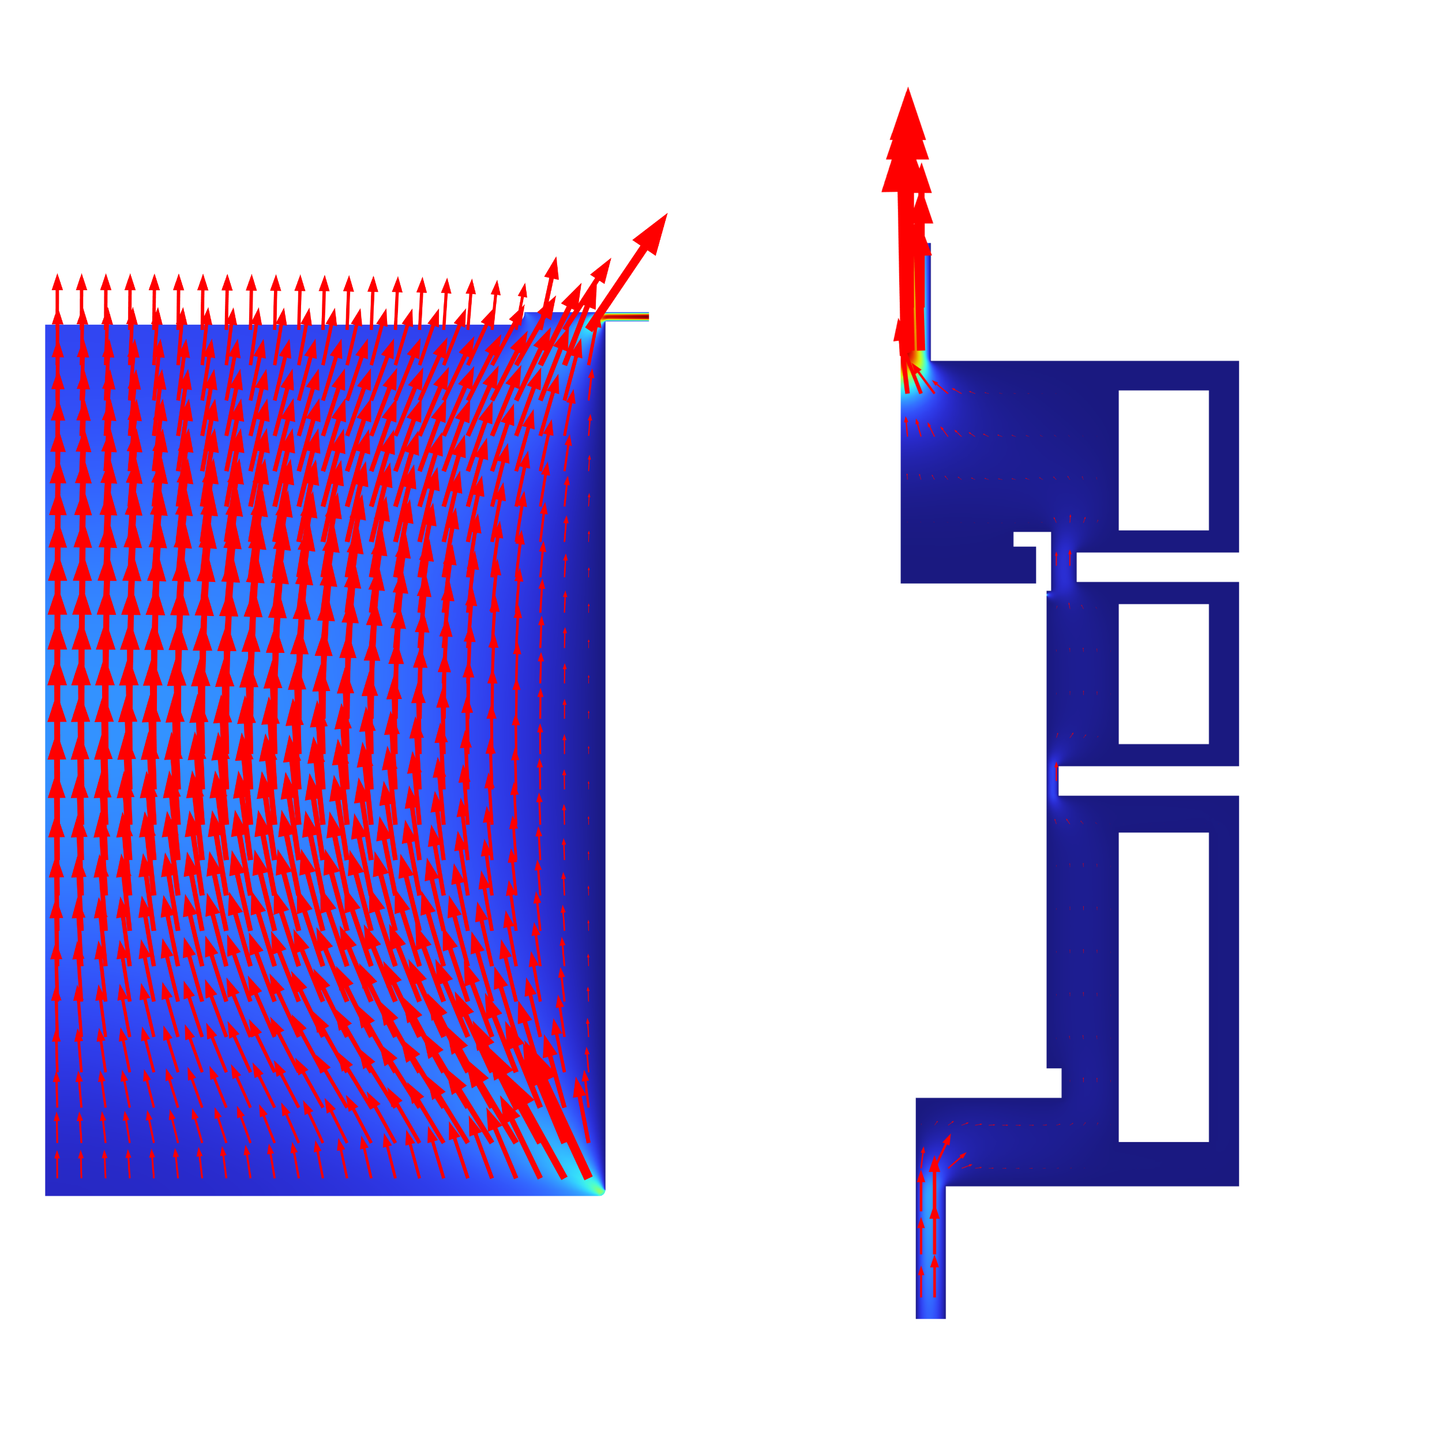
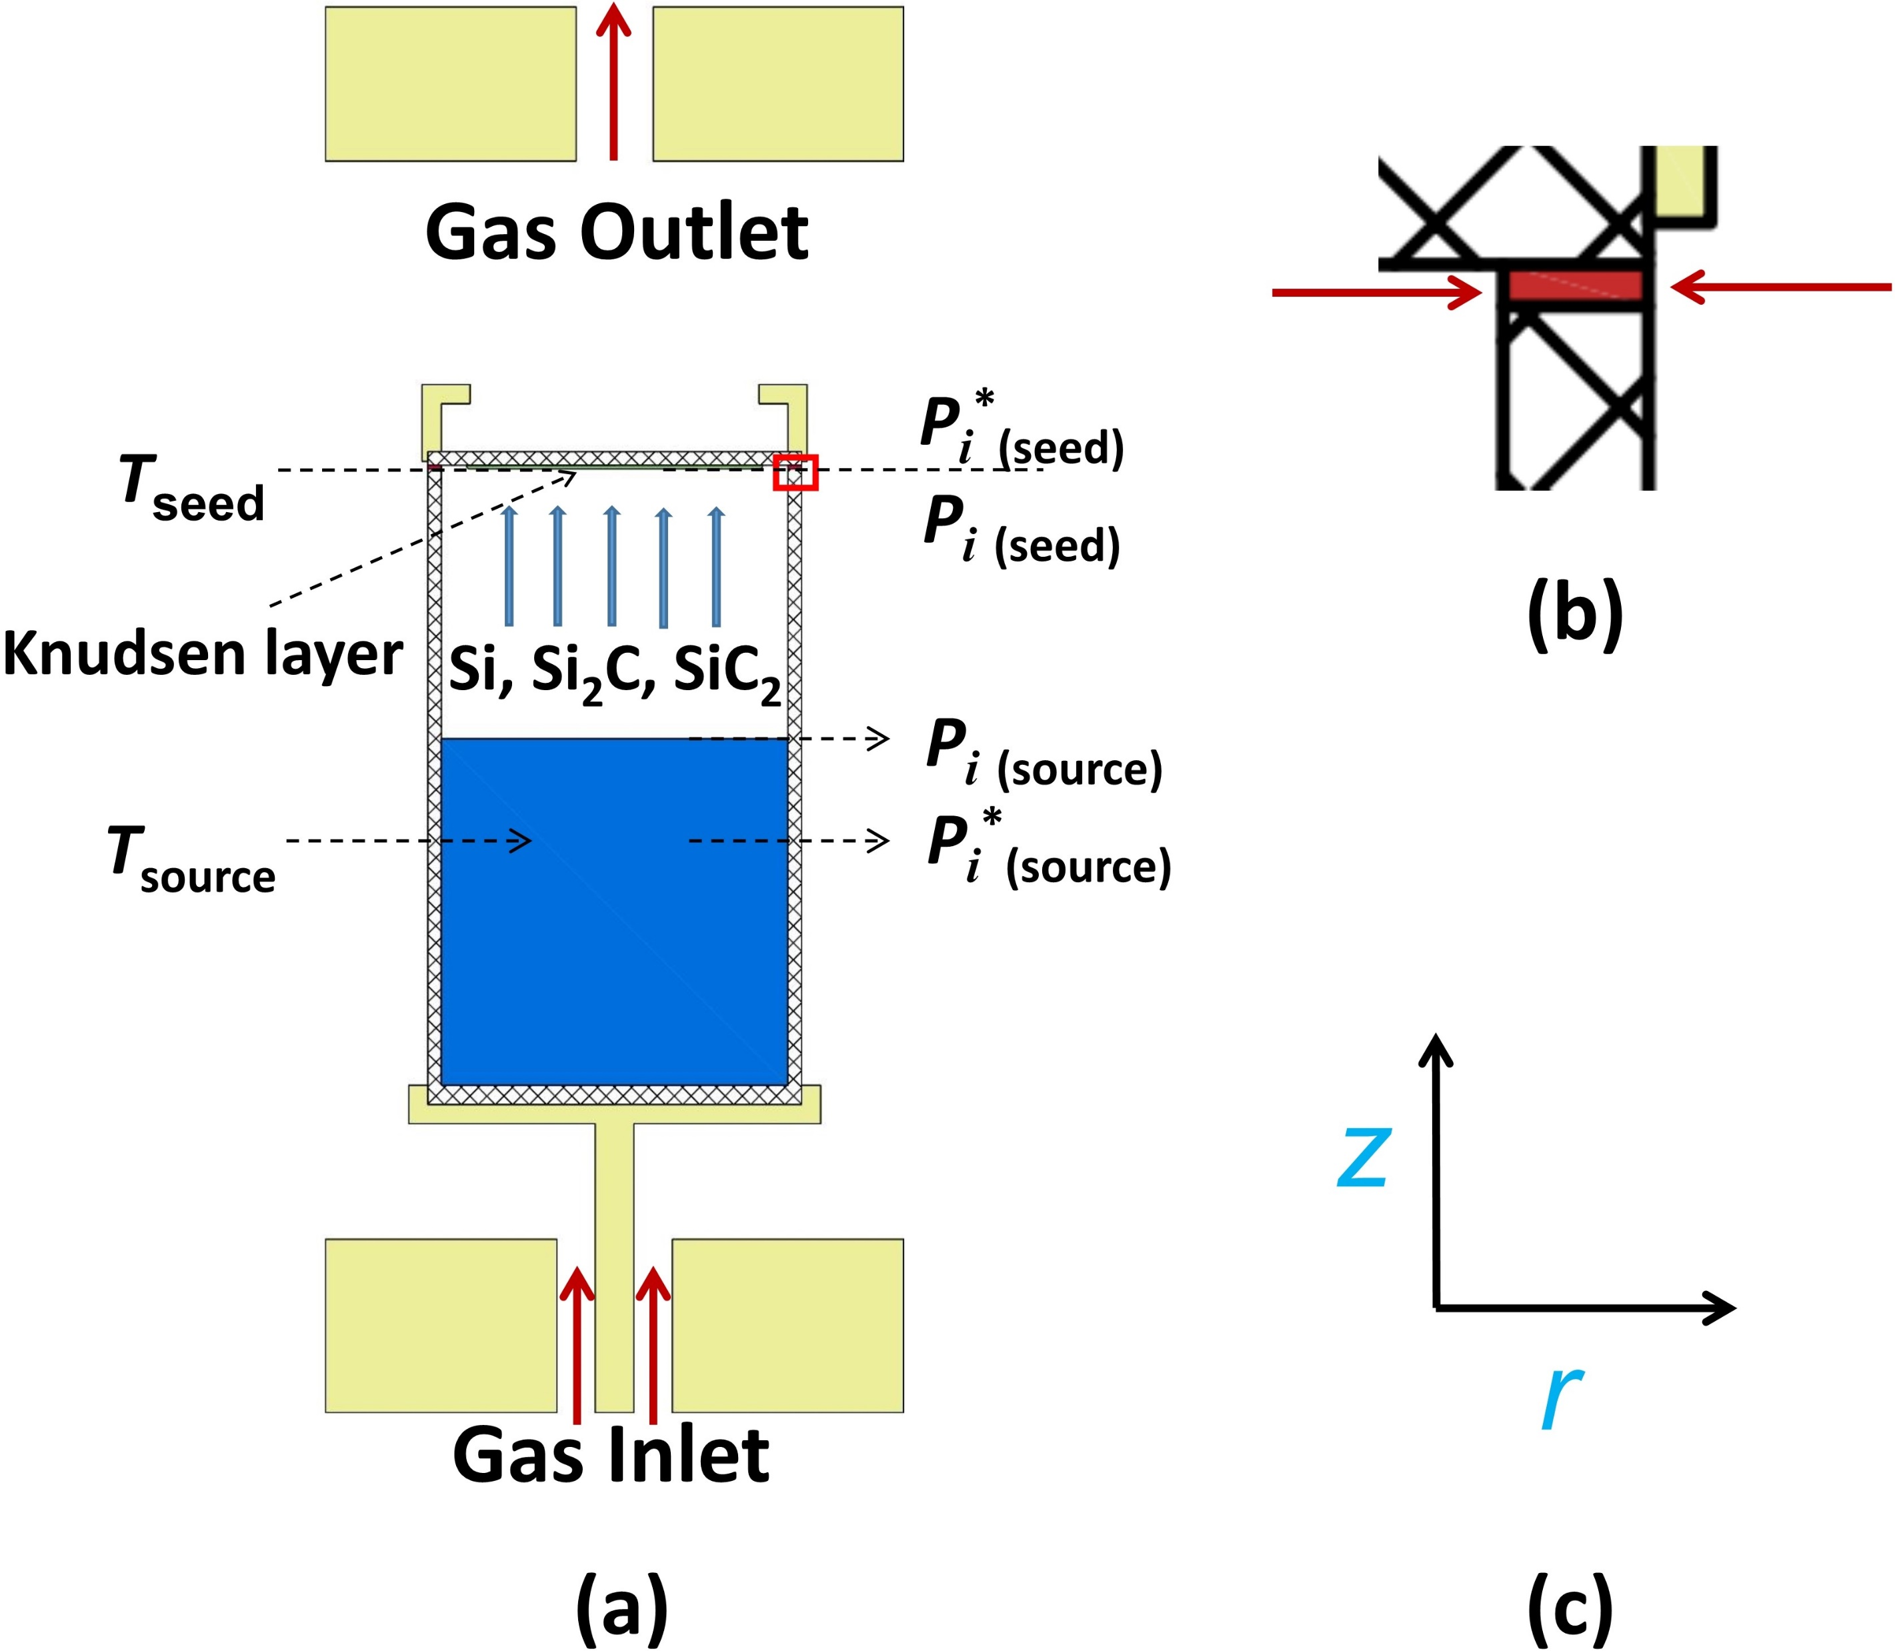
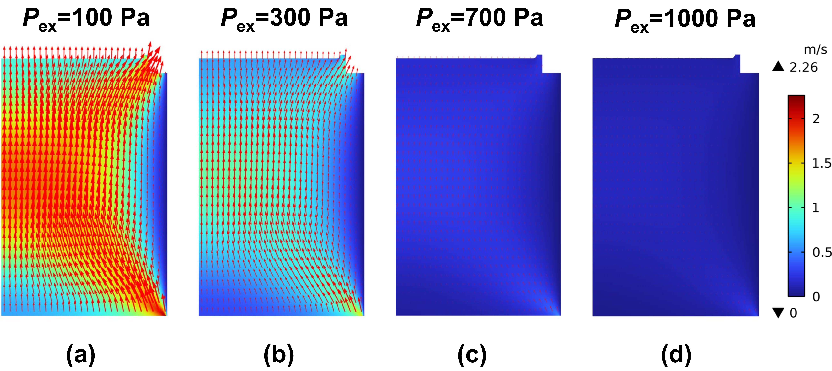

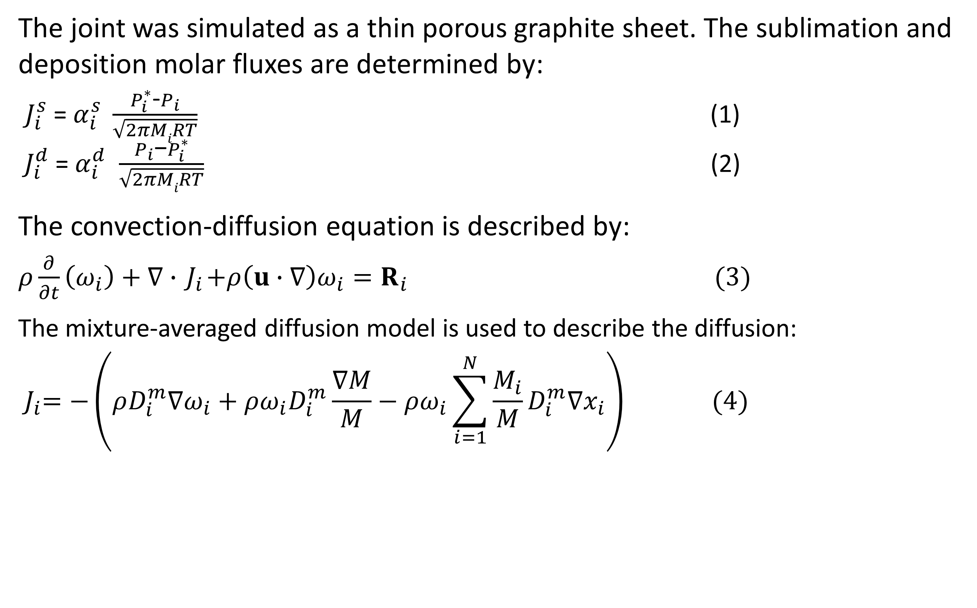
Numerical simulation of the gas species transport in the PVT growth of single-crystal SiC
The exchanges of the internal and external gas species is simulated as gas flowing through a thin porous graphite sheet during the PVT growth of SiC.
Binjie Xu1,2, Xuefeng Han1,2*, Deren Yang1,2, Xiaodong Pi1,2†
1 Zhejiang University
2 ZJU-Hangzhou Global Scientific and Technological Innovation Center
Abstract
We propose a multi-component ﬂow model that includes the inside and outside of a growth chamber and a joint between the seed crystal holder and crucible, allowing gas species exchanges. The joint is simulated as a thin porous graphite sheet. The Hertz-Knudsen equation is used to describe the sublimation and deposition. The convection and diﬀusion are described by the Navier-Stokes equations and mixture-averaged diﬀusion model, in which the Stefan ﬂow is considered. We have analyzed the effects of several experimental conditions on the transport of gas species and the growth rate of single-crystal SiC.
Methodology
The joint was simulated as a thin porous graphite sheet. The sublimation and deposition molar fluxes are determined by:
$J_{i}^{s}$= $α_{i}^{s} \frac{P_{i}^{∗}\text{−}P_{i}}{\sqrt{2πMiRT}}$ (1)
$J_{i}^{d}$= $α_{i}^{d}$ $\frac{P_{i}\text{−}P_{i}^{∗}}{\sqrt{2πMiRT}}$ (2)
The convection-diffusion equation is described by:
$ρ\frac{∂}{∂t}\left(ω_{i}\right)+∇∙{ J}_{i}+ρ\left(u∙∇\right)ω_{i}=R_{i}$ $(3)$
The mixture-averaged diffusion model is used to describe the diffusion:
$${ J}_{i}=−\left(ρD_{i}^{m}∇ω_{i}+ρω_{i}D_{i}^{m}\frac{∇M}{M}−ρω_{i}\sum_{i=1}^{N}{\frac{M_{i}}{M}}D_{i}^{m}∇x_{i}\right) (4)$$
FIGURE 1. (a) Physical model of PVT growth of SiC crystals; (b) Enlargement of the joint between the seed crystal holder and the crucible; (c) The radial axis “r” and axial axis “z”.
Results
The results can be seen in Figure 2, the fluid flow velocity reduces with the increase in pressure since the viscosity increases with pressure. Besides, the crystal growth rate is effectively reduced by the pressure, which is not shown in the picture. Additionally, the fluid flow velocity increases significantly with the heating power, and the crystal growth rate follows a similar trend. The results are not totally shown in the pictures.
FIGURE 2. The flow velocity field between the source powder and the seed in the half zone of the crucible under different P_{ex}.
[1] S.K. Lilov. Mater. Sci. Eng.: B, 21(1):65–69 (1993).
[2] A.S. Segal et. al. Mater. Sci. Eng.: B, 61-62:40–43 (1999).
[3] C. F. Curtiss et. al. Ind. Eng. Chem. Res., 38(7):2515–2522 (1999).
[4] J. Dong et. al. J. Synth. Cryst., 33(3):283–287 (2004).
[5] R. J. Millington. Science, 130(3367):100–102 (1959).

