Slide 1
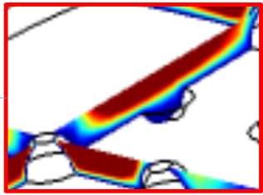
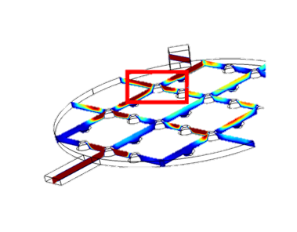
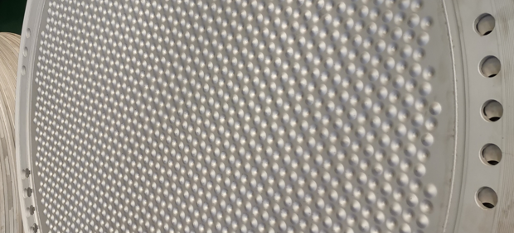
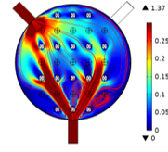
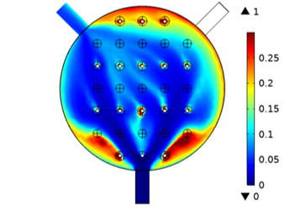


Analysis of the Diphasic Flow in a Industrial Alkaline Water Electrolyzer
Analyzing the effect of the concave-convex bipolar endplate on the flow field and bubble distribution inside the water electrolyzer
K. Hu, D. Huang, A. Lu, J. Fang
School of Electrical and Electronic Engineering, Huazhong University of Science and Technology, Wuhan, China
Abstract
Alkaline water electrolysis is regarded as the most mature technology for large-scale commercial application for green hydrogen production. However, the efficiency of the electrolyzer is relatively low compared with Proton Exchange Membrane electrolysis. Apart from the differences in terms of catalyst and the membrane, the flow field is a critical issue affecting the power-to-hydrogen efficiency of the alkaline water electrolyzer. This is due to the bubble effect, which states that the produced bubbles during water electrolysis will cover on the catalyst layer will obstruct the contact between the electrolyte and the catalyst, resulting in the decline of the effective reaction area. The concave-convex bipolar endplate is applied in the industry to relieve the bubble effect. This research unveil the mechanism of this structure on improving the flow field inside the water electrolyzer through a bidirectionally couple multiphysics model.
Methodology
To investigate the effect of the concave-convex structure of the endplate on the improvement of the diphasic flow field, a multiphysics model is established in COMSOL Multiphysics, with a 5*5 array of the concave-convex structure. The Euler-Euler model is applied in the simulation, which is bidirectionally coupled with the electrochemical model. On the one hand, the gas production rate is proportional to the local current density according to Faraday’s Law (1); On the other hand, the bubble coverage on the plate will obstruct the contact between the electrolyte and the catalyst, resulting in the decline of the effective reaction area (2).
Figure 1. Concave-convex bipolar endplate of an industrial alkaline water electrolysis stack
(1)
(2)
Results
The simulation results are shown in Figure 2. Firstly, the flow field, depicting the velocity of the electrolyte, is shown on the left. It can be obviously noted that the concave-convex structure increase the uniformity of the flow field. Specifically, the concave structure contributes to the reduction of the local flow resistance, leading to increased flux in the corresponding direction. On the other hand, the convex structure introduces the local circling effect to increase the uniformity, which can be detected through the flow line.
Accordingly, the bubble distribution is shown on the right. It can be seen that the bubbles mainly accumulates near the edge where the flow rate is low. In the majority part of the plate, the bubble effect is relieved.
Figure 2. Simulation results of the flow field (left) and the bubble distribution (right) inside the flow channel of the electrolyzer
REFERENCES
D. Huang, et al, “A multiphysics model of the compactly-assembled industrial alkaline water electrolysis cell,” Appl. Energy, vol. 314, no. March, p. 118987, 2022.
K. Hu et al., “Comparative study of alkaline water electrolysis, proton exchange membrane water electrolysis and solid oxide electrolysis through multiphysics modeling,” Appl. Energy, vol. 312, no. February, p. 118788, 2022.

