Slide 1
Designing Wireless Charging Systems with COMSOL Multiphysics®
Nirmal Paudel, Ph.D.
Veryst Engineering LLC, Needham, MA, USA
 npaudel@veryst.com
 www.veryst.com

Slide 2
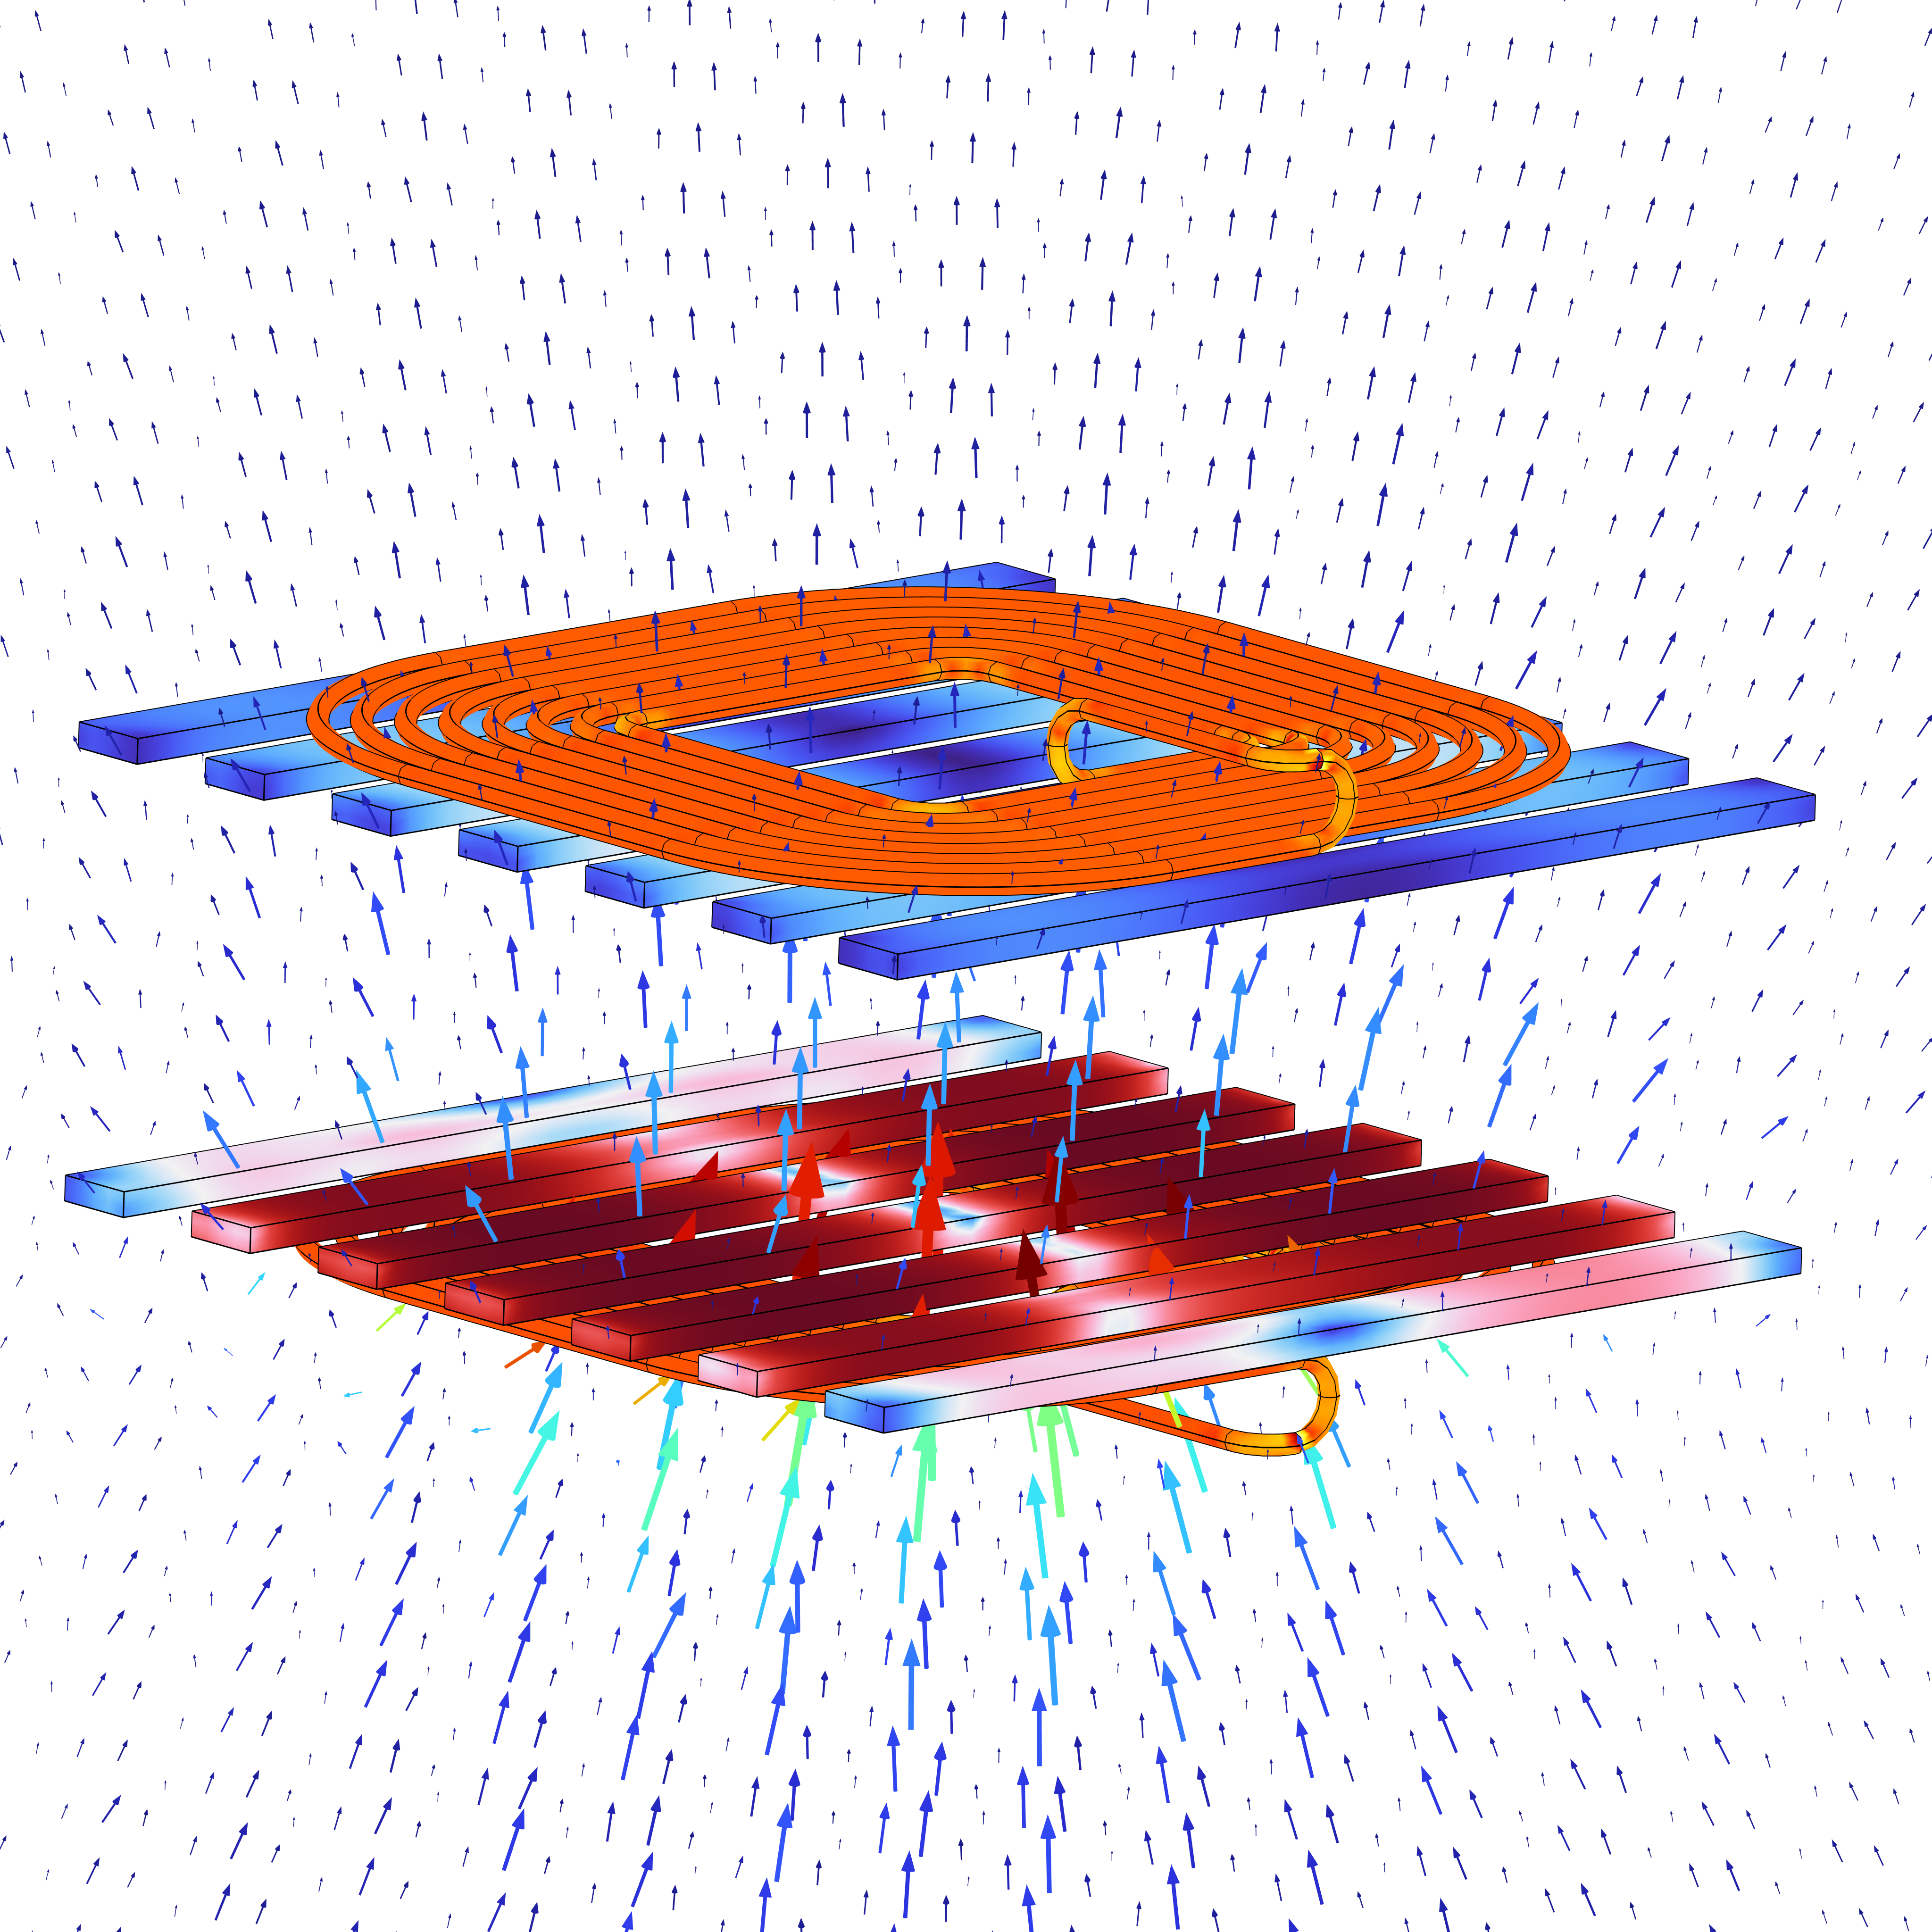
Agenda
Introduction to wireless power transfer (WPT)
WPT applications
WPT modeling workflow and component considerations
Design Example – 15W Qi Design WPT
COMSOL FEA Model
FEA + Circuit Coupling
Results
Q&A

Slide 3

What is WPT?
Wireless Power Transfer (WPT) is the transmission of electrical energy from a power source to a device without using physical wires, typically through electromagnetic fields.
Wireless power systems typically rely on magnetic resonance or inductive coupling to transfer energy between two coils.
An alternating current (AC) in the transmitter coil generates a time-varying magnetic field, which induces voltage in the receiver coil through Faraday’s Law.
From smartphones to electric vehicles—wireless power is transforming how energy moves in a contactless world.
Faraday’s Law of Induction: The basis for all inductive wireless charging.
Qi-standard wireless power transfer system

Slide 4


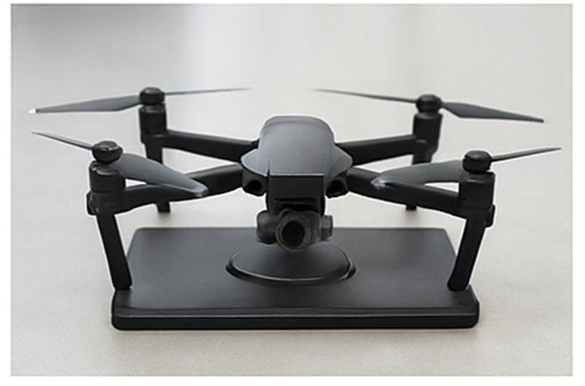
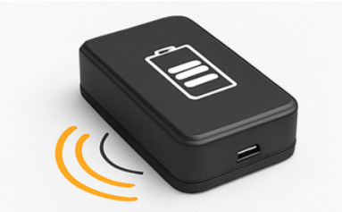

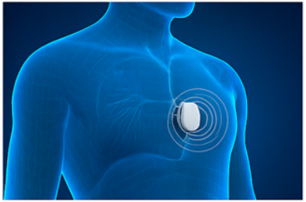
WPT: Industry Applications
Consumer Products
Automotive & EVs
Aerospace
Power & Energy
Robotics & Automation
Medical
Notes:
"This slide highlights the broad application of wireless power transfer across industries.
In consumer electronics, it's already common in phones, earbuds, and wearables, offering convenience and sealed designs.
In automotive, wireless charging is being used for EVs, e-bikes, and scooters, including both stationary and dynamic charging.
In aerospace, it's helping drones, UAVs, and satellites recharge without physical connections, especially in hard-to-reach areas.
The power and energy sector uses WPT in hazardous or remote environments, avoiding cables.
In robotics, it powers rotating joints and mobile robots continuously without wires, improving reliability.
And finally, in medical devices, wireless charging enables sealed, safe implants, surgical tools, and wearables.
So, WPT is enabling safer, more reliable, and cable-free power delivery across a wide range of technologies."

Slide 5
Design vs. Performance Parameters
Design Parameters
Performance Parameters
Coil geometry (diameter, number of turns)
Coil spacing / air gap
Wire type (Litz wire, gauge)
Ferrite shield (μr, thickness, placement)
Operating frequency
Alignment tolerances
Power transfer efficiency (%)
Coupling coefficient (k)
Output power (W)
Stray magnetic field reduction (H-field)
Voltage/current ripple at receiver
Thermal rise / temperature stability
EMI / EMC compliance
Qi Standard: Wireless power transfer for consumer electronics using inductive coupling, with power levels up to 15 W (Qi) or 50 W (Qi2).
Features: Magnetic alignment, in-band communication for power negotiation, and safety mechanisms like FOD and thermal regulation.
Standards for EV: There are separate standards for WPT for EV like SAE J2954, SAE J2894/1, IEC 61980-1 etc.

Slide 6
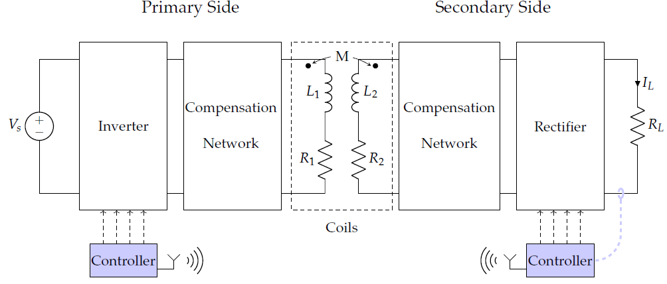
Typical WPT Components
Primary/Transmitter
  Power supply
  Inverter
  Compensation network
  Primary coil
  Primary core
  Primary shield
Secondary/Receiver
  Secondary coil
  Secondary core
  Secondary shield
  Compensation network
  Rectifier & load
Safety circuits (Foreign object detection or living object detection)
EMC/EMI shielding
Cores
Shields
Figure: Generic structure of a wireless charger.
https://doi.org/10.3390/en14061547
Notes:
A WPT system consists of two major sections — the primary (transmitter) and the secondary (receiver) — each with specific roles and components.
On the Primary Side,
It starts with a power supply, which feeds an inverter that converts DC to high-frequency AC.
The compensation network ensures efficient energy transfer by resonating with the coil at the operating frequency.
The primary coil, often mounted on a core and covered with a shield, generates the magnetic field.
On the Secondary Side,
The secondary coil captures the magnetic field and induces voltage, supported by its own core and shield.
A compensation network maximizes power capture and transfers it to a rectifier, which converts it back to DC for the load, such as a battery.
To ensure safety and compliance,
Foreign Object Detection (FOD) and Living Object Detection (LOD) prevent hazards,
and EMC/EMI shielding helps meet regulatory standards and avoids interference.
Together, these components form a tightly integrated system for efficient and safe wireless power delivery.

Slide 7
WPT Design Challenges
Most common design challenges for WPT systems
  Magnetic Effects:
    Magnetic fields
    Nonlinear magnetic materials
    Skin effects
    Proximity effects
    Excitations systems
    Lumped parameters (RLC)
    Shielding
  Multiphysics Effects:
    Thermal and/or structural
  System Level Design:
    Accurate model of load, battery or grid.
Notes:
Designing WPT systems goes far beyond coil design. There are three major categories of challenges.
1. Magnetic Effects:
We deal with strong magnetic fields, which can induce eddy currents in nearby structures.
Nonlinear magnetic materials like ferrites complicate the field distribution.
Skin and proximity effects at high frequency increase conductor losses.
The use of lumped RLC models may not fully capture these distributed effects.
Shielding becomes critical to prevent interference and meet EMC standards.
2. Multiphysics Effects:
Power loss leads to heating, so thermal modeling is essential.
Structural deformation due to thermal expansion or electromagnetic forces can affect alignment or coil shape.
3. System-Level Design:
Accurate modeling of the load, whether a battery or grid interface, is crucial.
Dynamic loads can detune the system or affect efficiency if not properly accounted for.
Solving these challenges requires a coupled electromagnetic–thermal–mechanical approach and careful system co-design.

Slide 8
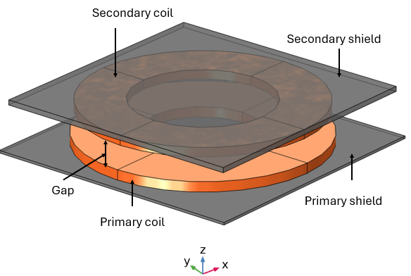
Design Constraints & Objective
Design Constraints for >15W Qi Wireless Power Transfer
  Primary coil OD = 48 mm
  Primary coil ID = 23 mm
  Secondary coil OD = 47 mm
  Secondary coil ID = 28 mm
  Shielding on both sides
Design Target
  Output power >15 W for frequency 110 kHz.
  Efficiency >95% for all operation.

Slide 9
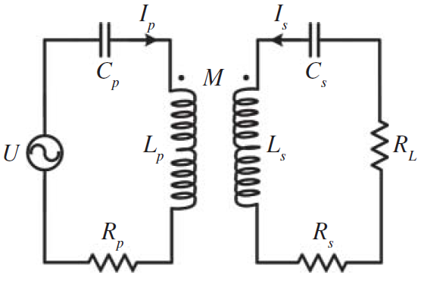
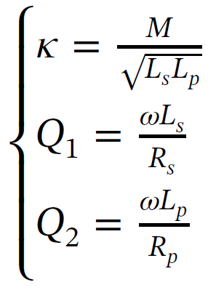
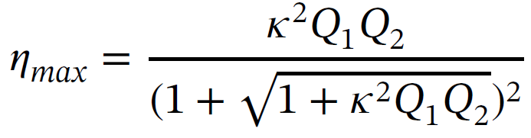
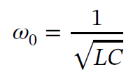
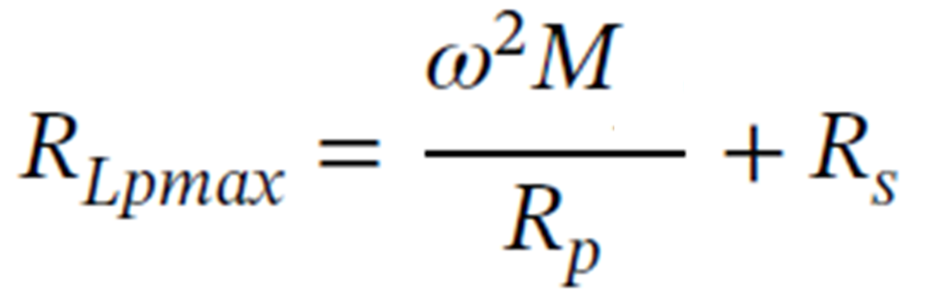
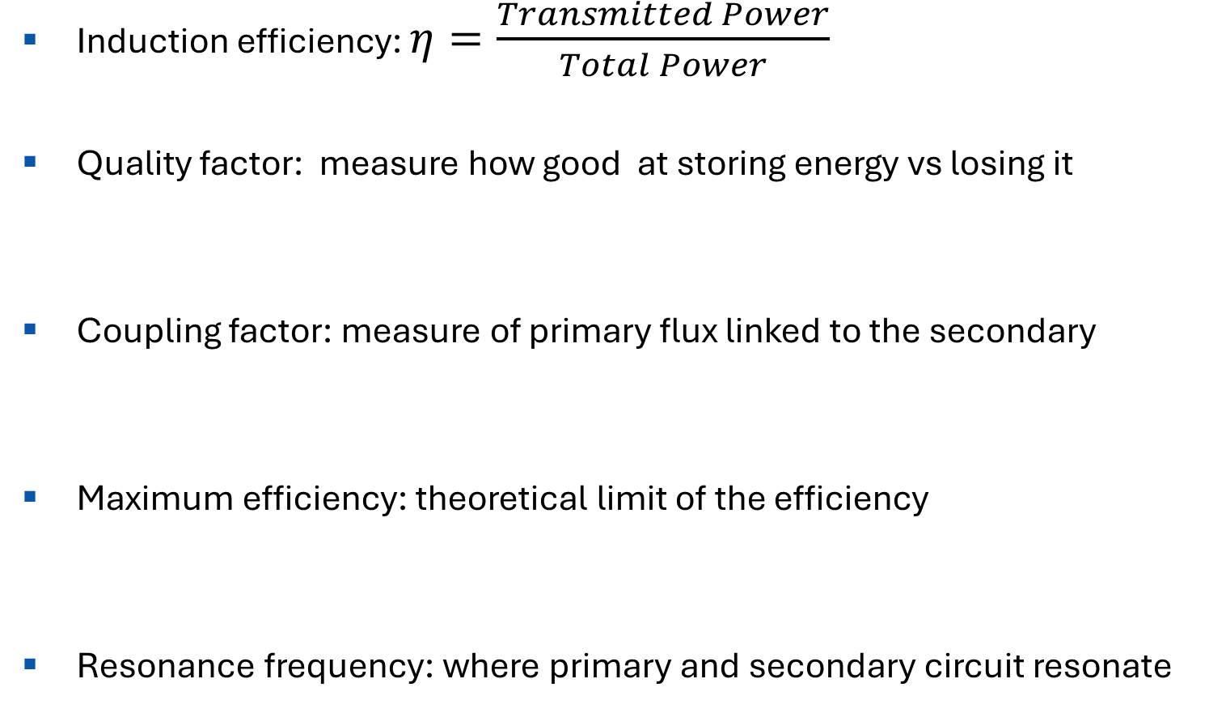
Important Equations
Induction efficiency: $η=\frac{Transmitted Power}{Total Power}$
Quality factor: measure how good at storing energy vs losing it
Coupling factor: measure of primary flux linked to the secondary
Maximum efficiency: theoretical limit of the efficiency
Resonance frequency: where primary and secondary circuit resonate
Primary
or
Transmitter
Secondary
or
Receiver
Circuit diagram of a series-series compensation of a WPT.
Where:
ω – angular frequency
L_{p} – primary inductance
L_{s} – secondary inductance
M – mutual inductance
R_{p} – primary resistance
R_{s} – secondary resistance
Notes:
The Quality Factor, or Q-factor, is a measure of how "good" a resonant circuit is at storing energy versus losing it.
In wireless power transfer, a higher Q-factor means lower energy losses in the coils and a sharper resonance, which is critical for efficient power transfer.
Mathematically, for an RLC circuit:
Q = (ωL) / R
– where ω is the angular frequency, L is the inductance, and R is the resistance.
A high Q helps achieve better efficiency and stronger coupling, but may make the system more sensitive to detuning.
The Q-factor and bandwidth are inversely related in a resonant system. A high Q-factor means narrow bandwidth, and a low Q-factor means wider bandwidth.
Mathematically:
Bandwidth (Δf) = f₀ / Q

Slide 10
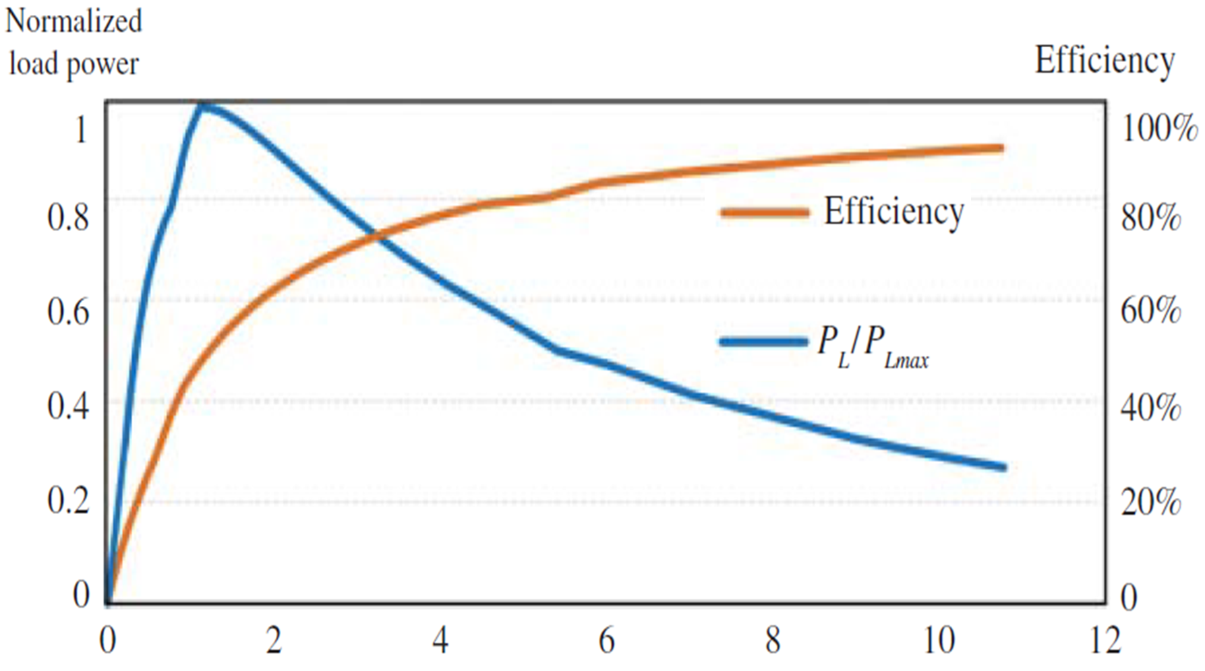
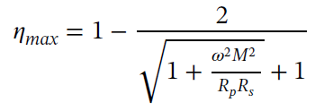

Efficiency & Maximum Power Transfer
The maximum power is transferred to the load when the load resistance matches the Thevenin (or reflected) source resistance.
At this point, the power delivered to the load is maximum, but not the efficiency.
As load resistance increased beyond the matched point, less current is drawn, so less power is transferred, but losses are reduced, so efficiency increases.
Efficiency can be increased by reducing the internal resistance (R_{p} and R_{s}) of the primary and secondary coils and by increasing the mutual inductance (M).
There is always some loss due to inverters, ratifiers, and resonance circuits.
Z_{R} = reflected source impedance
R_{p} = primary resistance
Rs = secondary resistance
M = mutual inductance
$$\frac{ZR}{Rp}$$
Notes:
In wireless power transfer systems, maximum power is delivered to the load when the load resistance matches the source’s Thevenin or reflected resistance.
At this point, the power transfer is maximized, but efficiency is not — because significant power is also lost internally.
As the load resistance increases beyond the matched point, less current is drawn, so the power delivered drops, but efficiency improves due to reduced conduction losses.
Efficiency can be enhanced by minimizing the internal resistance of the coils (Rp and Rs) and by increasing the mutual inductance (M) between the primary and secondary coils.
However, it’s important to note that inverters, rectifiers, and resonant circuits always introduce additional losses, so system-wide optimization is essential.
"Maximum power transfer occurs when the load resistance is matched, but that point does not yield the highest efficiency.
For high-efficiency operation, the load resistance is typically set higher than the matched condition, sacrificing some power for reduced losses.“
Page # 37 of Book by Zhen Zhang and Hongliang Pang “Wireless Power Transfer”.

Slide 11
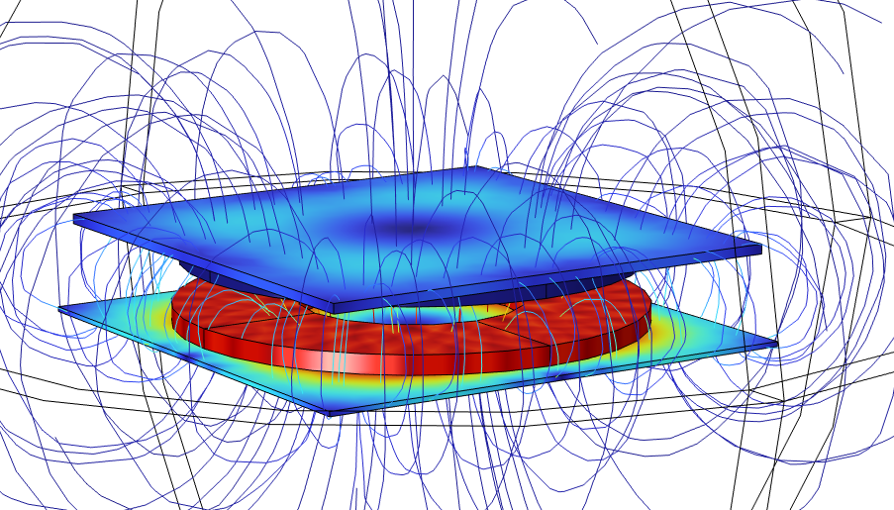
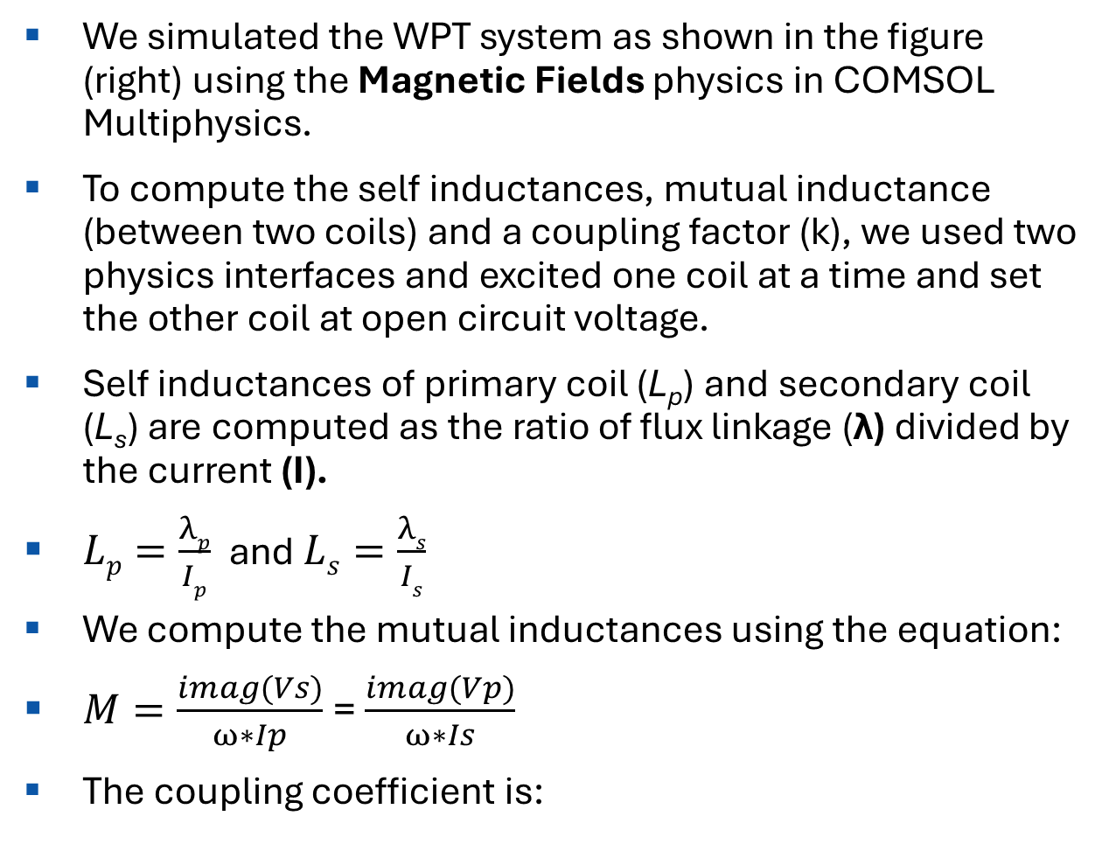
Electromagnetic Simulation
We simulated the WPT system as shown in the figure (right) using the Magnetic Fields physics in COMSOL Multiphysics.
To compute the self inductances, mutual inductance (between two coils) and a coupling factor (k), we used two physics interfaces and excited one coil at a time and set the other coil at open circuit voltage.
Self inductances of primary coil (L_{p}) and secondary coil (L_{s}) are computed as the ratio of flux linkage (λ) divided by the current (I).
$Lp=\frac{λp}{Ip}$ and $Ls=\frac{λs}{Is}$
We compute the mutual inductances using the equation:
$M=\frac{imag(Vs)}{ω∗Ip}$ = $\frac{imag(Vp)}{ω∗Is}$
The coupling coefficient is:
Model geometry
Magnetic flux density and flux lines around the device
Notes:
Magnetic Fields 1: We excited only Primary and set secondary current is zero.
Magnetic Fields 2: We excited only Secondary and set Primary current to zero.

Slide 12
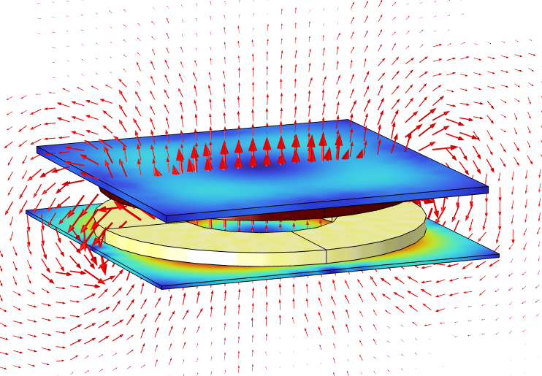
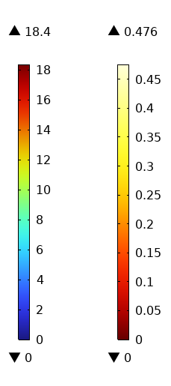
Magnetic Flux Density and Current Density
We plot the magnetic flux density norm (mT) in the shield and current density norm (A/mm²) in the coils.
The maximum flux density is 18.4 mT at 1 A current through the coils. The magnetic flux and current density both within the reasonable limits for the safer design.
mT
A/mm²
Arrow plot of magnetic flux density in log scale

Slide 13
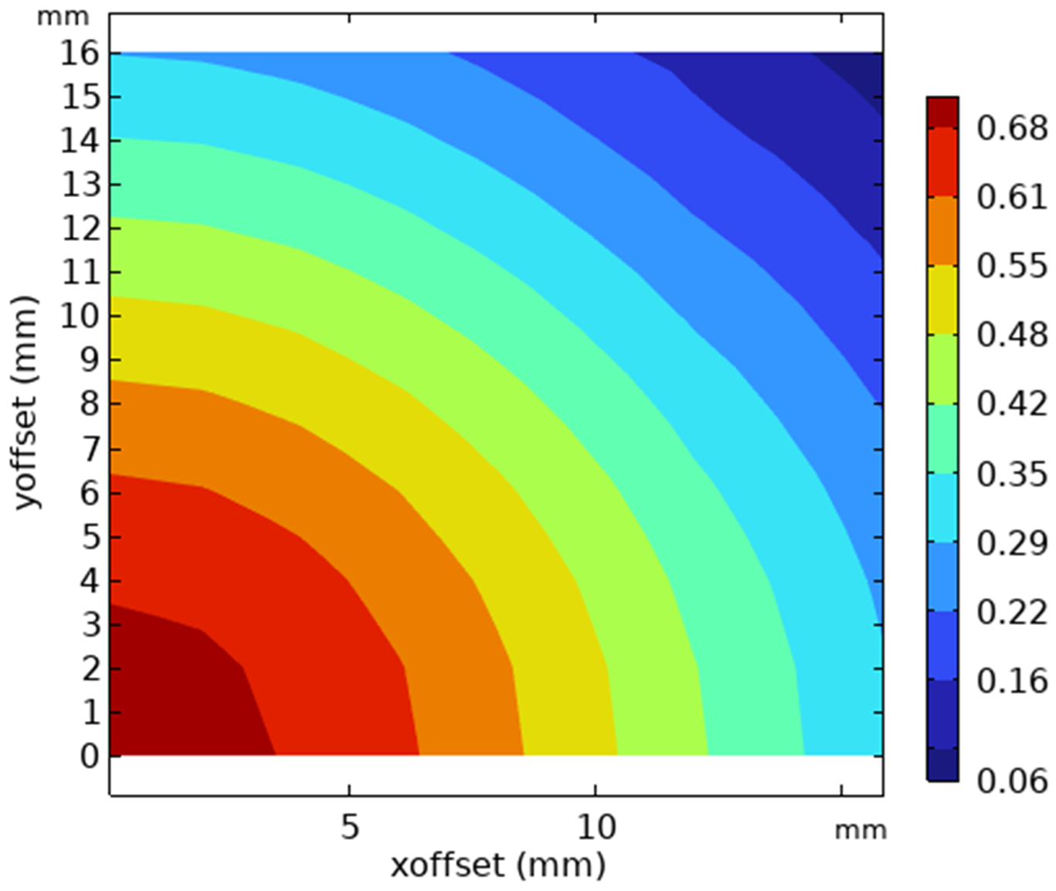
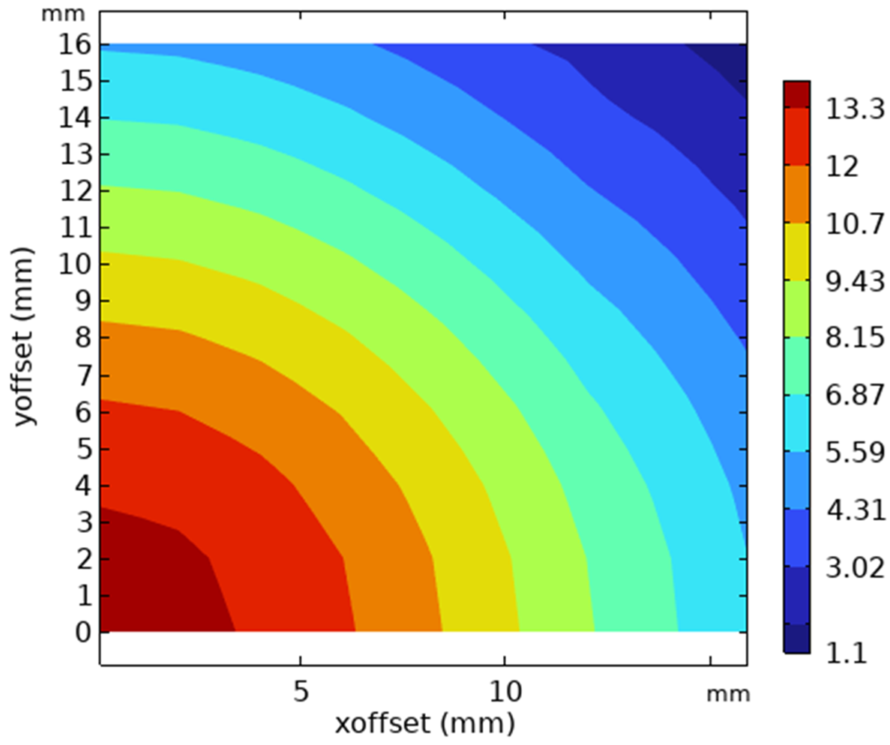
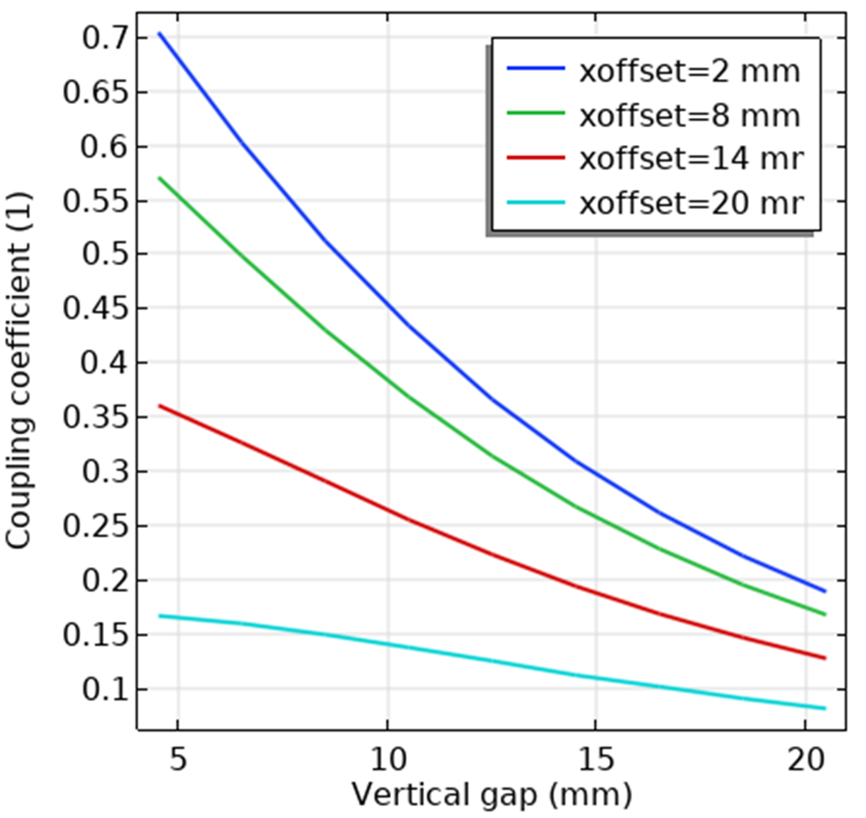
Coupling Coefficient and Mutual Inductance
We perform the parametric sweep study to find the variation of coupling coefficient and mutual inductance with vertical, x-axis misalignment, and y-axis misalignment.
The maximum coupling coefficient is 0.7, which is reduced to 0.18 with an x-offset of 20 mm.
uH
Coupling coefficient vs vertical gap.
Coupling coefficient
Mutual Inductance

Slide 14
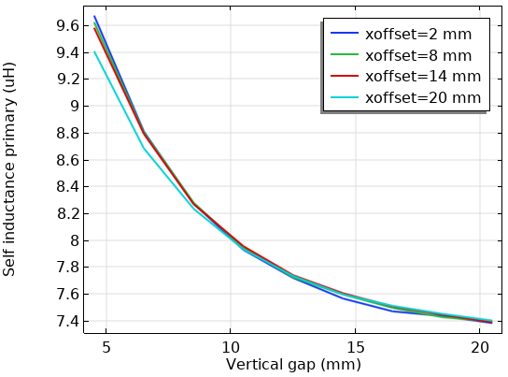
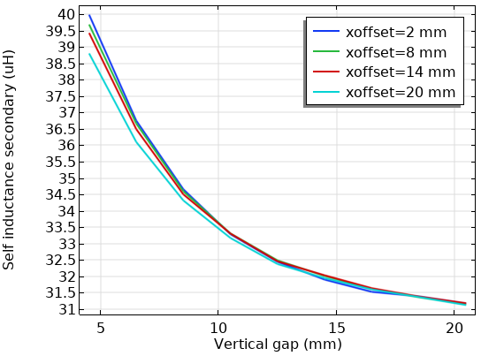
Self Inductances
Self-inductance decreases as the vertical gap increases.
Vertical gap has a strong impact on coupling; x-axis misalignment has minimal effect.
Key design insight: minimize vertical gap for stronger coupling and higher efficiency.

Slide 15
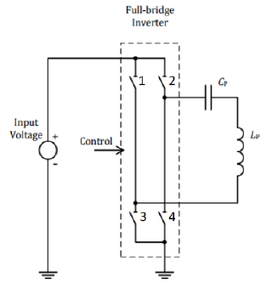
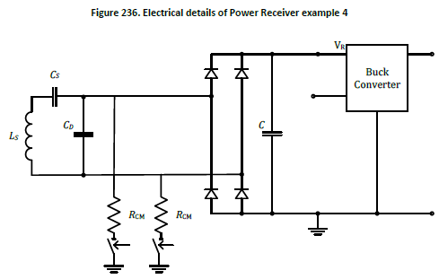
Full Circuit Design
The full circuit diagram of power transmitter design MP-A4 and electrical detail of power receiver example 4 as per Qi standard is shown below.
The input voltage is converted to 100 kHz AC to the primary coil, the induced voltage in the secondary with compensation network and rectification is converted to a DC voltage.
The resistive loss in the load after the buck converter (output voltage of 5 V) is the output power.
The communication modulator consists of two capacitors in series with two switches, each with a capacitance of R_{cm} = 30 ohms.
Full-bridge rectifier
Transmitter | Receiver
Lp = 8.9 uH | Ls=33.6 uH
M = 42.96 uH | M=42.96 uH
Cp=276 nF | Cs=56 nF
 | RL = 5 Ohm
 | Cd =0.8 nF
 | Cf = 33 uF
M
L_{s}
filter
Load
Coils + Shields

Slide 16
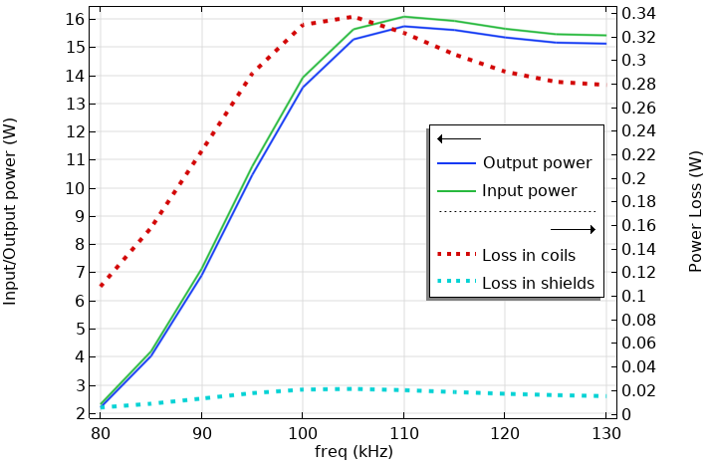
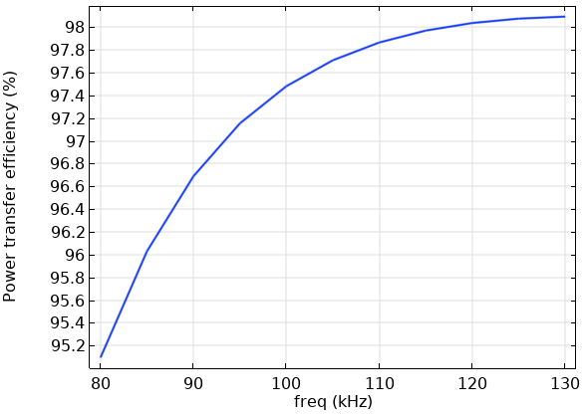
FEA Circuit Coupling
We coupled the FEA model with the compensation and load circuit via Electrical Circuit interface.
We simulated the coupled simulation for various design parameters: frequency range, capacitor and load resistance tuning, compute the losses and efficiency as demonstrate below.
97.8%

Slide 17
Design Performance
Design factors affecting performance:
  Compensation and load tuning: The resonant capacitor and load resistance are tuned to achieve maximum power transfer.
  Frequency alignment: Resonance ensures minimal reactive losses and optimal energy transfer.
  Coupling and alignment: Coil geometry and separation determine the magnetic coupling strength.
Performance evaluation:
  Input voltage around 12 V AC, output power ~16 W, efficiency ~98%.
  Computed input power, output power, and losses across the operating frequency band to verify performance.
Conclusion: The optimized design meets the target power and efficiency criteria.

Slide 18
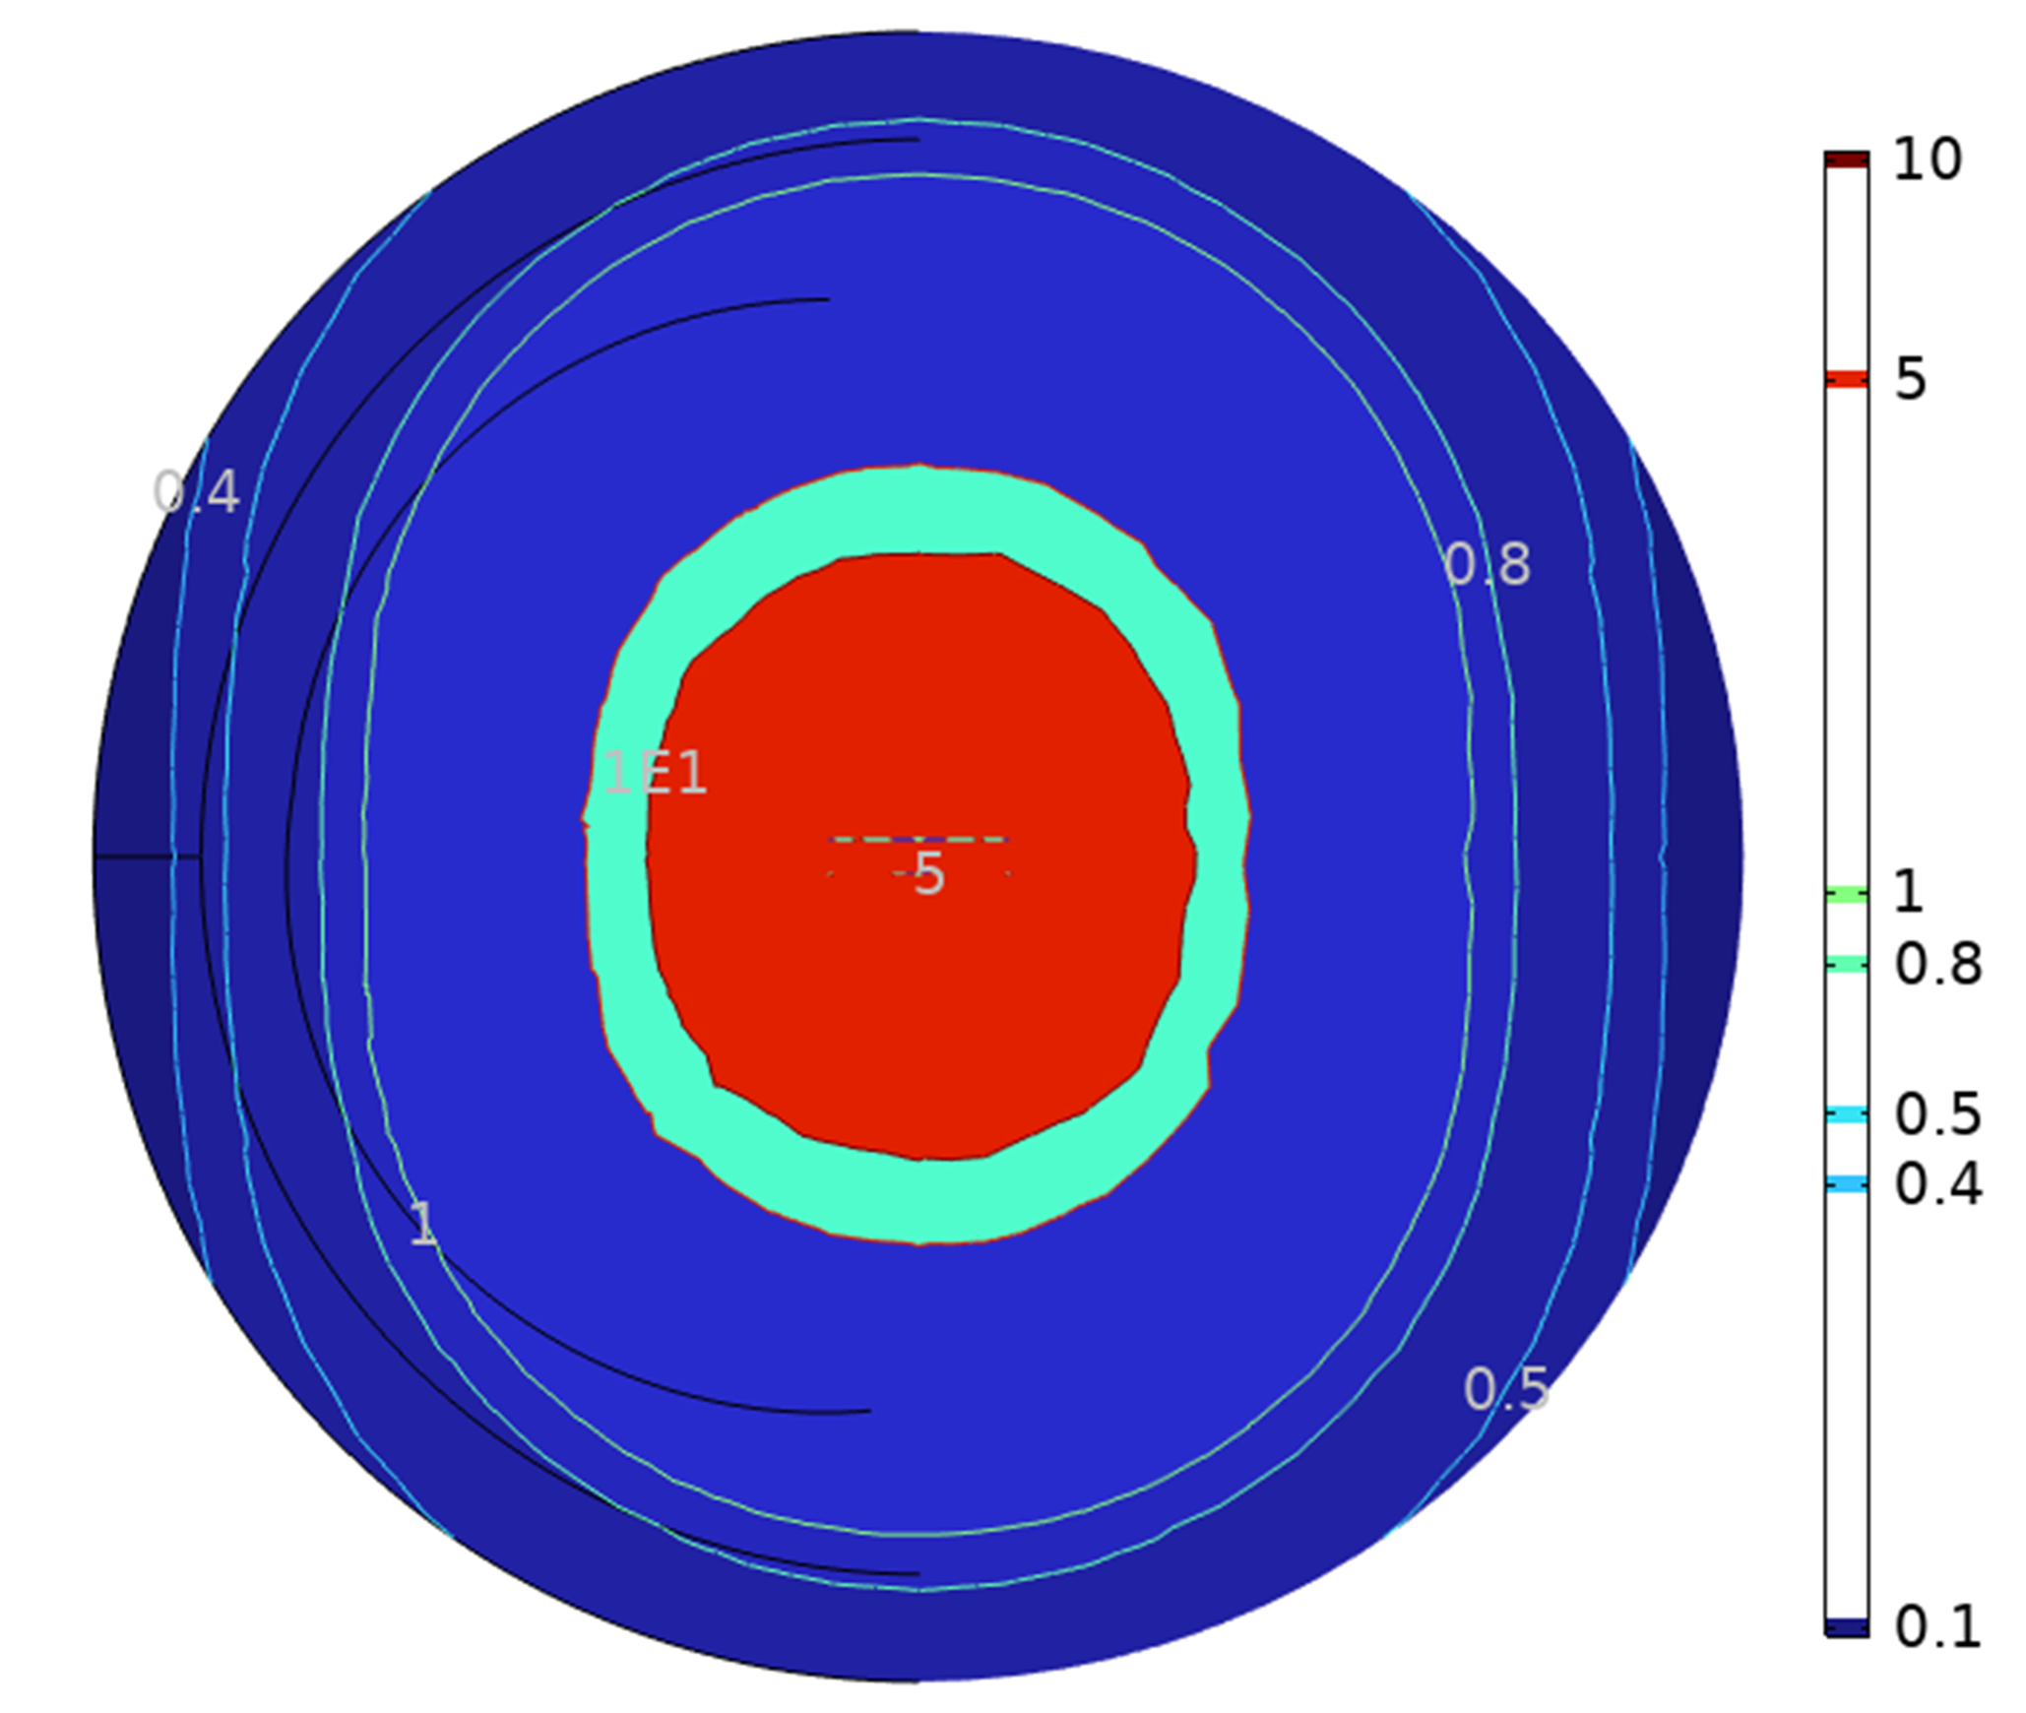
Leakage Flux Around the Device
We showed the leakage magnetic field strength (in A/m) around the device at the cross-section of the device.
Magnetic field strength measured at ≥15 cm from the charger, under maximum power, must remain ≤ 0.815 A/m (50% of the FCC maximum power exposure limit), ensuring Qi standard compliance.
The design satisfy the above requirements in all direction.
A/m
14cm
mT
10cm
Cross-sectional contour plot of magnetic field strength (A/m)
Notes:
Parameter Value: Frequency Range~110–205 kHz (Qi BPP/MPP) Typical Leakage Limit≤ 27–100 µT RMS, depending on proximity
Regulation Basis ICNIRP, IEC 62311, FCC Part 15, CE EMC
Design Target~10–30 µT at 2 cm from pad edge

Slide 19
Conclusion
We introduced the wireless power transfer, its types, and applications for various industries.
We showed the workflow of modeling the WPT system in COMSOL.
We discussed various design parameters and ways to optimize/tune them for optimal power transfer.
We demonstrate the use of COMSOL to design the system that meets the power and efficiency requirement as per the Qi Standard.
  Output power >15 W for frequency 110 kHz.
  Efficiency >95% for all operation.
Simulation such as these can be used to optimize the WPT system, reducing the number of prototypes and time to market.

Slide 20
Q&A
Contact:
npaudel@veryst.com
www.veryst.com

