Slide 1
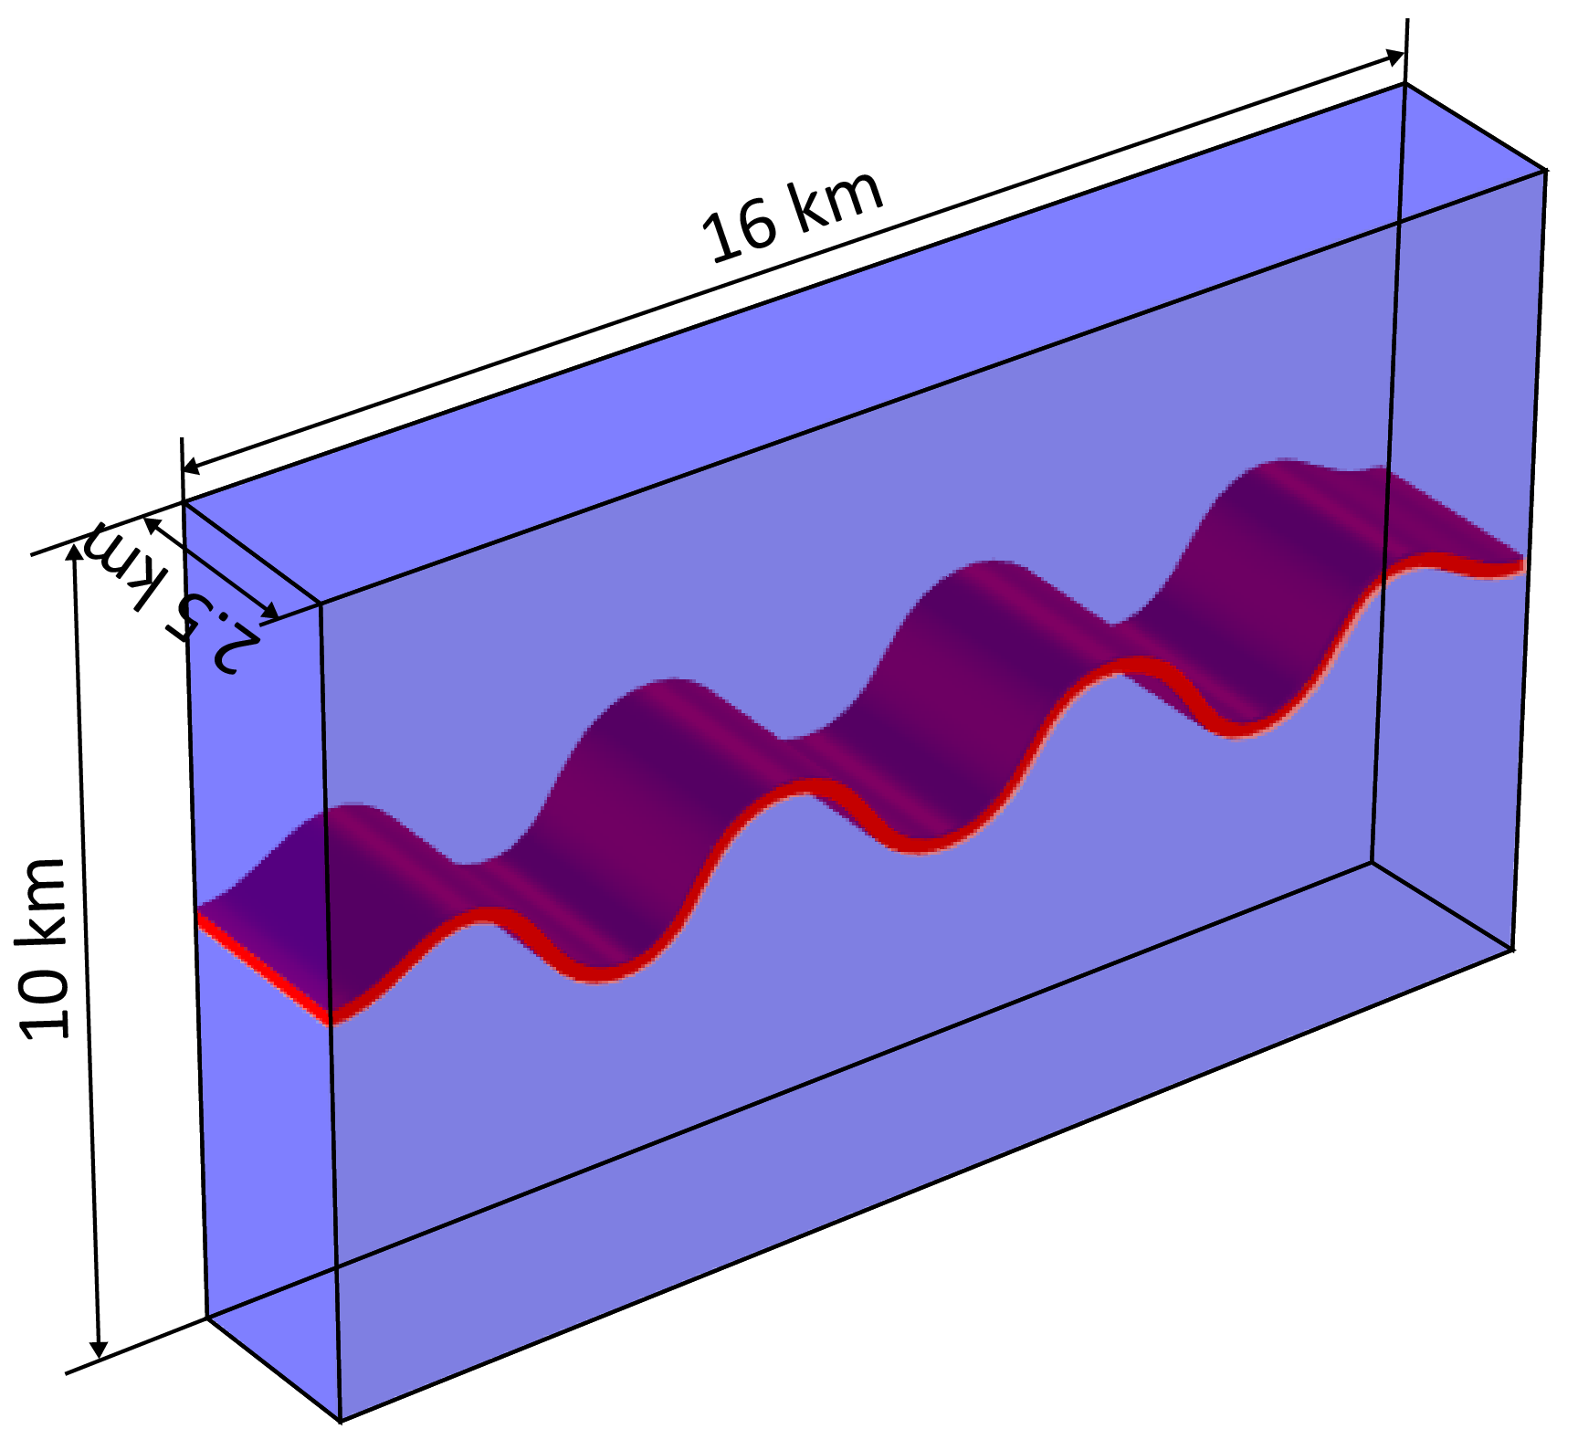
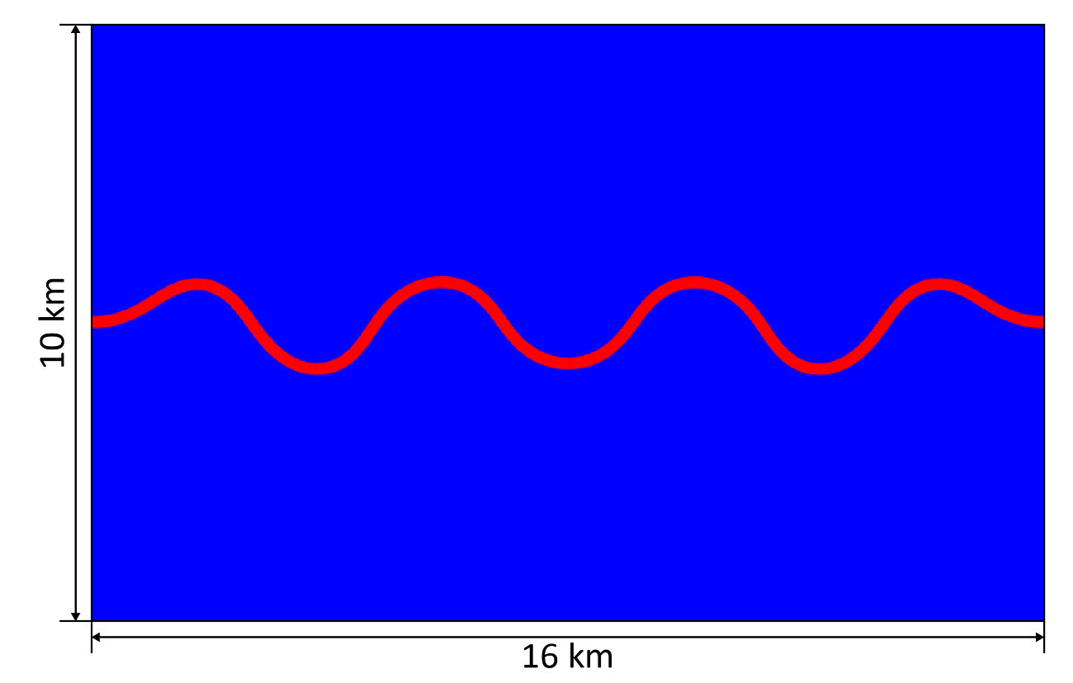
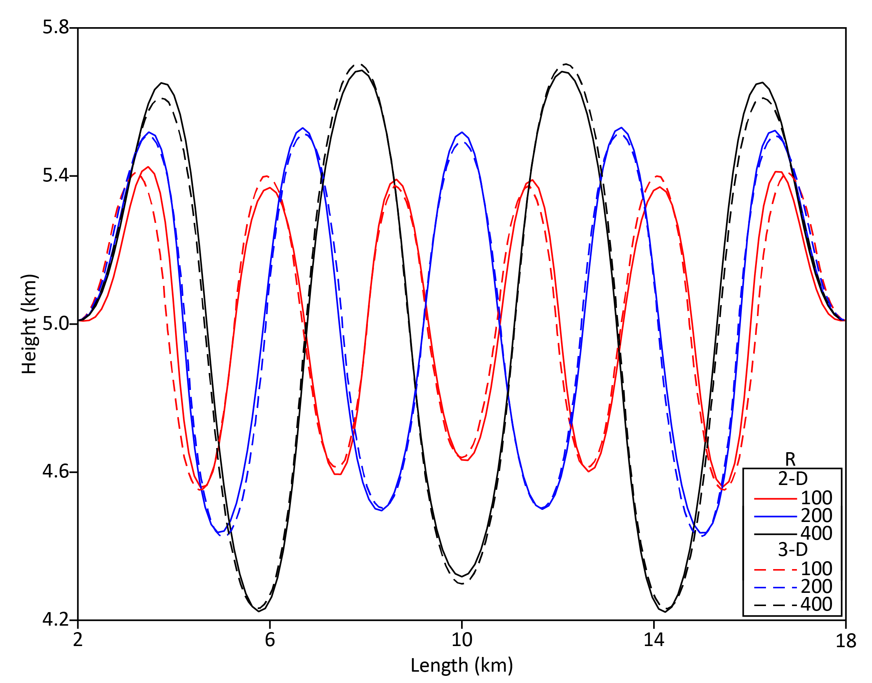
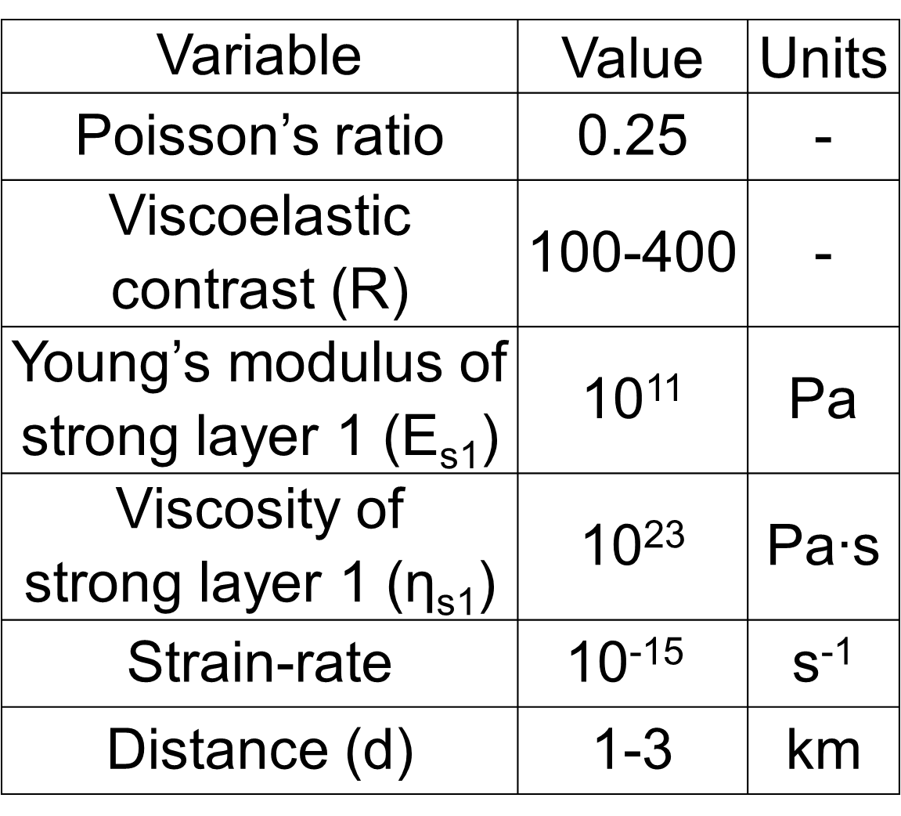
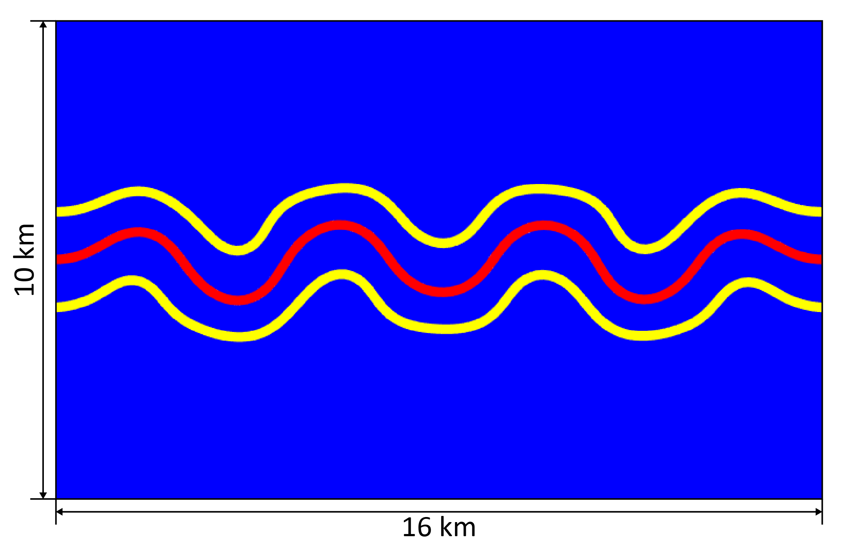
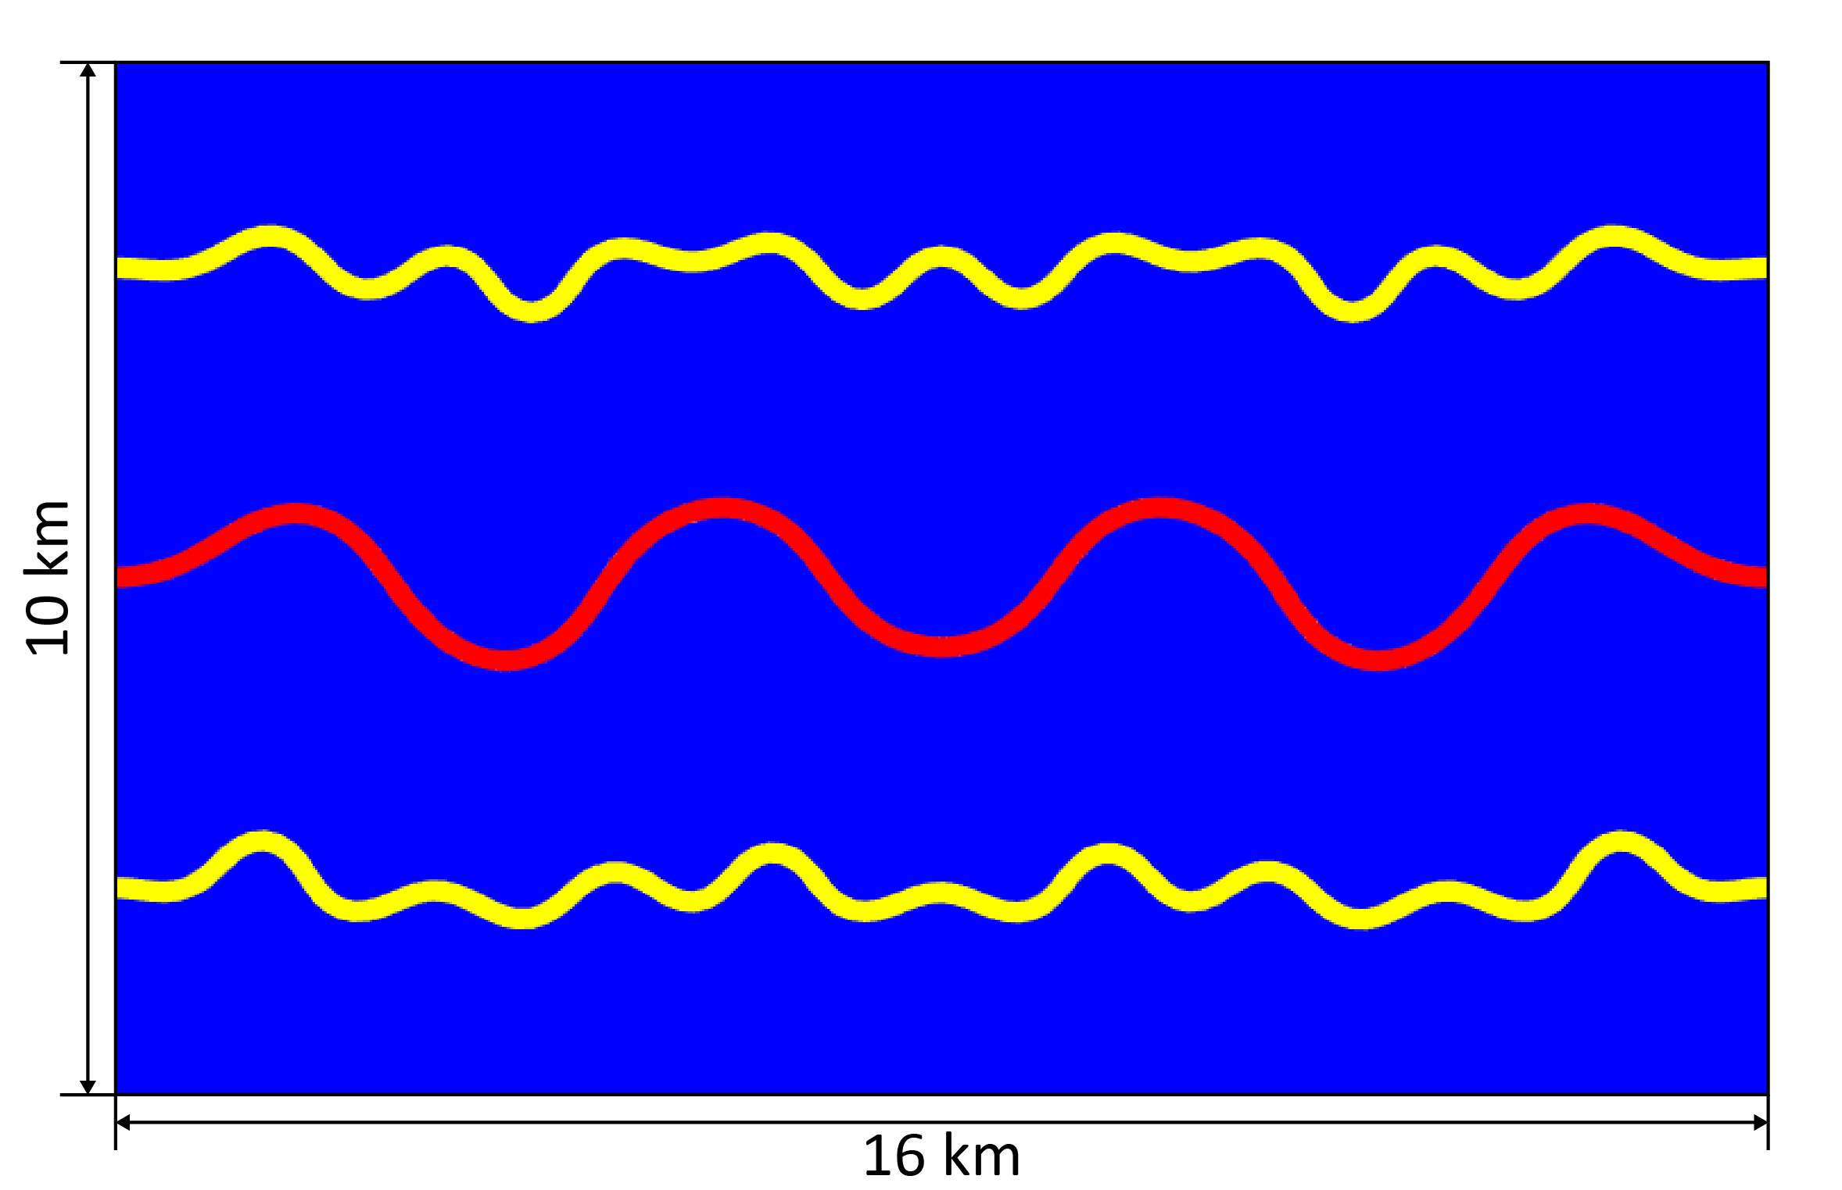
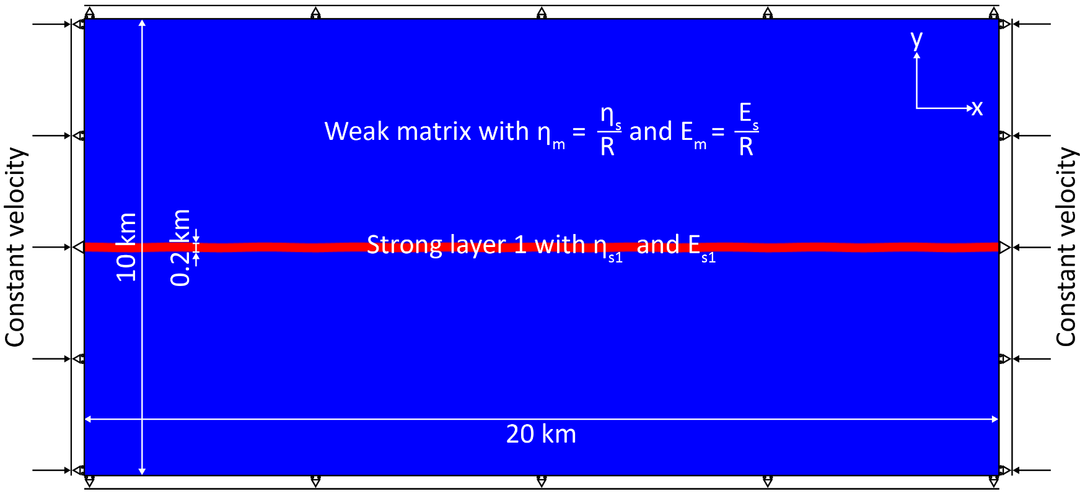
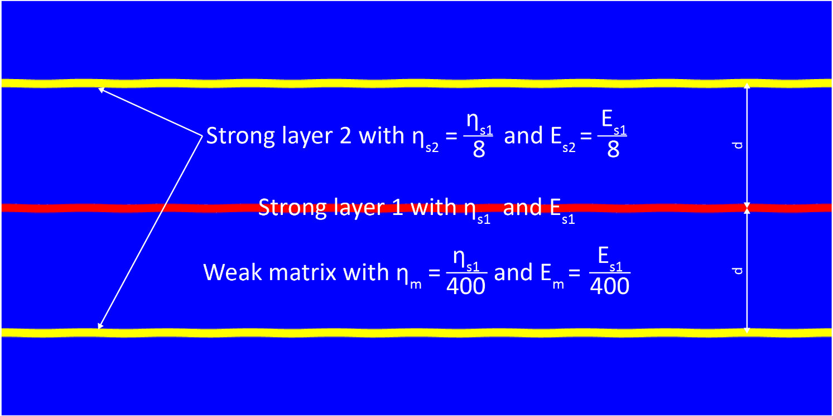
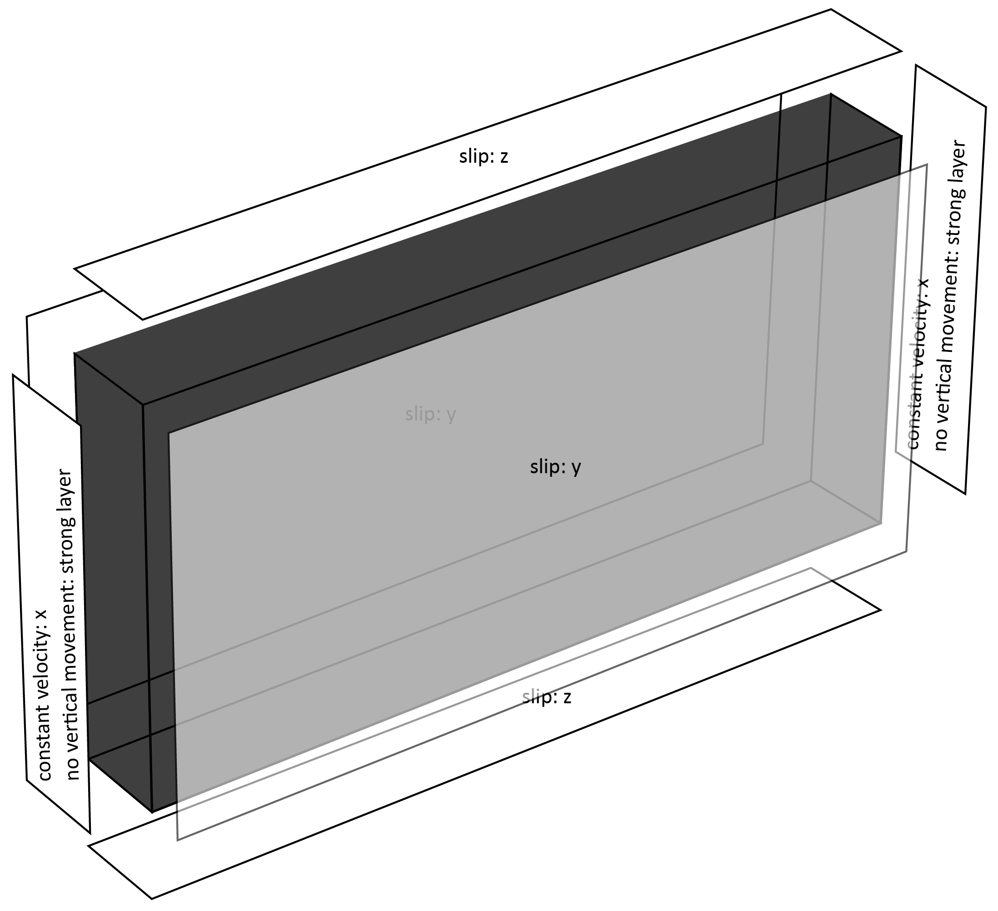
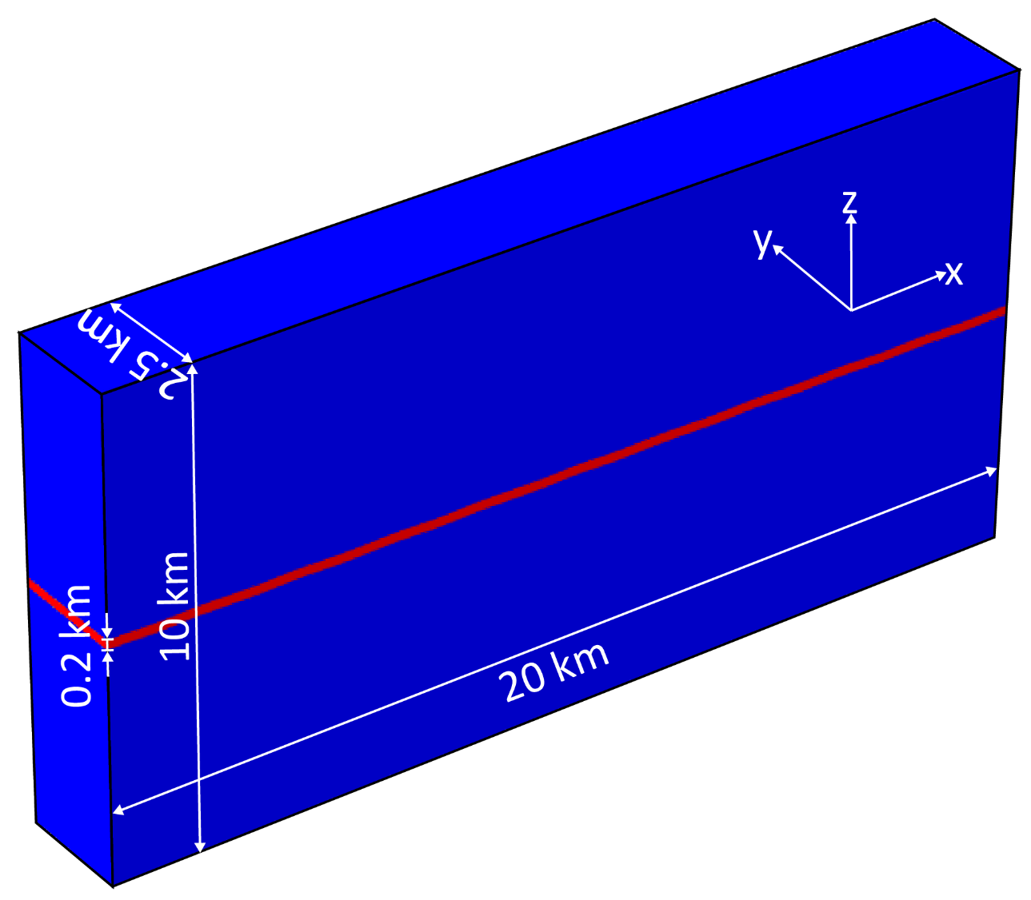


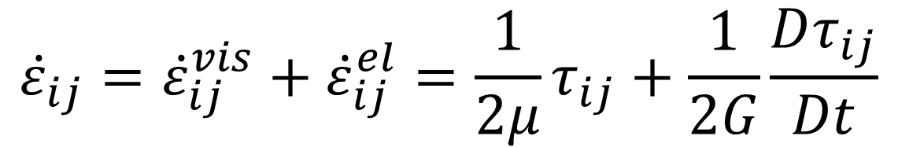
Buckling structure modeling of viscoelastic lithosphere
using COMSOL Multiphysics®
Seok-Hyeon Do¹, Byung-Dal So¹
1. Department of Geophysics, Kangwon National University, Chuncheon, Gangwon-do 24341, South Korea
INRODUCTION:
The buckling structure is a very common structure at material interface with viscoelastic contrast under compression. The buckling includes information with stress history (e.g., the magnitude and direction). Based on the information, we can infer the geometry of the lithosphere in the past, and predict how the lithosphere evolves in the future. We study the buckling structure in the material with various lithospheric strength and test the effects of viscoelastic contrast (R) and the distance between layers (d).
RESULTS:
These are 2D and 3D single layer modeling results (R =200 and 20% compression).
Figure 3. 2D buckling structure
Figure 4. 3D buckling structure
As R increases, the wavelength and amplitude increase.
COMPUTATIONAL METHODS:
We used the Lagrangian solid mechanics approach in time-dependent manner, and assumed that the lithosphere behaves as Maxwell viscoelastic solid.
The model consists of a weak matrix and a strong layer imposed with initial perturbation ($0.01 km×\sin{πx}$). The side walls of the domain are subjected to lateral compression at the constant strain rate, and are free in vertical movement except for the strong layer. We applied "force linear strain" to the weak matrix.
Table 2. Model parameters
$$\frac{∂σ_{ij}}{∂x_{j}}=0$$
1) momentum equation
$${\dot{ε}}_{ij}={\dot{ε}}_{ij}^{vis}+{\dot{ε}}_{ij}^{el}=\frac{1}{2μ}τ_{ij}+\frac{1}{2G}\frac{Dτ_{ij}}{Dt}$$
2) constitutive relation
Figure 5. Amplitude and wavelength of 2D (solid lines) and 3D (dashed lines) single layer modelsdepending on R (different colors)
$\frac{Dτ_{ij}}{Dt}=\frac{∂τ_{ij}}{∂t}+v_{k}\frac{∂τ_{ij}}{∂t}−W_{ik}τ_{kj}+τ_{ik}W_{kj}$ $where$ $W_{ij}=\frac{1}{2}\left(\frac{∂v_{i}}{∂x_{j}}−\frac{∂v_{j}}{∂x_{i}}\right)$
As d increases, the influence of the most strong
layer on overall features becomes smaller.
Table 1. Description of symbols
Figure 6. 2D multilayer
buckling structure (d = 1)
Figure 7. 2D multilayer
buckling structure (d = 3)
CONCLUSIONS: In our study, we confirmed the Comsol multiphysics® can simulate the buckling structures depending on viscoelastic contrast and the distance between layers, which follows the relation proved theoretically. Furthermore, we found that the buckling structures from 2D and 3D models are similar. From a geodynamic perspective, we can apply Comsol multiphysics® to lithospheric buckling to explore the compressional geodynamic structures such as subduction zones, passive margins, and orogens.
Figure 1. 2D single layer
model setup
Figure 2. 2D multilayer
model setup
Acknowledgement: This research was supported by the National Research Foundation of Korea (NRF-2014R1A6A3A04055841)and Ministry of the Interior and Safety as Earthquake Disaster Prevention Human resource development Project.
REFERENCES:
Biot, Theory of Folding of Stratified Viscoelastic Media and Its Implications in Tectonics and Orogenesis1, Geological Society of America bulletin, 72, 1595-1620, (1961)
Zhang et al., Computer simulation of single-layer buckling, Journal of Structural Geology, 18, 643-655 (1996)
Schmid and Podladchikov, Fold amplification rates and dominant wavelength selection in multilayer stacks, Philosophical Magazine, 86, 3409-3423 (2006)
Figure 3. 3D single layer model setup
Excerpt from the Proceedings of the 2019 COMSOL Conference in Cambridge

