Slide 1
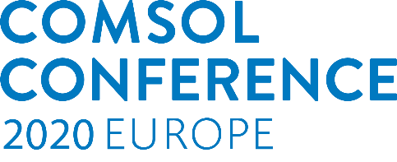


Shape and Topology Optimization of Loudspeaker Drivers
René Christensen, PhD
Senior Specialist Vibroacoustics
GN Hearing
Notes:
My name is René Christensen and I work for the Danish company GN Hearing, where we do hearing aids. My presentation is on shape and topology optimization, not of hearing aids, but of loudspeakers. The reason being that I can draw loudspeaker CAD myself, and that the geometry does not belong to a company, so I am free to share my results. Note that none of the loudspeaker designs you will see are intended to be produced, and so the nominal improvements are not important. Instead, I aim at showing the many ways you can combine physics and optimization in COMSOL Multiphysics.

Slide 2
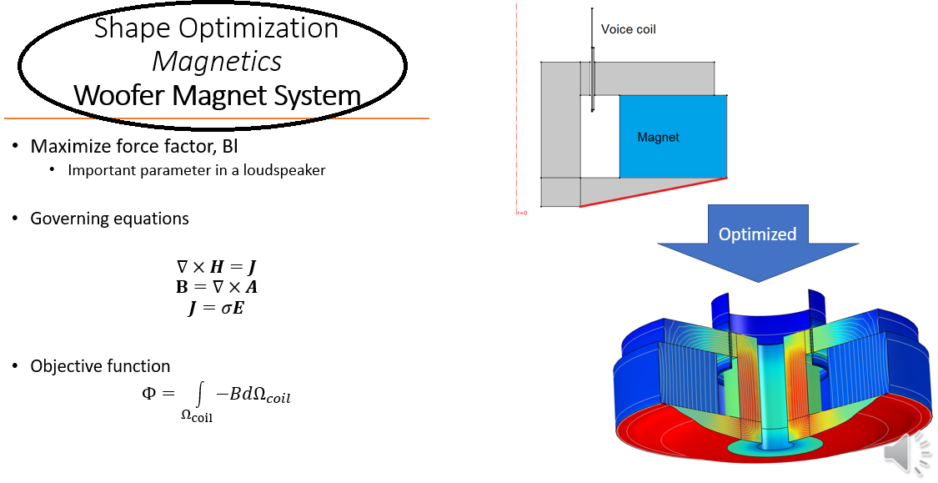
Introduction
Optimization
Shape vs Topology Optimization
Examples
Compression Driver – Acoustic Shape Optimization
Woofer Magnet System – Magnetics Shape Optimization
Woofer Basket – Solid Mechanics Topology Optimization
Woofer Basket – Solid Mechanics Shape Optimization
Woofer – Vibroacoustic Shape Optimization
Tweeter – Acoustic Topology Optimization
Woofer – Heat Conduction (Solid) Topology Optimization
Conclusion
Questions
Notes:
I will give a very brief introduction to shape and topology optimization and how they differ. And then we will look at several examples of the use of shape and topology optimization for different loudspeaker applications, such as compression drivers, woofers baskets, tweeter phase plugs, with the physics ranging across acoustics, solid mechanics,magnetostatics, and even heat conduction. For each example the type of optimization, the type of physics, and the application in question is given the headline, and the objective and governing equations are shown on the left of the slide, with the example visualized on the right side of slide.

Slide 3
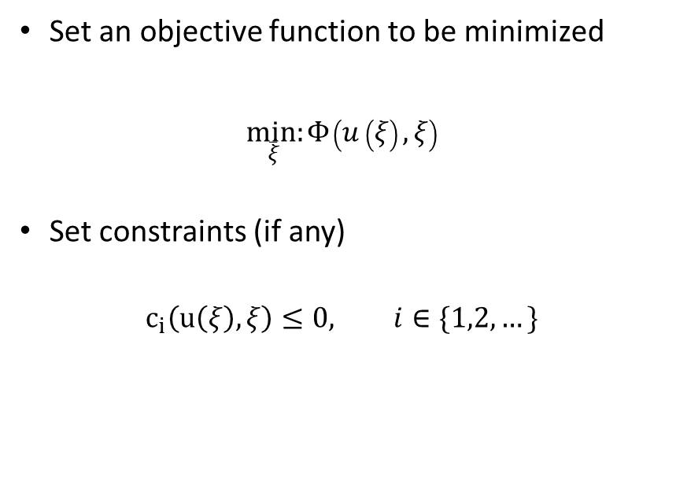





Optimization
Shape optimization
Topology Optimization
Set an objective function to be minimized
$\underset{ξ}{min:}{Φ}\left(u\left(ξ\right),ξ\right)$
Set constraints (if any)
$$c_{i}\left(u\left(ξ\right),ξ\right)≤0, i∈\{1,2,…\}$$
$$ξ=[β_{11},β_{12},..,β_{21},β_{22},…β_{mn}]$$
$$ξ=0.5$$
$$ξ=1$$
$$ξ=0$$
Notes:
For optimization in general we have a target or objective, where we seek to typically minimize some objective function. It could for example be that we want to minimize the difference between a desired response and the response that we have in our finite element simulation. And most often we also have some constraints to include in the optimization. For shape optimization we allow boundaries to deform, so for 2D geometries we deform edges, and for 3D we deform surfaces. In contrast to that, we have topology optimization where a certain domain is assigned as a design domain, where a domain variable is to be varied continuously across this domain, aiming at having a binary design, where only the extreme values 0 or 1 are used, as they will refer to for example two different available materials, or to material and void, or to solid mechanics and acoustics.

Slide 4
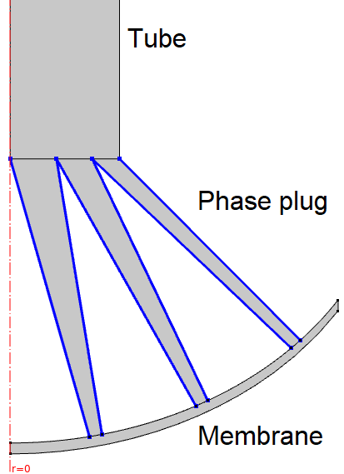
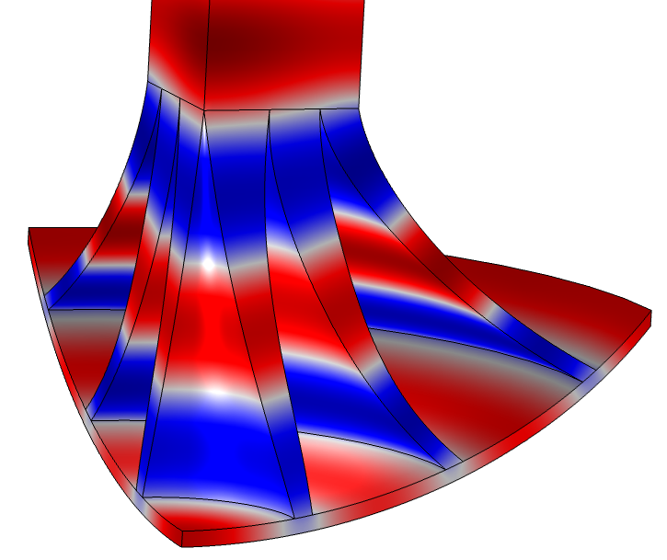
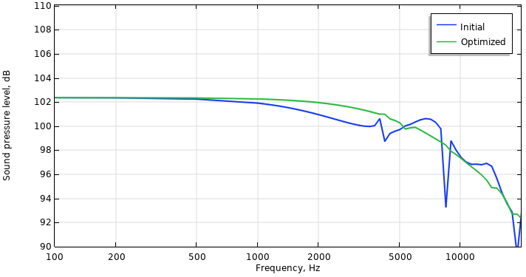

Shape Optimization Acoustic Compression Driver Phase Plug
Recreated from:
“Numerical Optimization Strategies for Acoustic Elements in Loudspeaker Design”. Bezzola, Andri. New York, NY, USA : Audio Engineering Society, 2018. AES 145th Convention. pp. 1-12.
Minimize variance between target response and actual response
A smoother response is desired
Governing equation
$$∇∙\left(\frac{1}{ρ}∇p\right)+\frac{ω^{2}}{K}p=0$$
Objective function
$$Φ{∝\left(SPL−{SPL}_{target}\right)}^{2}$$
Optimized
Notes:
The first example here is shape optimization of a compression driver phase plug, with the physics being acoustics. We seek to have smooth sound pressure level at the output of a tube attached to the compression driver, and so we assign 6 lines on the phase plug to be shape optimized in an axisymmetric geometry. The deformations of the boundaries are controlled via Bernstein polynomials. The resulting geometry is shown at the bottom along with the initial and optimized sound pressure level, and we see that we can obtain a much smoother response with the curved boundaries compared to the straight boundaries in the initial geometry.

Slide 5
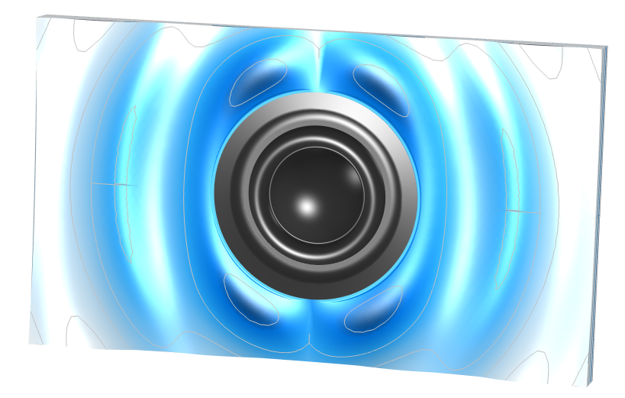
Shape Optimization Acoustic Waveguide
Of course also possible for external problems, such as waveguides and phase plugs
Directional index can be used in objective function
Notes:
While the compression driver is an internal acoustics problem, we can also use shape optimization for external acoustics problems, such as waveguides as depicted here, or phase plugs, using the same methodology.

Slide 6
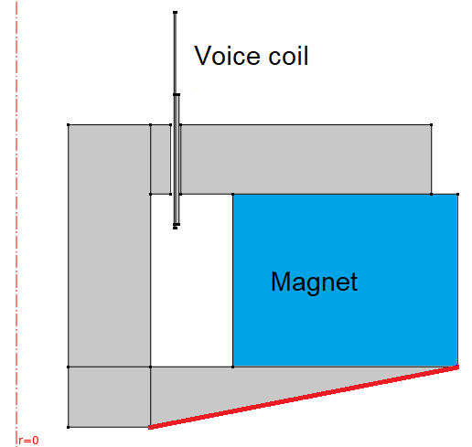
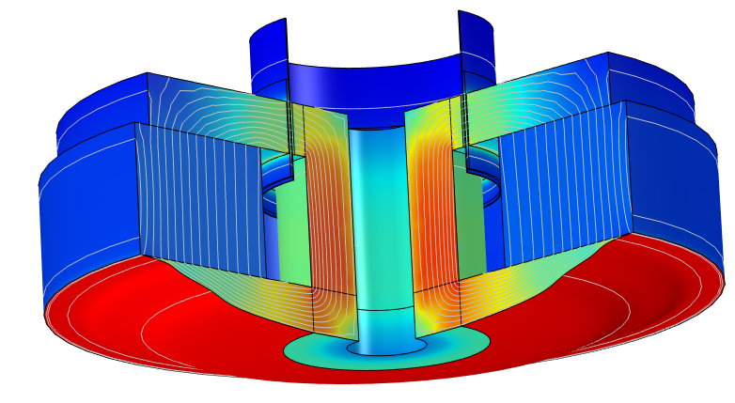
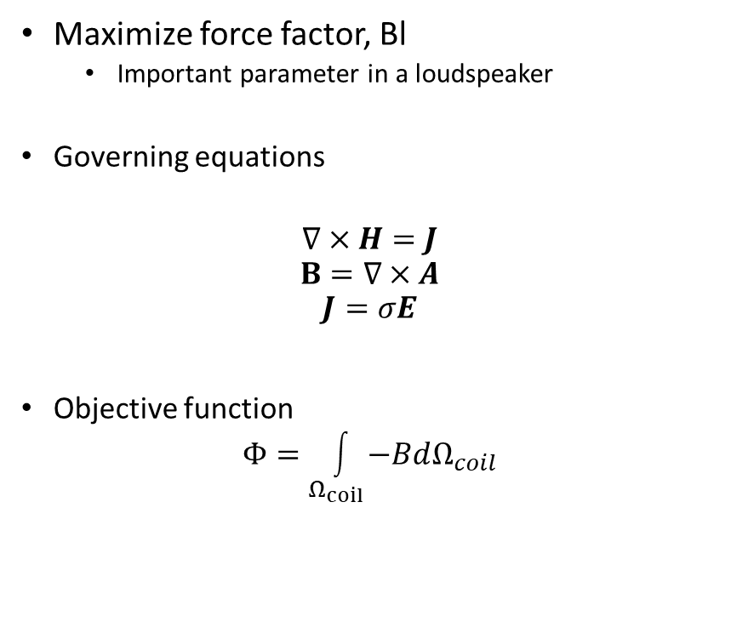
Shape Optimization Magnetostatics Woofer Magnet System
Based on:
“Topology Optimization of a Magnetic Circuit” – Application Library Model
Maximize force factor, Bl
Important parameter in a loudspeaker
Governing equations
$$∇×H=J$$
$$B=∇×A$$
$$J=σE$$
Objective function
$$Φ=\int_{Ω_{coil}}{−BdΩ_{coil}}$$
Optimized
Notes:
The next example is still shape optimization, but for a magnetics problem where the force factor of a loudspeaker magnet system is to be maximized. The starting point is a COMSOL Application Library case where topology optimization was applied with the same objective, but the procedure did not change the topology; only the shape, so it was an obvious case for using shape optimization instead. And the result obtained for the force factor is actually higher when doing shape optimization, which is quite typical, as shape optimization can fine-tune obtained topology optimization results.

Slide 7
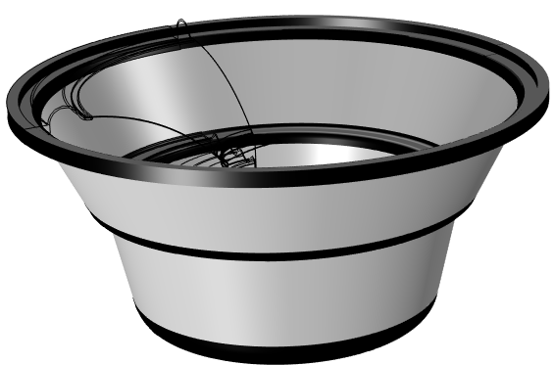
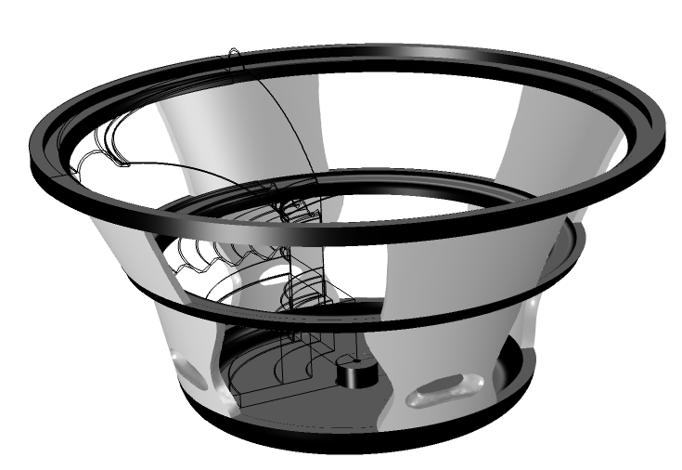
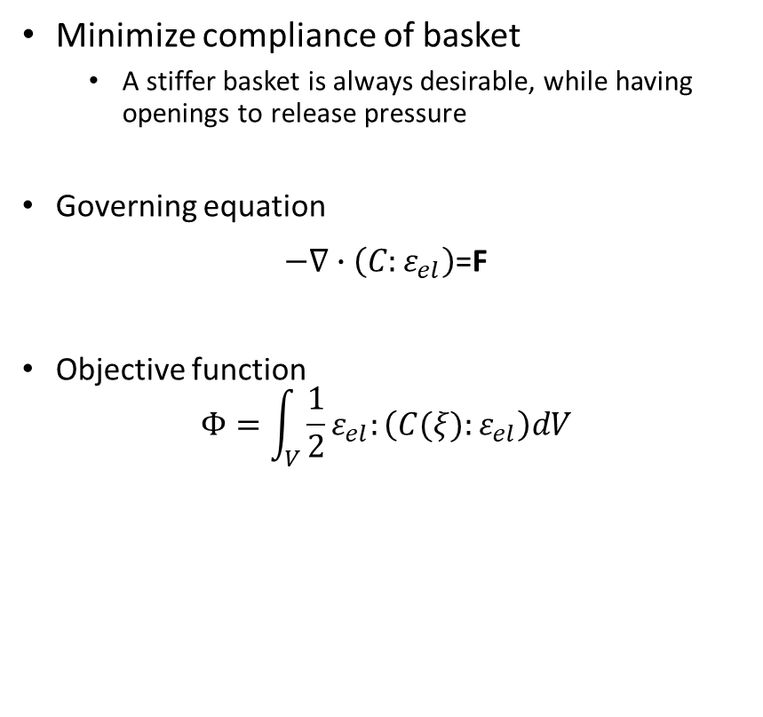
Topology Optimization Solid Mechanics Woofer Basket
Minimize compliance of basket
A stiffer basket is always desirable, while having openings to release pressure
Governing equation
$−∇∙\left(C:ε_{el}\right)$=F
Objective function
$$Φ=\int_{V}{\frac{1}{2}ε_{el}:\left(C(ξ):ε_{el}\right)dV}$$
Optimized
Notes:
Moving onto topology optimization, we look at making a woofer basket as stiff as possible, so the physics is now solid mechanics. We want to use only 50 % of the initially assigned material, and so we will get holes in the structure. We want openings anyway, as to not have large pressure build-ups behind the cone or the spider, and we see that the optimized structure has 12 holes in it. So with topology optimization we get the maximum stiffness for this particular basket and objective, and the objective is typically strain energy that we seek to minimized. For this case I have in fact used a slightly different objective, but that is not of much importance for the current presentation.

Slide 8
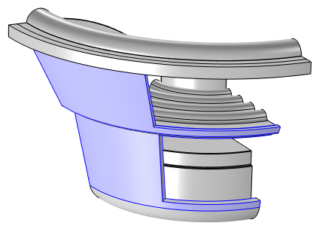
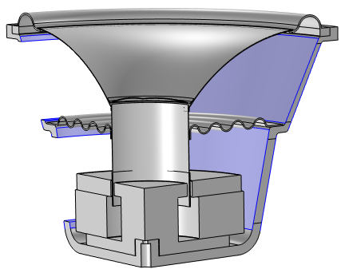
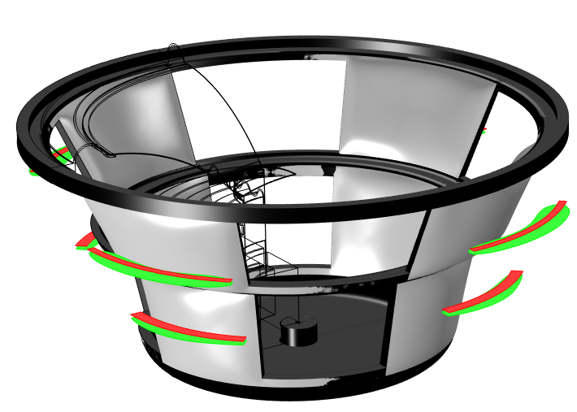
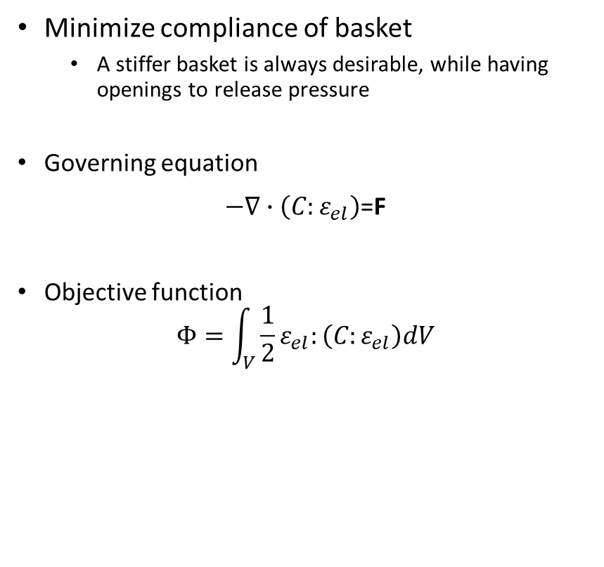
Shape Optimization Solid Mechanics Woofer Basket
Minimize compliance of basket
A stiffer basket is always desirable, while having openings to release pressure
Governing equation
$−∇∙\left(C:ε_{el}\right)$=F
Objective function
$$Φ=\int_{V}{\frac{1}{2}ε_{el}:\left(C:ε_{el}\right)dV}$$
Optimized
Notes:
We now try to maximize the stiffness of the basket using shape optimization instead. The initial geometry is inspired by the topology optimized geometry. The colored sections are offset cross-sections, where red is the initial thickness, and green is the shape optimized cross-section, and so we see that the optimized geometry is simply made thicker to increase the stiffness.

Slide 9
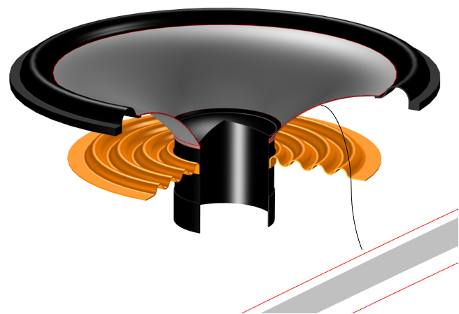
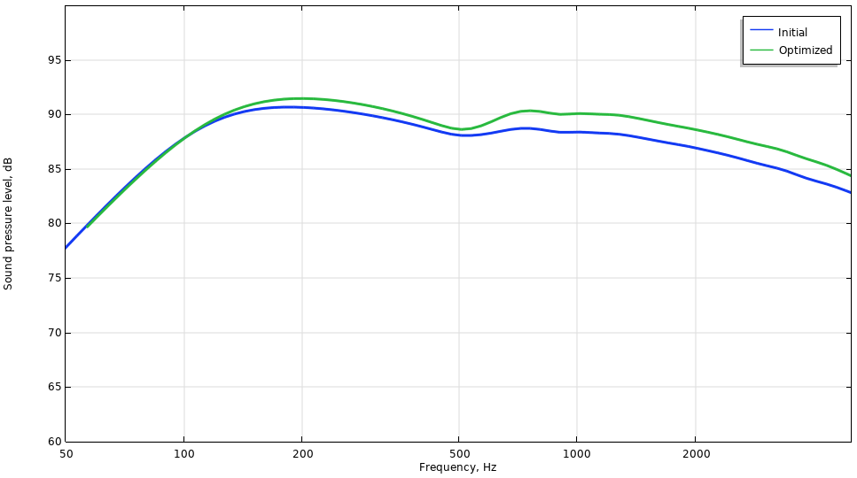
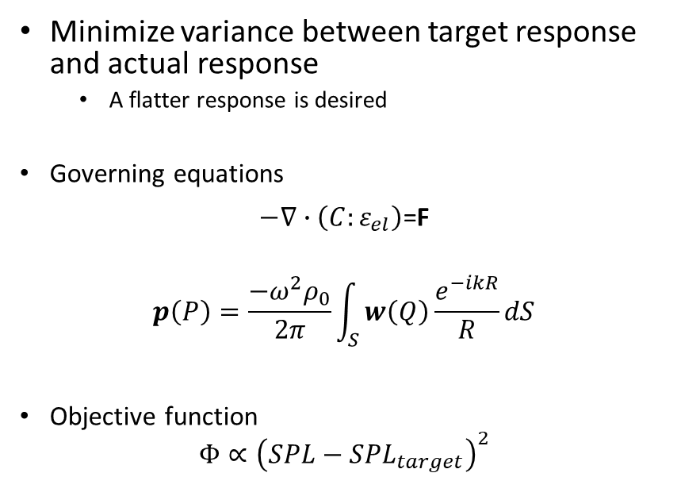
Shape Optimization Vibroacoustics Woofer Cone
Minimize variance between target response and actual response
A flatter response is desired
Governing equations
$−∇∙\left(C:ε_{el}\right)$=F
$$p\left(P\right)=\frac{−ω^{2}ρ_{0}}{2π}\int_{S}{w\left(Q\right)\frac{e^{−ikR}}{R}dS}$$
Objective function
$$Φ∝{\left(SPL−{SPL}_{target}\right)}^{2}$$
Notes:
Staying with shape optimization, we look here at a coupled acoustics/solid mechanics problem for a woofer. While you can in principle do shape optimization at an interface between these two physics, the solver setup has to be modified quite a lot, so we instead opted for including the acoustics implicitly via the so-called Rayleigh integral, so that the solid mechanics does not couple explicitly to any other domain. The loudspeaker dome boundaries in a 2Daxisymmetric model were shape optimized using third-order Bernstein polynomials, and a slight improvement in the sound pressure level is seen for the optimized geometry compared to the initial geometry.

Slide 10
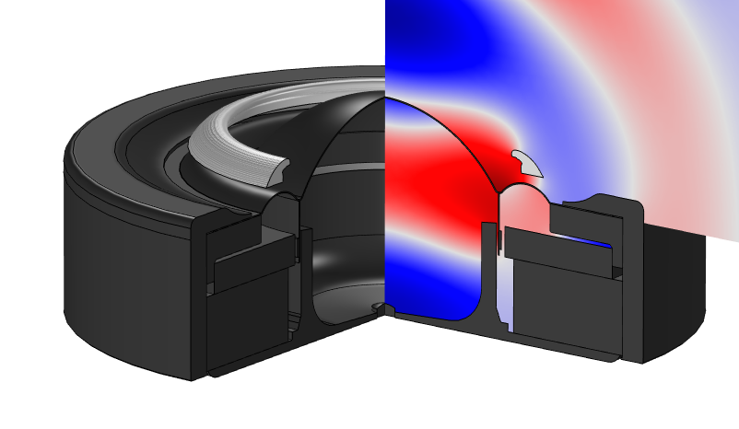
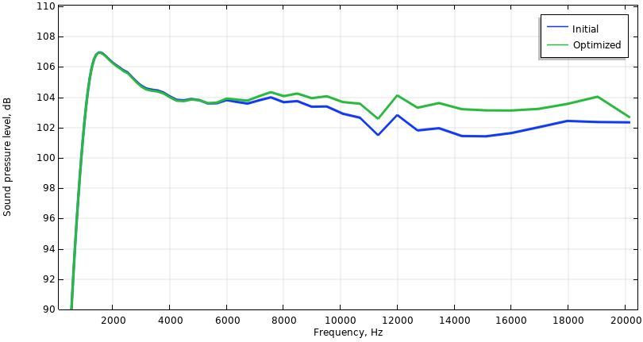
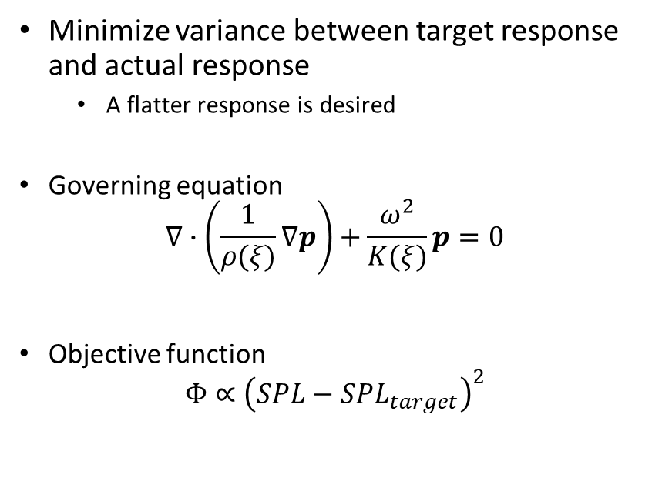
Topology Optimization Acoustics Tweeter Phase Plug
Minimize variance between target response and actual response
A flatter response is desired
Governing equation
$$∇∙\left(\frac{1}{ρ(ξ)}∇p\right)+\frac{ω^{2}}{K(ξ)}p=0$$
Objective function
$$Φ∝{\left(SPL−{SPL}_{target}\right)}^{2}$$
Notes:
Going back to topology optimization, we now look at acoustics again, where we seek to flatten the sound pressure level response from a tweeter by making a phase plug to put in front of it. And we can indeed find a geometry that will do just that, with a design we could not have produced without applying formal optimization.

Slide 11
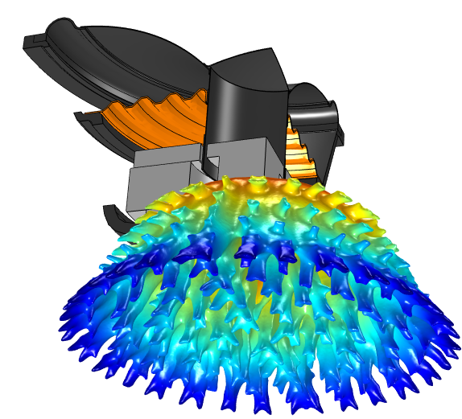
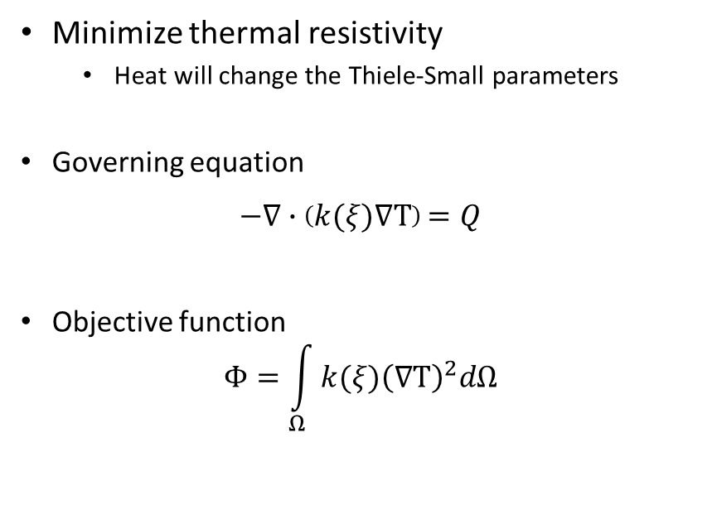
Topology Optimization Heat Transfer (Solids) Heat Sink Woofer Basket
Minimize thermal resistivity
Heat will change the Thiele-Small parameters
Governing equation
$−∇∙\left(k(ξ)∇T\right)=Q$
Objective function
$$Φ=\int_{Ω}{{k(ξ)\left(∇T\right)}^{2}dΩ}$$
Notes:
Finally, we consider a topology optimization case, this time making a heat sink for a woofer, so the physics here is heat transfer in solids. The objective is to minimize the thermal resistivity within a given design domain. With high currents running in the voice coil for a prolonged time, heat is generated, and as the materials making up the loudspeaker all have some temperature dependencies, both small-signal and large-signal behavior are impacted, so it can be a good idea to have a heat sink applied to the basket. A quarter of the complete geometry was used, but the heat sink is shown here in full 3D by mirroring the resulting geometry twice. Again, this optimized geometry is probably not one you would find using traditional engineering methods.

Slide 12
Conclusion
Shape and Topology Optimization have both been demonstrated across multiple physics
The techniques have great potential in aiding engineers in their design decisions
You will need good underlying models before optimization is applied
Optimization is not meant to replace known engineering techniques but should rather be a supplement; a way to produce non-intuitive solutions
Manufacturability should always be considered
Notes:
We have now seen shape and topology optimization being applied across many different physics with the product being a loudspeaker. The techniques can of course be applied to many different products, and you can create truly innovative solutions. However, you need to be careful, and not forego time-tested engineering methods, and you should also consider if the resulting optimized can be manufactured without too many production problems. So use it carefully, and as a great addition to your engineering toolbox.

Slide 13
Questions?
rechristensen@gnresound.com
www.acculution.com
Notes:
Thank you very much and let me know if you have any questions.

