Slide 1
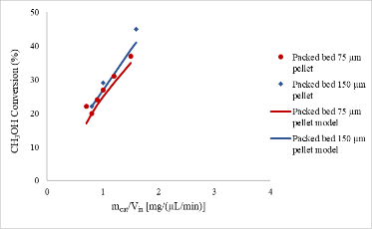
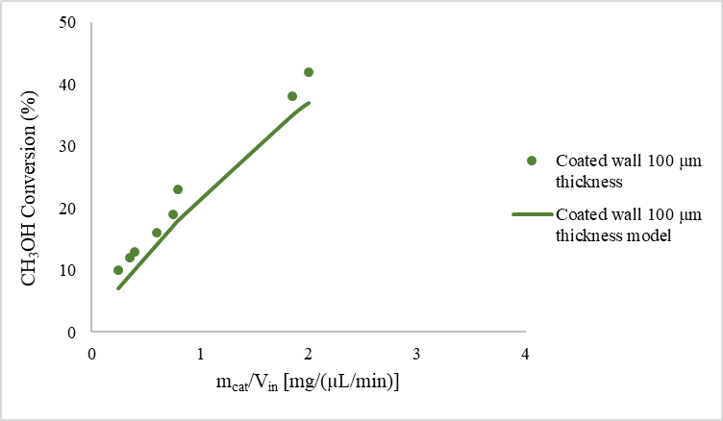
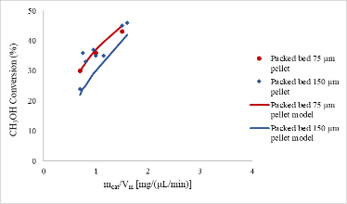
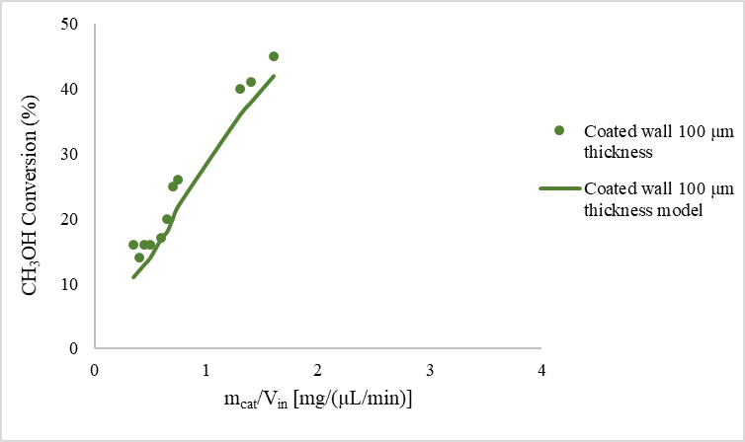
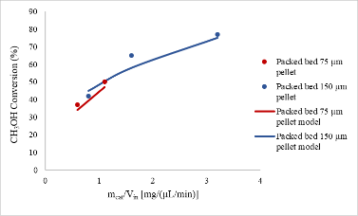
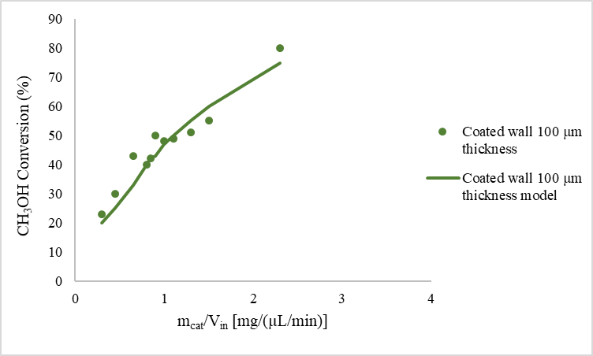
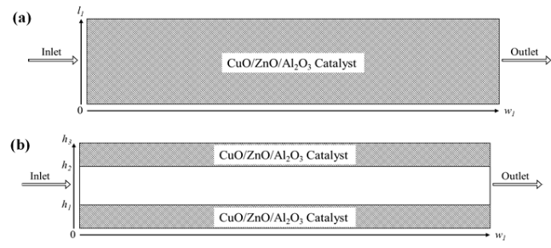
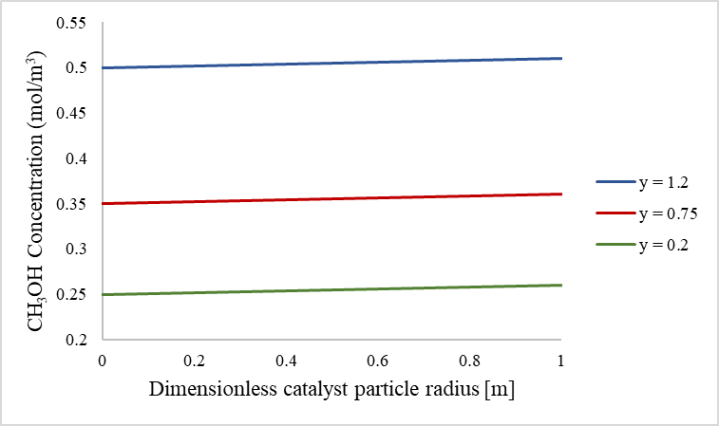
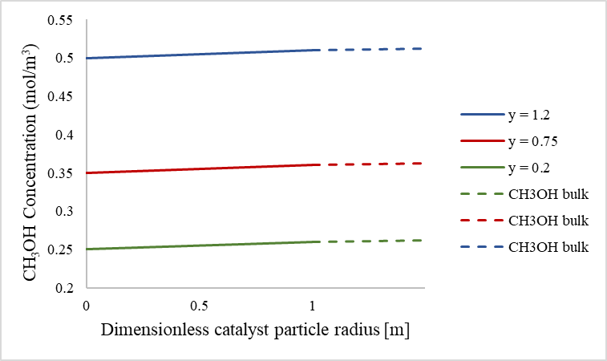
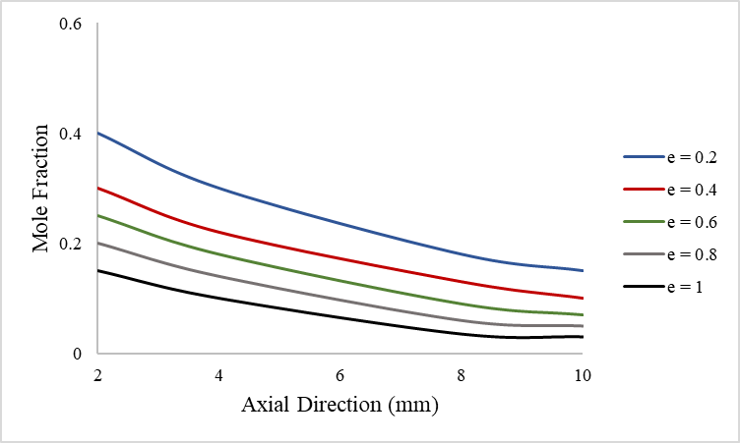
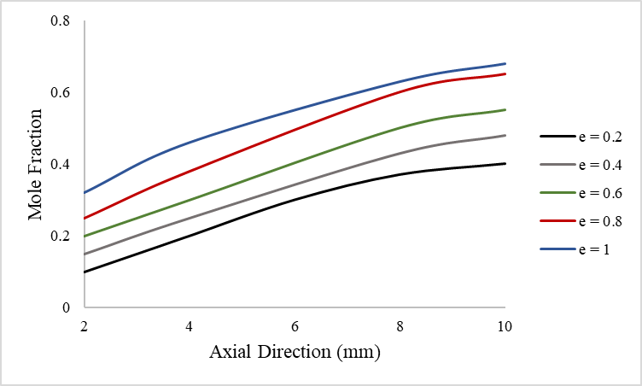


Packed Bed and Coated Wall Microreactors for Methanol Steam Reforming for Hydrogen Production
Sanaa Hafeez¹, Elsa Aristodemou¹, S.M. Al Salem², George Manos³ and Achilleas Constantinou^{1,3}
1. London South Bank University, London, UK 2. Kuwait Institute for Scientific Research, Kuwait 3. University College London, London, UK
INTRODUCTION
RESULTS
Methanol (CH₃OH) is an attractive choice of fuel due to its large availability because it can be produced from renewable resources.
Microreactors have been employed for renewable fuel production because of enhanced mass transfer, better temperature control leading to improved heat transfer and larger surface-area-to-volume ratios ¹.
Recently microreactors for hydrogen production have been employed to provide the on-line hydrogen source for polymer electrolyte membrane fuel cells (PEMFCs).
The catalytic steam reforming of methanol occurs with the CuO/ZnO/Al₂O₃ catalyst ²:
210 ºC
210 ºC
220 ºC
220 ºC
$CH_{3}OH+H_{2}O⇌CO_{2}+3H_{2}$
$$CH_{3}OH →CO+2H_{2}$$
$CO+H_{2}O⇌CO_{2}+H_{2}$
COMPUTATIONAL METHODS
230 ºC
230 ºC
Figure 2. Comparison of coated wall and packed bed microreactors at different catalyst sizes and wall temperatures with experimental ³ results: (a) T_{w}=210 ºC, S/M=1.1; (b) T_{w}=220 ºC, S/M=1.1; (c) T_{w}=230 ºC, S/M=1.1.
Figure 1. Packed bed and coated wall microreactors used for the modelling.
The mass balance equation for the species in the catalyst bed is given by:
$u_{x}\frac{δc_{i}}{δx}{=D}_{i,A}\frac{δ^{2}c_{i}}{δx^{2}}+D_{i,T}\frac{δ^{2}c_{i}}{δy^{2}}−J_{i}S_{b}$ (1)
The specific surface area of the pellets exposed to the fluids in the packed bed and can be expressed as:
$S=S_{a}\left(1−ε\right)$ (2) $S_{a}=\frac{3}{r_{pe}}$ (3)
The mass transfer can be demonstrated as:
$J_{i}=h_{i}(c_{i}−c_{i,ps})$ (4) $h_{i}=\frac{Sh∙D_{i}}{2r_{pe}}$ (5)
$Sc=\frac{μ}{ρ_{M}∙D_{i}}$ (6) $Re=\frac{2r_{pe}∙ρ∙u_{x}}{μ}$ (7)
$Sh=2+0.552{Re}^{1/2}{Sc}^{1/3}$ (8)
The mass balance inside the catalyst pellet is acquired by conducting a shell balance across a spherical shell:
$\frac{δ}{δr}\left(r^{2}D_{i,e}\frac{δc_{i,p}}{δr}\right)=r^{2}r_{p}R_{i,p}$ (9)
Figure 3. (a) Concentration profiles of CH₃OH within the catalyst particle at varying axial height of the packed bed microreactor. (b) Concentration profiles of CH₃OH at the catalyst particle surface and the bulk fluid at varying axial height of the packed bed microreactor.
Figure 4. Molar variations of (a) CH₃OH; and (b) H₂; for varying catalyst thickness along the axial direction of the coated wall microreactor.
CONCLUSIONS
CONCLUSIONS
The modelling results have shown a good validation with experimental results.
The performance of the packed bed and coated wall reformer at a constant wall temperature was analogous, indicating that the average temperature of the catalyst bed in the packed bed microreactor and the average temperature of the catalyst layer in the coated wall microreactor are similar.
It was concluded that there were negligible internal and external mass transfer resistances, which agreed with the experimental results.
S. Hafeez, G. Manos, S. Al-Salem, E. Aristodemou and A. Constantinou, React. Chem. Eng., 2018, 3, 414-432.
J. Amphlett, K. Creber, J. Davis, R. Mann, B. Peppley and D. Stokes, Int. J. Hydrog. Energy, 1994, 19, 131-137.
M.-t. Lee, R. Greif, C. P. Grigoropoulos, H. G. Park and F. K. Hsu, J. Power Sources, 2007, 166, 194-201.
Excerpt from the Proceedings of the 2020 COMSOL Conference

