Slide 1
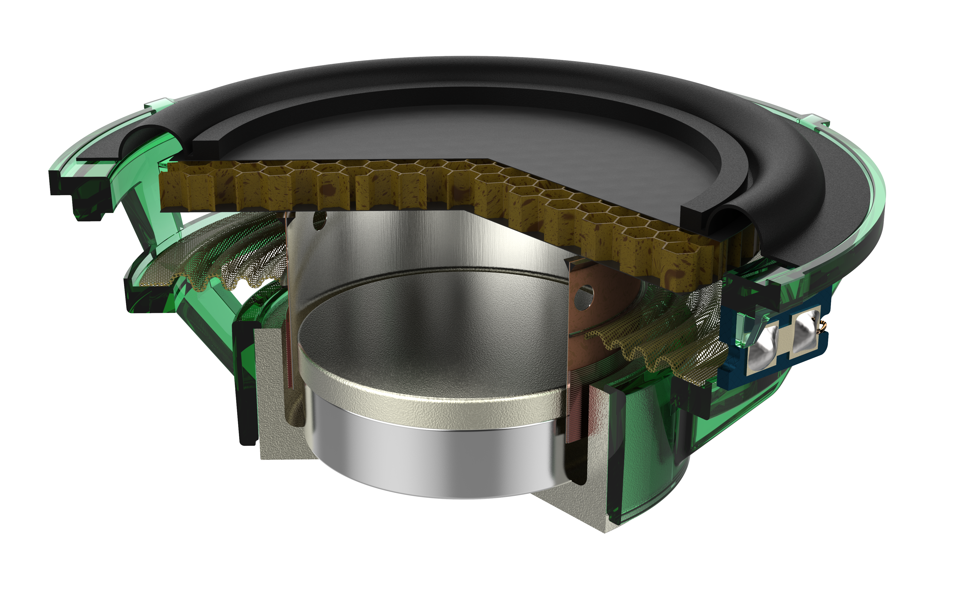
TECTONIC AUDIO LABS AND VALVE CORPORATION Optimizing Virtual Reality Headsets Designs
Tectonic Audio Labs and Valve Corporation teamed up to design a virtual reality (VR) headset for use in the gaming industry
The headset features a balanced mode radiator (BMR) speaker, which was designed using electromagnetics, mechanical, and acoustics simulation
The final design, the Valve Index® Headset, is regarded as the gold standard for VR audio
“Designing the Gold Standard of Immersive Audio for Virtual Reality” COMSOL News 2020: Tim Whitwell, Tectonic Audio Labs, Washington, USA
A cutaway view of the BMR speaker

