Slide 1
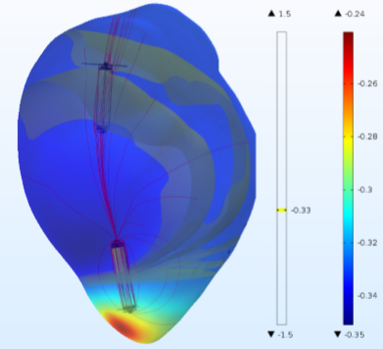
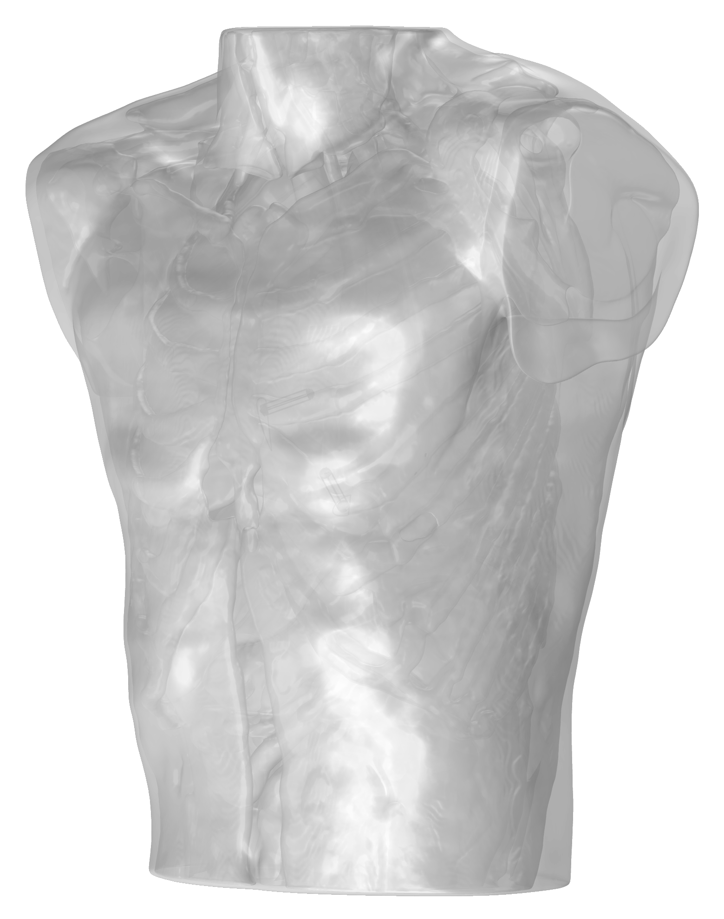
MICROPORT CRM
Optimizing Intrabody Communication for Pacemaker Systems
Leadless cardiac pacemakers (LCPs)
  Self-contained generator and electrode system
  Eliminates the need for pocket or transvenous leads
Multinode LCP systems require synchronization between implanted devices to function properly
Developed a human torso model in the Synopsys Simpleware™ software to import into the COMSOL Multiphysics® software
Electromagnetics simulation used to:
  Calculate the channel attenuation for LCP devices
  Optimize transceivers for LCP systems
Channel attenuation for an LCP capsule in the right atrium (top) and CAD model geometry of a human torso (right)
”Investigating Intrabody Communication for Leadless Cardiac Pacemakers”, Mirko Maldari, MicroPort CRM, France
Synopsys and Simpleware are trademarks and/or registered trademarks of Synopsys, Inc. in the U.S. and/or other countries.

