Slide 1
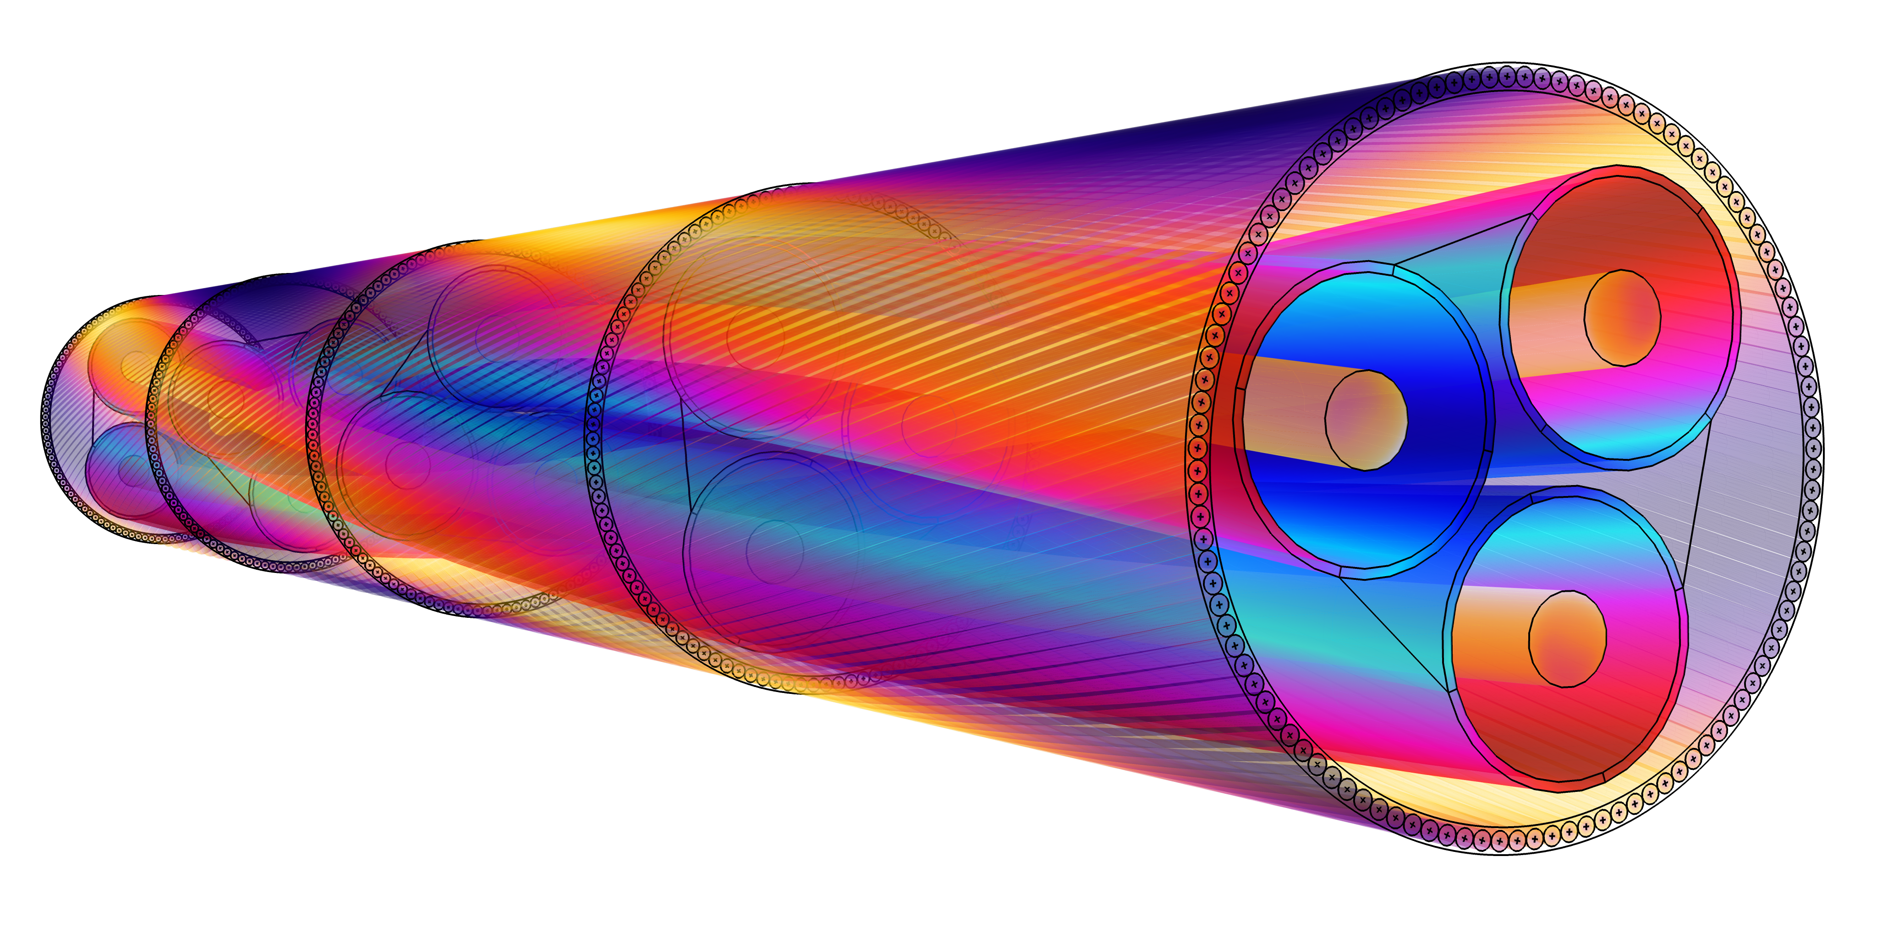
NKT
Modeling Armor Losses in High-Voltage Cables
Cables are expensive to install and maintain, as well as difficult to analyze experimentally
NKT uses electromagnetics modeling to:
  Test cable designs virtually
  Visualize how different cable parameters affect armor losses
  Predict cable performance in different installation conditions
Simulated losses are within 3% of measured experimental results
  More accurate than current IEC standard for this type of cable
“3D Modeling of Armor Losses in High-Voltage Cables”
Ola Thyrvin, NKT, Sweden
A 3D cable modeled in COMSOL Multiphysics®

