Slide 1
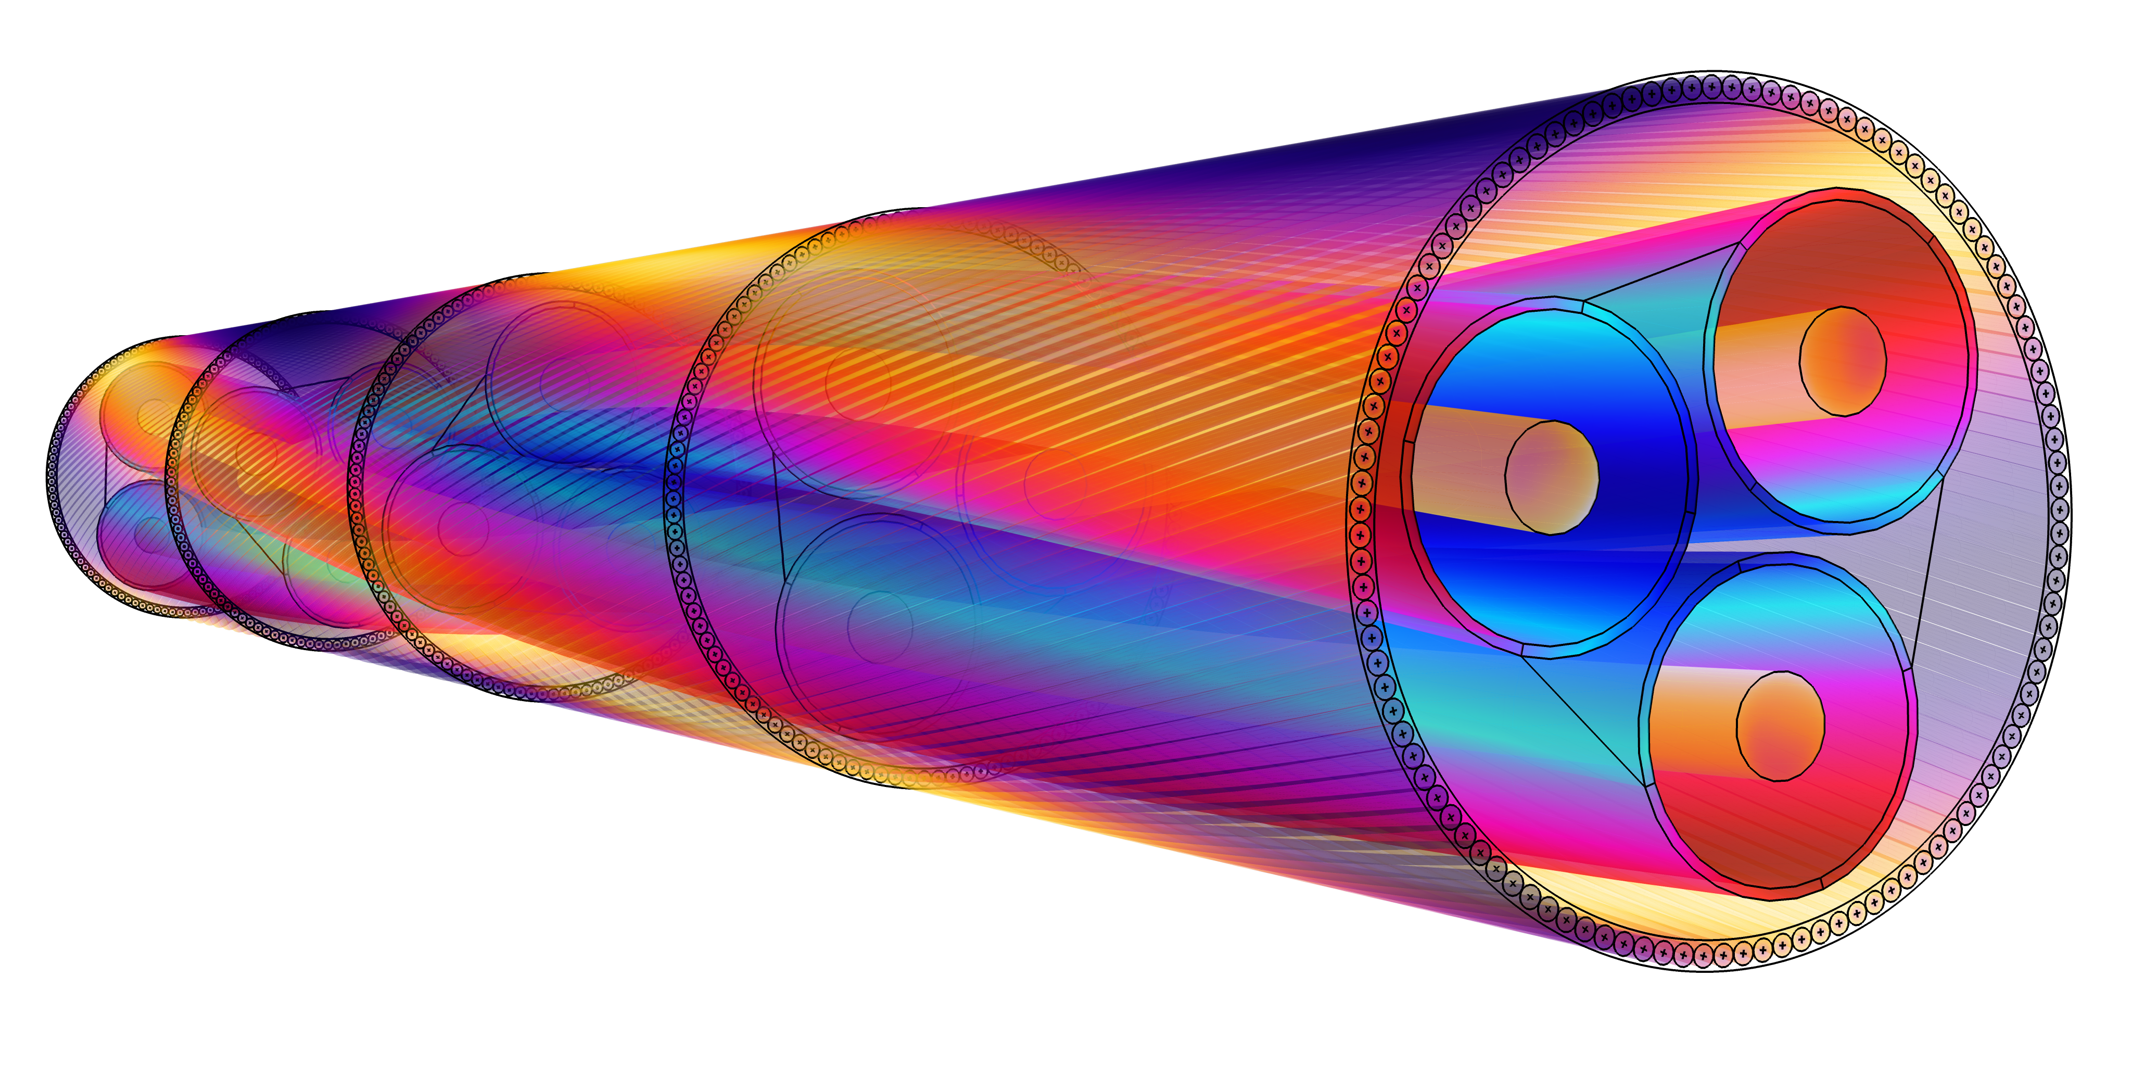
NKT Modeling Armor Losses in High-Voltage Cables
Cables are expensive to maintain and demanding to test experimentally
Repairs can cost $12,000 per day and $1 million per project (estimated)
Some cable standards (i.e., IEEE, IEC) overestimate armor losses
For some cases, the losses are around 50% of what the standards give
NKT, a global cable supplier, turned to electromagnetics simulation to analyze cable designs
“3D Modeling of Armor Losses in High-Voltage Cables” Ola Thyrvin, NKT, Sweden
A 3D cable modeled in COMSOL Multiphysics®

Slide 2
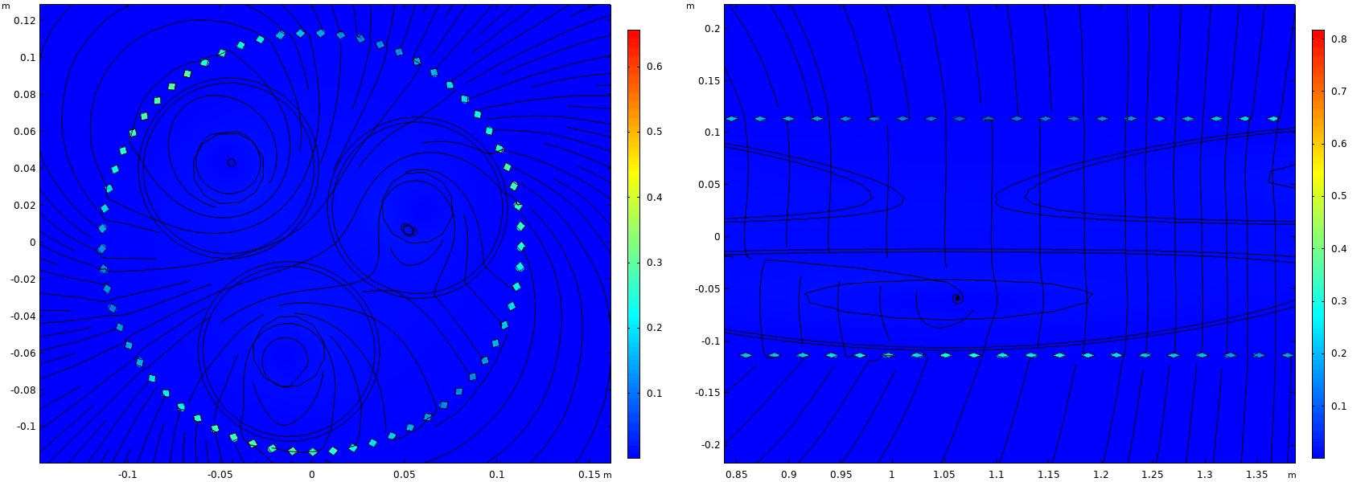
NKT Modeling Armor Losses in High-Voltage Cables
NKT uses electromagnetics modeling to:
Test cable designs virtually
Visualize how different cable parameters affect armor losses
Predict cable performance in different installation conditions
Results validated with existing cable data
Losses within 3% of measured experimental results
More accurate than the current standards for this type of cable
“3D Modeling of Armor Losses in High-Voltage Cables” Ola Thyrvin, NKT, Sweden
Magnetic flux in the air gap between conductors in an armored cable model

